Slide 1
The Association of the People CARing for the FUture
www.carfu.org
www.gonder.org.tr

Slide 2
About CARFU- CARing for the FUture
Established by the people who want to be useful to the world, aim to use their experience and knowledge to permanent profits for their environment.
Member profile from social sciences to technical sciences such as bureaucrats, businessmen and academicians.
CARFU asks for: “what can we do for the future?” with a scientific approach.
CARFU at its core has been formed to support everyone who says “I have a good idea for the world!” .

Slide 3
Institutional
Started to work on 13 February 2013,
It got “the legal entity” on 29 May 2013, according to the Turkish Law No 5253 on Associations.
It places in Ankara, Turkey.
It operates internationally and open for cooperation.
It is open for individual and organization to be a member with approx. 100 USD.
The First General Assembly held on 11th of October, 2013.

Slide 4
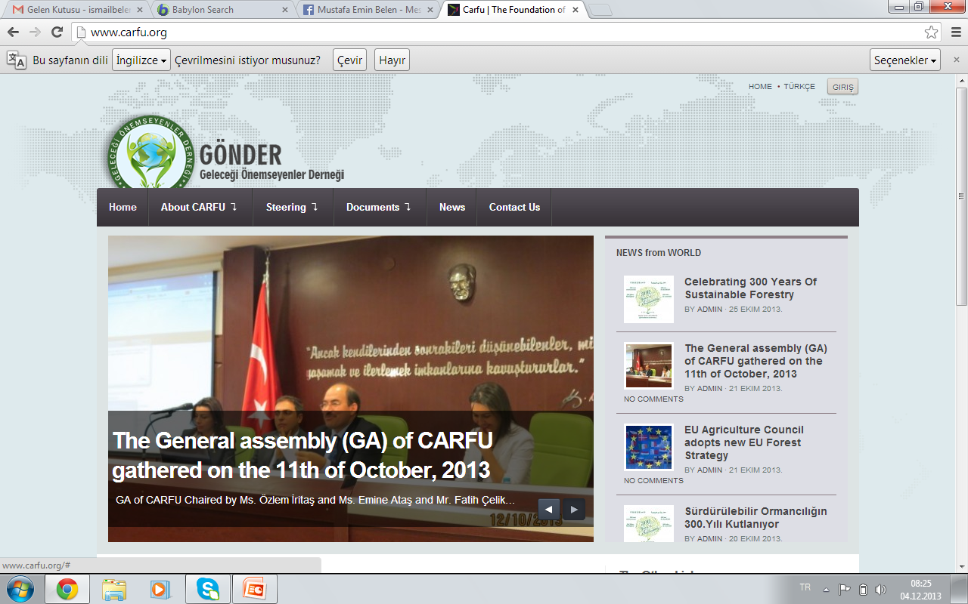

Slide 5
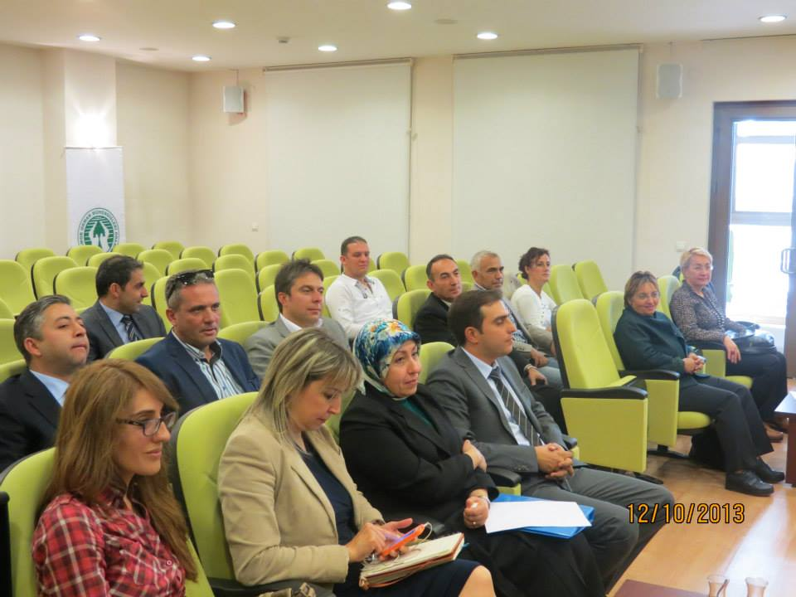

Slide 7
Steering Committee
İsmail Belen- Forest Engineer
Bedia Dinç- Medical Doctor (Ass. Profesor)
Özlem İritaş- Environment Engineer
Servet İritaş- Medical Doctor
Şule Özevren- Agricultural Engineer
Kutluay Ataş- Mechanical Engineer
Ali Temerit- Forest Engineer

Slide 8
Method of study
CARFU uses these methods for achieving its aims:
To prepare, implement and control of plans and projects,
Cooperate with related national/international individual, institutions and organizations,
To prepare, publish and disseminate reports,
Arrange activities for raising the public awareness and education.
To take/give support from/to related persons, institutions and organizations.

Slide 9
Topics
Science, industry, technology
Health, sports, education, tourism
Employment, commerce, economy,
Information systems, energy, security, communication
Science politics, international affairs, public administration
Agriculture, livestock, forestry, rural development, natural resources management, environment, climate change

Slide 10
Project Preparations
Regional Cooperation on the Natural Resources Management in Near East-
Ministry of Foreign Affairs-TİKA and probably FAO??
Combating Malaria in Angola and Surrounding
TİKA and World Health Organization and probaly UNDP
Heating and cooling the Erzurum Airport with ground heat-
Ministry of Development-East Anatolia Development Agency
Supporting Forest Based Technology as Small and Medium-Sized Enterprises (SMEs) and Entrepreneurs in Turkey, Near East and Balkan Countries-
Ministry of Economy (Together with EU and Islamic Development Bank)

Slide 11
International Colloboration
We would like to be partner of “Collaborative Partnership on Mediterranean Forestry”
Thank you.

