Slide 1
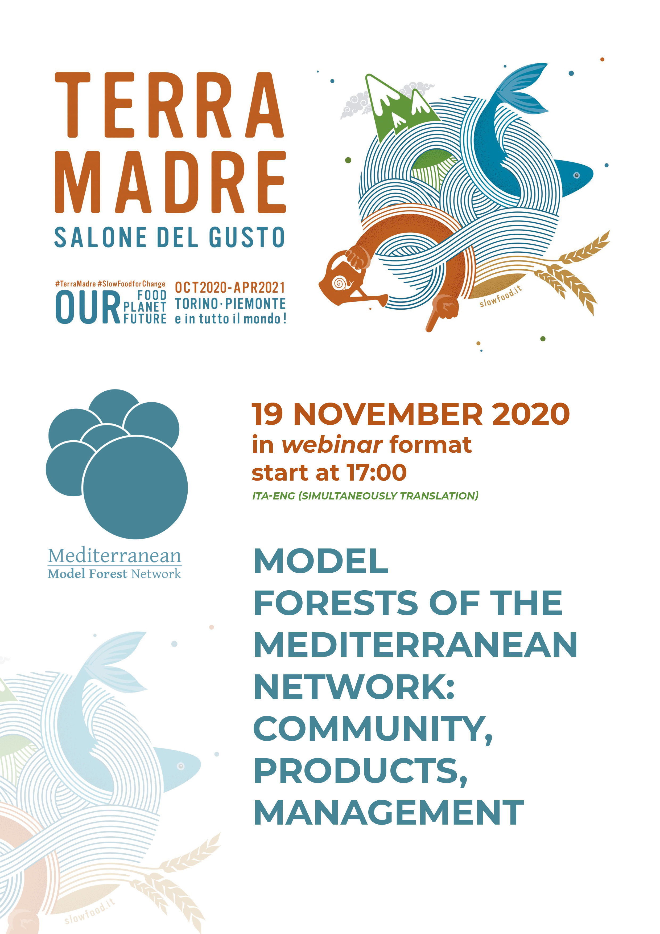
19 November 2020
17.55-18:10 (Roma Time)
The valorization of no wood forest products in Turkey through the Model Forest concept
Ismail BELEN
Senior Expert of Agriculture and Forests, Ministry of Agriculture and Forests of Turkey
ismailbelen52@gmail.com

Slide 2
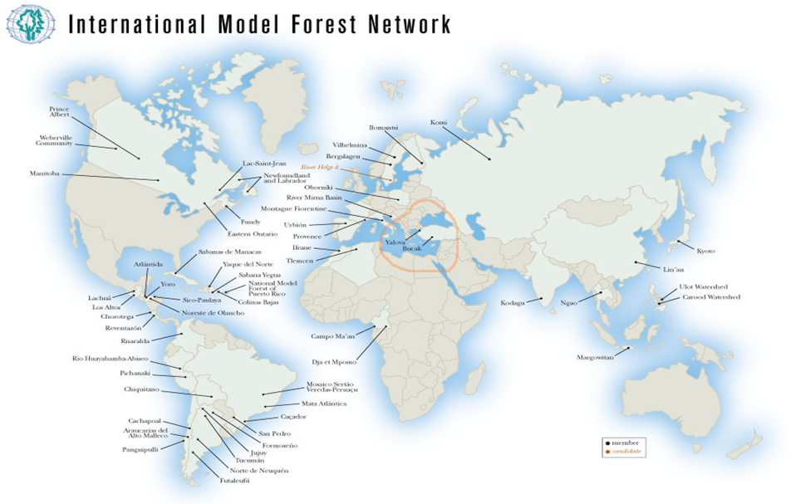
MODEL FORESTS IN TURKEY

Slide 3
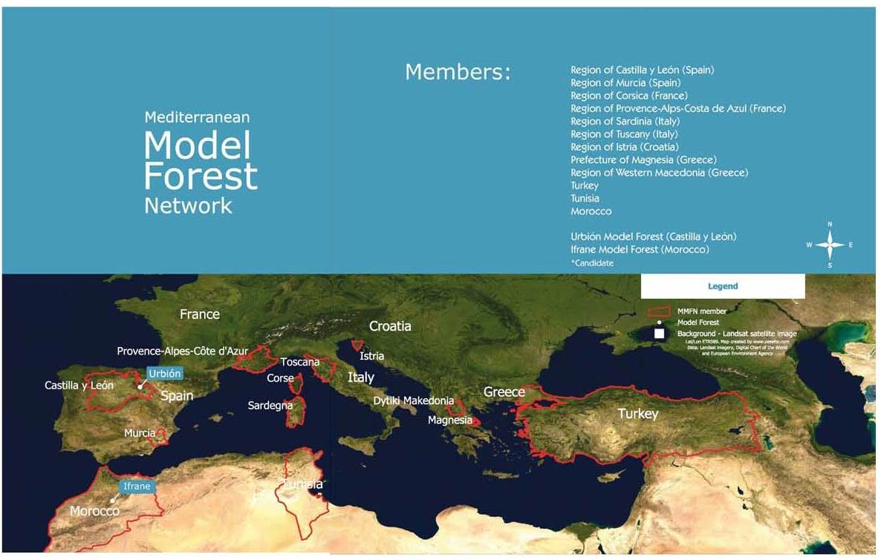
MEMBERSHIP TO MMFN/IMFN

Slide 4
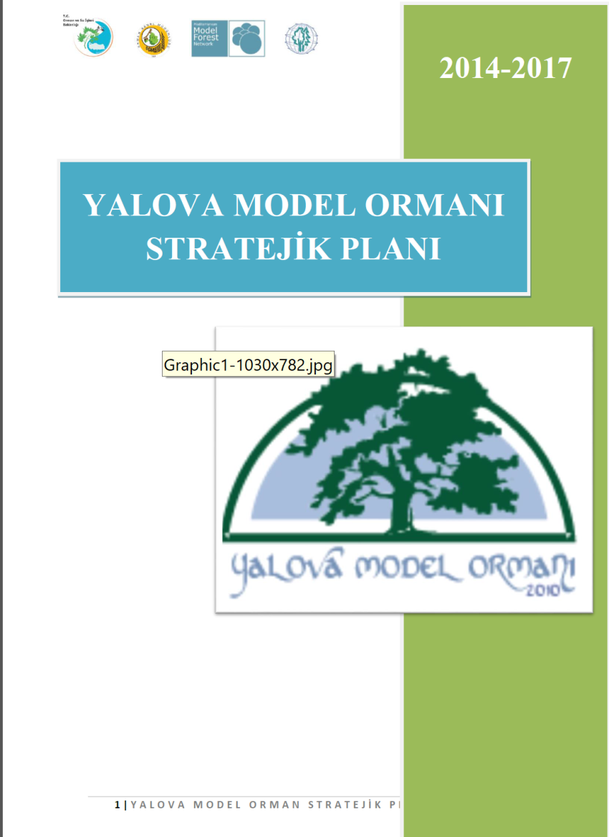

Slide 5
Brief History
Turkey participation process in Model Forest started in 2007. While we were discussing the issue to be a member or not, we made some changes at the "Forest Management Regulation-FMR", which is one of the basic documents in the management of forests. The FMR was published in the Official Gazette dated February 5, 2008.. https://www.mevzuat.gov.tr/mevzuat?MevzuatNo=11952&MevzuatTur=7&MevzuatTertip=5
Item 5/c of FMR as follows: "Forest management plans can be made with different contents and bases in order to implement changes in forestry practices, to develop a new model, and to determine whether this model can be applied or not". Based on the FMR, we obtained official and written permission from the Minister of the time to participate in the MMF. http://www.gonder.org.tr/?p=1280
The model forest issue was added to the founding law of the General Directorate of Forestry(GDF) in 2011. The related item as follows: To determine, protect and operate recreation areas, urban forests, research forests, arboretum areas, forest biodiversity conservation areas, model forest and conservation forest areas. https://www.mevzuat.gov.tr/MevzuatMetin/19.5.4.pdf
As a result, we declared two model forests namely Yalova and Bucak.

Slide 6
Non-Wood Forest Products in Turkey “Light in Weight Heavy in Value”
In 2011, the Department of Non-Wood Products and Services (DNWFPS) was established as the central unit of the GDF.
The total amount of marketed NWFPs in Turkey for 2019 was calculated about 880 million USD.
NWFPs are mainly found in state-owned forests. The main collectors of NWFPs are "forest villagers" who live in forests and on the edge of villages. As of 2019, the income generated by forest villagers from the sale of NWFPs was 123 million USD.
The number of forest villagers working in wood production is around 150 000 people. The number of forest villagers working in the collection of NWFPs is around 25 000 people.
However, the NWFPs sector makes an economic contribution directly or indirectly to approximately 500 000 people in Turkey. This number includes the people working in the field for collection, working in drying processes, working in the process of making the product or semi-finished products, packer, end seller-retailer, exporter etc.

Slide 7
Indicator | Unit of measure | Amount
Country area (FAO,2016) | ha | 78 535 000
Forest area by FAO (FAO,2016) | ha | 11 715 000
Forest area by national definitions (GDF,2020) | ha | 22 740 297
Private forest area | ha | 18 000 (0.080% of total forest)
Growing stock (2019) | m3 | 1 679 356 210
Annual increment (2019) | m3 | 47 200 000
Industrial wood in the rough production-2019 | m3 | 22 113 248
Annual fFuel wood production-2019 | Stere/m3 | 5 589 798 stere/3 912 858 m3
Country population (TURKSTAT, 2020) | Person | 83 154 997
Forest villages subject to Forest Act (GDF, 2018b) | Number | 22 712
Forest villagers subject to Forest Act | Person | 7 013 712

Slide 8
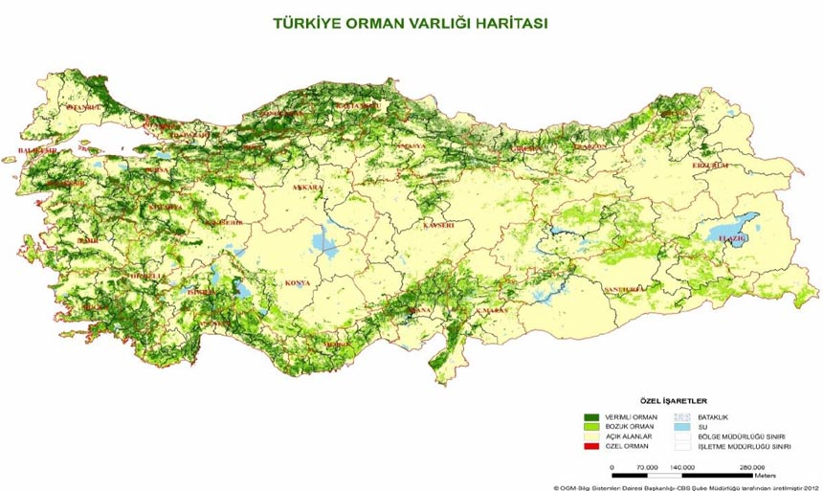

Slide 9
Definition Used by Turkey for NWFPs
For Turkey, “Communiqué No. 302 on Inventory and Planning of NWFPs and Production and Sales Principles (Communiqué of NWFPs)”, which was put into practice in 2016, is the most comprehensive and directing legislation on NWFPs. (GDF, 2016)
Non-Wood Forest Product (NWFP): It refers to biological and mineral origin products other than wood obtained from forests and trees, and other products exposed during the production of wood such as bark, chip, shrub, root, stump, and cone.

Slide 10
Revenues from Non-Wood Forests Products in Turkey in 2019 million TL/USD

Slide 11
Changes in the Price of the Bay (1 Kg.)-2019-Turkey- USD

Slide 12
Top 10 NWFPs with their total values in 2019
No | English Name | Latin Name | Contribution to national economy-USD | Area
1 | Bay tree | Laurus nobilis | 264 084 507 | 180 400
2 | Chestnut | Castanea sativa | 176 056 338 | 74 897
3 | Thyme | Origanum onites | 140 845 070 | 86 358
4 | Pine nut | Pinus pinea | 88 028 169 | 61 310
5 | Mushrooms | + | 35 211 268 | +
6 | Salvia | Salvia fruticosa Mill. | 21 126 761 | 11 874
7 | Carob bean | Ceratonia siliqua | 5 281 690 | 13 203
8 | Rosemary leaf (shoot) | Salvia rosmarinus / Rosmarinus officinalis | 4 401 408 | 6 107
9 | Tilia | Tilia platyphyllos/ tomentosa | 4 401 408 | 19 231
10 | Mulberry-Blackberry |  | 1 760 563 | +

Slide 13
Top 10 most exported NWFPs
No | Latin Name of the NWFP | Export Quantity (Ton) | Export Value-USD
1 | Laurus nobilis | 13 600 | 38 234 826
2 | Castanea sativa | 14 225 | 35 837 736
3 | Origanum onites | 16 830 | 57 247 281
4 | Pinus pinea | 516 | 26 946 250
5 | Mushrooms | 1 716 | 12 843 337
6 | Salvia fruticosa | 2 317 | 8 680 563
7 | Ceratonia siliqua | 953 | 1 131 485
8 | Salvia rosmarinus/ Rosmarinus officinalis | 592 | 1 716 307
9 | Tilia platyphyllos subsp. platyphyllos and Tilia tomentosa Moench | 107 | 1 100 870
10 | Mulberry-Blackberry- | 1415 | 5 190 832
 | Total | 52 271 | 188 929 487

Slide 14
Contribution of NWFPs to rural employment

Slide 15
Some Policy Documents
Related Articles of the Constitution
Forest Law
Organic Agriculture Law
Presidential Decisions and Decrees
Development Plans
National Basin Management Strategy (2014-2023)
Strategic Plan of General Directorate of Forestry (2017-2021)
Afforestation Regulation
Forest Management Regulation
Communiqué on Inventory, Planning, Production and Sales Principles of NWFPs
Administrative Structure
NWFPs and Forest Management Plans
NWFPs Utilization Plans

Slide 16
OFFICIAL STRATEGY ON NWFP STRATEGIES IN TURKEY
Production and Marketing of Non-Wood Forest Products (EXAMPLES)
Truffle Forest Action Plan (2014-2019),
Orchid Action Plan (2014-2018),
Gum Action Plan (2014-2019),
Honey Forest Action Plan (2013-2019),
Wild Fruit Species Action Plan (2014-2018),
Bluebery Action Plan (2015-2019),
Daphne Action Plan (2016-2020)
Resin Action Plan (2017-2021)

Slide 17
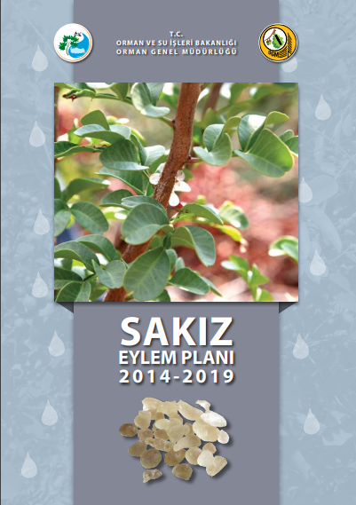
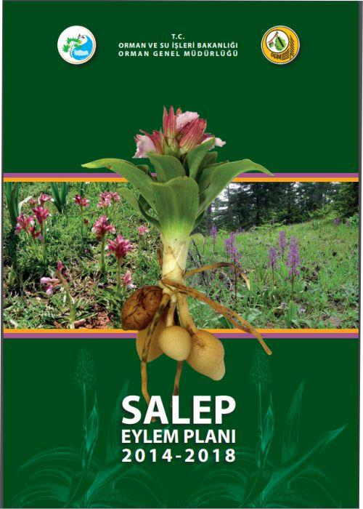
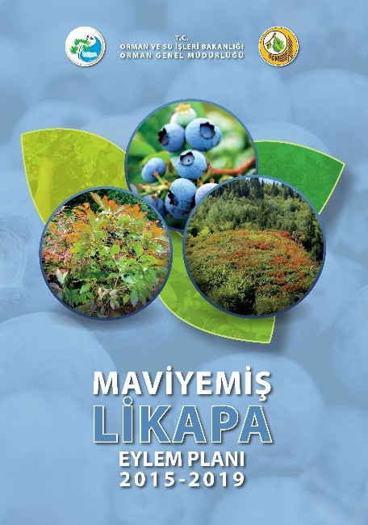
OFFICIAL STRATEGY ON NWFP STRATEGIES IN TURKEY
ACTION PLANS (EXAMPLES)

Slide 18
GENERAL DIRECTORATE OF ORESTRY
HIGH POTENTIAL AND ECONOMIC PROFIT
SOME OF OUR SPECIES

Slide 19
Pine Honey
The average honey production in Turkey from the past five years is 109 115 tons annually. According to FAO statistics, Turkey is the second country in the world produces the most honey in general.
There are approximately 80 000 agriculture holdings in apiculture/beekeeping. It can be said that the overall contribution of the sector could be calculated 1.173 billion USD. However, this is not a scientific or official calculation and can be used for a general idea. it can be said that 207 000 people are dealing with beekeeping in Turkey in total.
Pine honey is a unique honey produced by bees, not from flower pollen, but producing by an insect (Marchalina hellenica ) lived in the body of some pine tree species to the Mediterranean climate. Most of the world's pine honey (about 90%) is produced in Turkey (FAO, 2020)

Slide 20
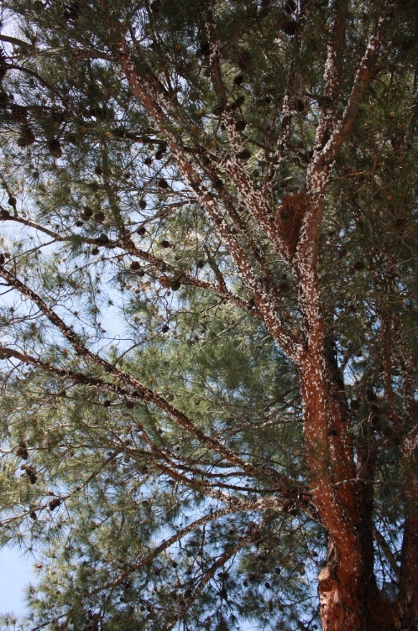
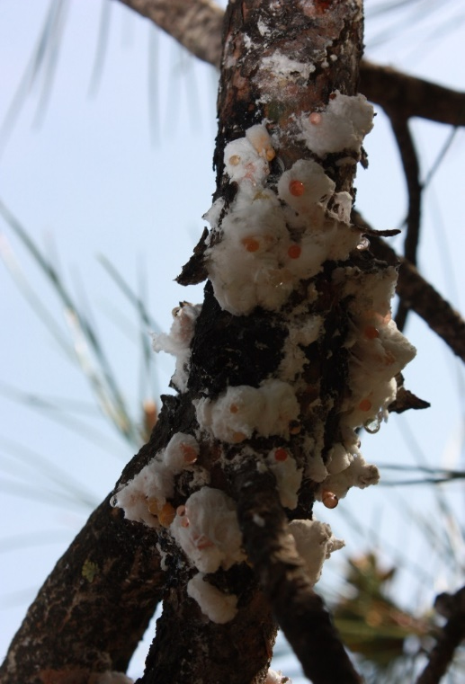

Slide 21
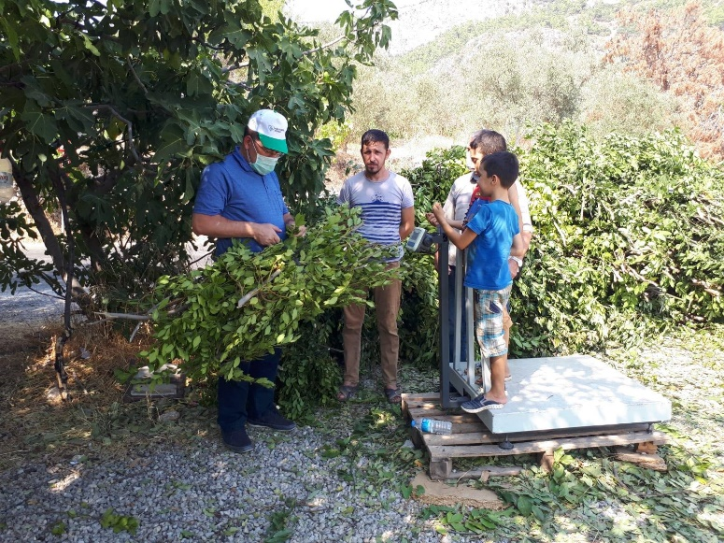
Bay Leaf
According to GDF, Turkey had a total area of 180 400 hectares of bay trees in the whole country in 2019. The total amount of bay leaf production was 32 600 tones in 2019.
The contribution of bay leaf to Turkey’s national economy was calculated as 264 084 507 USD in 2019. Turkey has exported approximately 13 600 tones and has the export value at around 38 million USD

Slide 22
Resin
Resin production showed an uneven process. The annual production, which approached 7 000 tons in the 1970s, has decreased since 1983, and almost no production was made in the 2000s.
In 2017, the "Resin Action Plan" was prepared and it was aimed to increase the production. It is aimed to increase the annual resin production, which was around 420 tons by 2020, to 5 000 tons by 2023.
Resin is produced mainly from Turkish pine/red pine- Pinus brutia and the maritime pine - Pinus pinaster. In addition to these two trees, a little amount of resin production is made from black pine- Pinus nigra roots. However, the area suitable for natural resin production has been calculated around 100 000 hectares.
Due to the limited production in Turkey, natural resin demand is met through imports. As of 2020, Turkey has been importing natural resin around 11 thousand tons annually. The commercial value of this is around 20 million USD.
In current practice in Turkey can be an average of 2 kg product per tree.

Slide 23
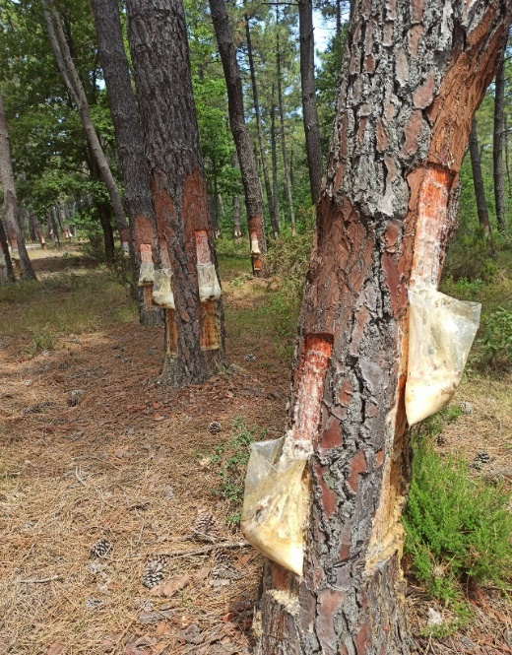
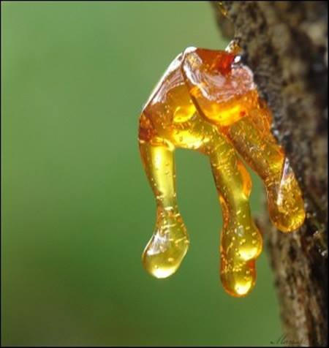

Slide 24
Truffle
Truffles have a world trading volume of USD3.5 billion, expected to increase USD 6 billion during next decade. Turkey has a target to reach USD350 million, grabbing a 10% share in the short term, and an action plan made operational since 2014.
Truffle, which was not even on the agenda of Turkey before 5-6 years ago, has drawn the attention of every society, from hunters to investors, from consumers to tourism today. According to data provided by GDF total volume of truffle production is around 40 tons. Increased momentum in truffle production continues.
Truffles were a source of livelihood so far for nearly 200 families in Turkey, the price of truffles varied between 100 Euros (USD112) and 500 Euros depending on the type and quality,
It is very difficult to give an exact figure about the annual truffle production amount worldwide. The producers are generally small-scale producers, sell their products to local markets and not keep the reports of the products they produce. For these reasons, governments have very little data on truffle production.
GDF along with its respective departments give priorities to the formulation of action and utilization plan and truffle species in the forest area selected based on inventory activities. As at the end of 2019, a total of 384 ha potential area determined for truffe production.

Slide 25
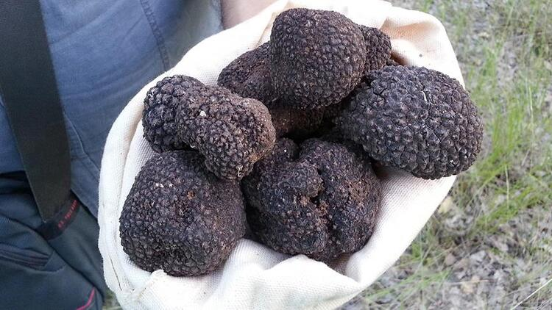
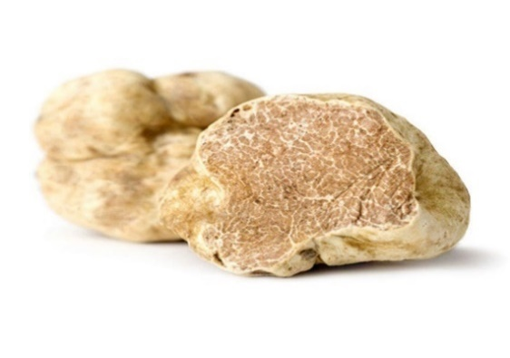
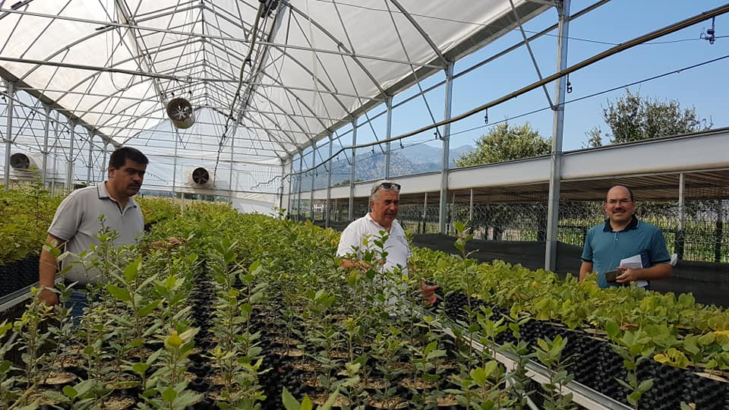

Slide 26
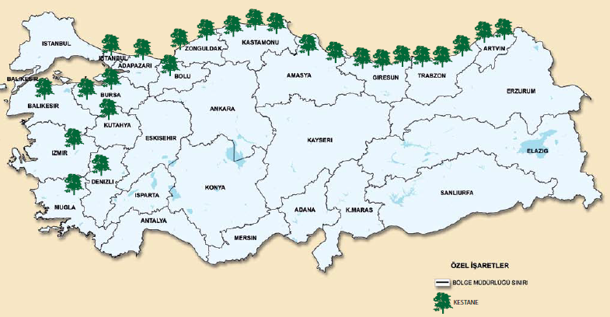
Chestnut
The distribution area of chestnut forests in Turkey is about 262,045 hectares .
According to the TUIK data of 2019, chestnut production in Turkey reaches over 70 000 tons annually, and the domestic product reaches 240 million TL in total. More than half of the chestnut fruit produced in two provinces mainly in the fruit sector of Aydın and İzmir where close to Eagean Sea.

Slide 27
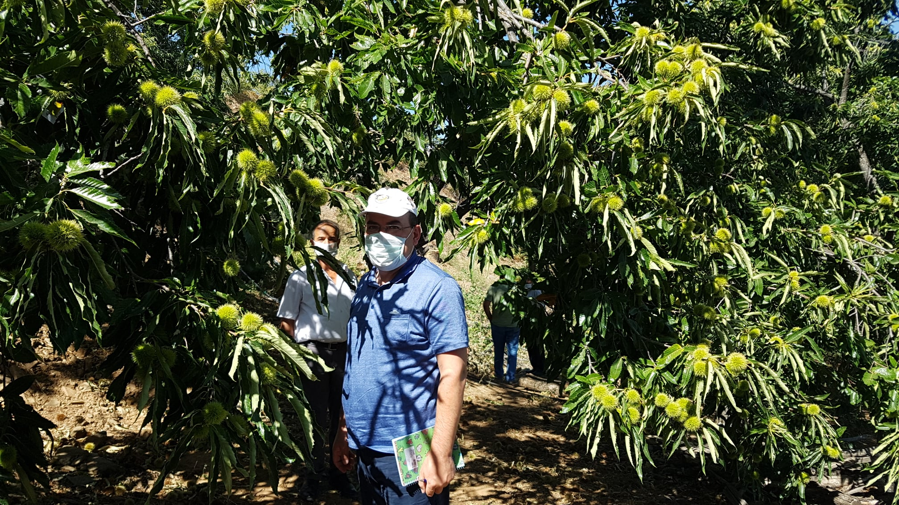

Slide 28
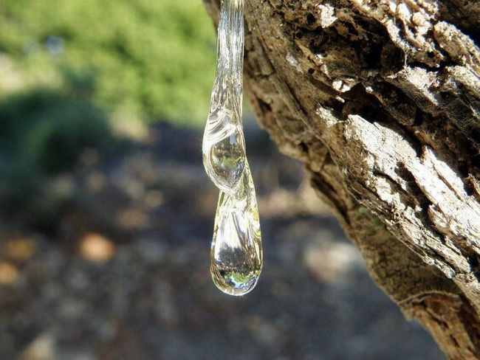
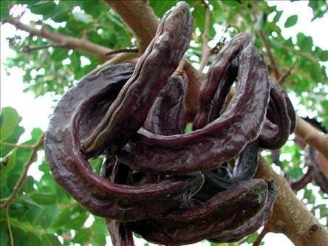
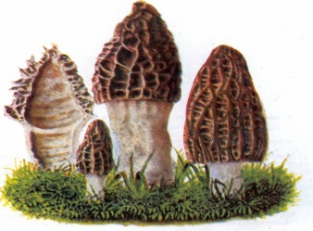
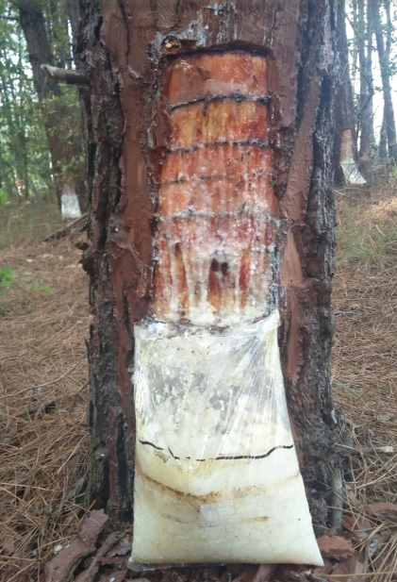
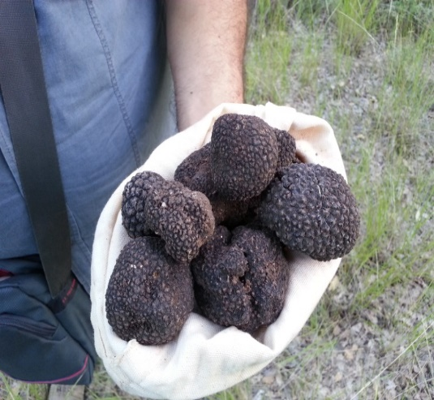
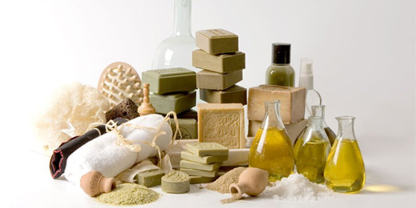
THANK YOU FOR YOUR ATTENTION

