Slide 1
6th European Forest Week, 22–28 November 2021
Side Event:
Non-wood forest products for people, nature and the green economy: Recommendations for policy priorities in Europe
Panel session:
Unlocking the full potential of the non-wood forest based bio economy, Rome,
Tuesday 23 November, 13:15 – 14:45 CET
«National Programmes for NWFPs in Turkey”
–Mr. İsmail Belen, Turkey

Slide 2
A few numbers about Turkey
Country area | 78 million ha
Forest area by national definitions | 23 million ha
Private forest area | 18 thousand
Country population | 85 million
Forest villagers | 7 million

Slide 3
Policy Tools
The Constitution has 177 Articles.
Article 45- Protection of farmers
Article 169- Conservation and improvements of forests
Article 170- Protection of forest villagers
Article 171- Promotion of cooperatives
Organic Agriculture Law:
NWFPs fall under the scope of "harvesting products from natural areas and sources".
Veterinary Services, Plant Health, Food and Feed Law
Forest Law

Slide 4
Presidency of the Republic of Turkey
Presidential Policy Councils
Ministry of Agriculture and Forestry
Ministry of Trade
Council of Health and Food Policies
Council of Local Administration Policies
Ministry of Industry and Technology
Presidency of Strategy and Budget
National Development Plans
GD of Sectors and Public Investments
GD of Forests
Depart. of NWFPs and Services
GD of Plant Production
GD of Animal Husbandry
GD of Food and Control
GD of Exportation
GD of Customs
Turkish Standards Institution
Turkish Patent and Trademark Office
Small and Medium Enterprises Development Organization of Turkey
Stakeholders of NWFPs

Slide 5
Some Regulations and Communiqués
Forest Management Regulation
Communiqués
Communiqué on Inventory, Planning, Production and Sales Principles of NWFPs-2016
Honey Forests Communiqué
Ecotourism Areas Communiqué
Truffle Communiqué

Slide 6
At the field/implementation
Action Plans- National Scale
Resine, bay leaf, blueberry, truffle, pine honey etc.
Utilization Plans- For the specific field and product
1 953 utilization plans
Investor Guidelines- For Private Sector
Truffle Orchard Investor Guidelines-2020

Slide 7
Cooperation with FAO on NWFPs-2020
NWFPs Assessment Report of Turkey
NWFPs Policy Report of Turkey,
Detailed reports for pine honey, bay leaf, chestnut, resin and truffle mushroom.
Technical Guidelines of NWFPs,
Status Update Reports Along with Recommendations in the Value Chain
http://www.gonder.org.tr/?p=10438

Slide 8
Contribution of NWFPs to national economy
In 2019, the contribution of NWFPs to economy 880 million USD,
Apr. 200 million USD export,
Contribution to forest villagers 123 million USD.
The number of forest villagers working in the collection of NWFPs is around 25 000 people. (wood production is around 150 000 people. )
The NWFPs sector makes an economic contribution directly or indirectly to apr. 500 000 people in Turkey.
This number includes the people; working in the field for collection, in drying processes, in the process of making the final product or semi-finished products, and packer, end seller-retailer, exporter etc.
No | NWFP | Export Value-USD
1 | Laurus nobilis | 38 mil.
2 | Castanea sativa | 35 mil.
3 | Origanum onites | 57 mil.
4 | Pinus pinea | 26 mil.
5 | Mushrooms | 12 mil.

Slide 9
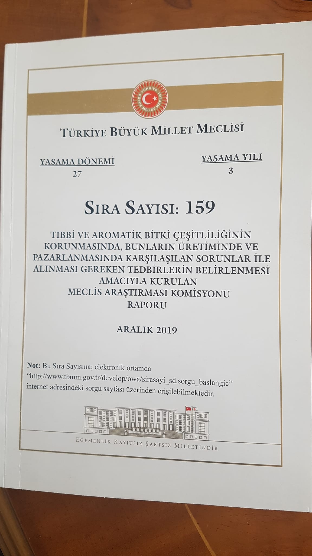
Involvement of the Parliament
There is close connection with NWFPs and medicinal and aromatic plants.
In December 2019, a "Commission for the Protection, Production and Marketing of Medicinal and Aromatic Plants" was established in the Turkish Parliament.
Working for a year, the Commission developed 127 proposals under 8 headings and conveyed them to the relevant Ministries.
Collection/harvesting from nature,
Domestication
Processing
Marketing
Legislation and institutional structure
Research and development
Employment and social security
Training, capacity building and awareness raising
https://www5.tbmm.gov.tr/sirasayi/donem27/yil01/ss159.pdf

Slide 10
THANK YOU
İsmail BELEN
Vice Chair of Committee on Mediterranean Forestry Questions-Silva Mediterranea/FAO
President of the Foundation of the People Caring for Future-CARFU
Senior Agriculture and Forestry Expert of the Ministry of Agriculture and Forest of Turkey
ismailbelen52@gmail.com https://www.linkedin.com/in/ismailbelen/ +90 506 222 48 19

