Slide 1
The forestry field in the Republic of Moldova: evolution, current situation and perspectives
Dr. Ion PLATON,
Deputy Director ”Moldsilva” Agency;
Dr. Victoria COVALI,
Deputy Director ”Moldsilva” Agency
Chișinău, November 2021

Slide 2
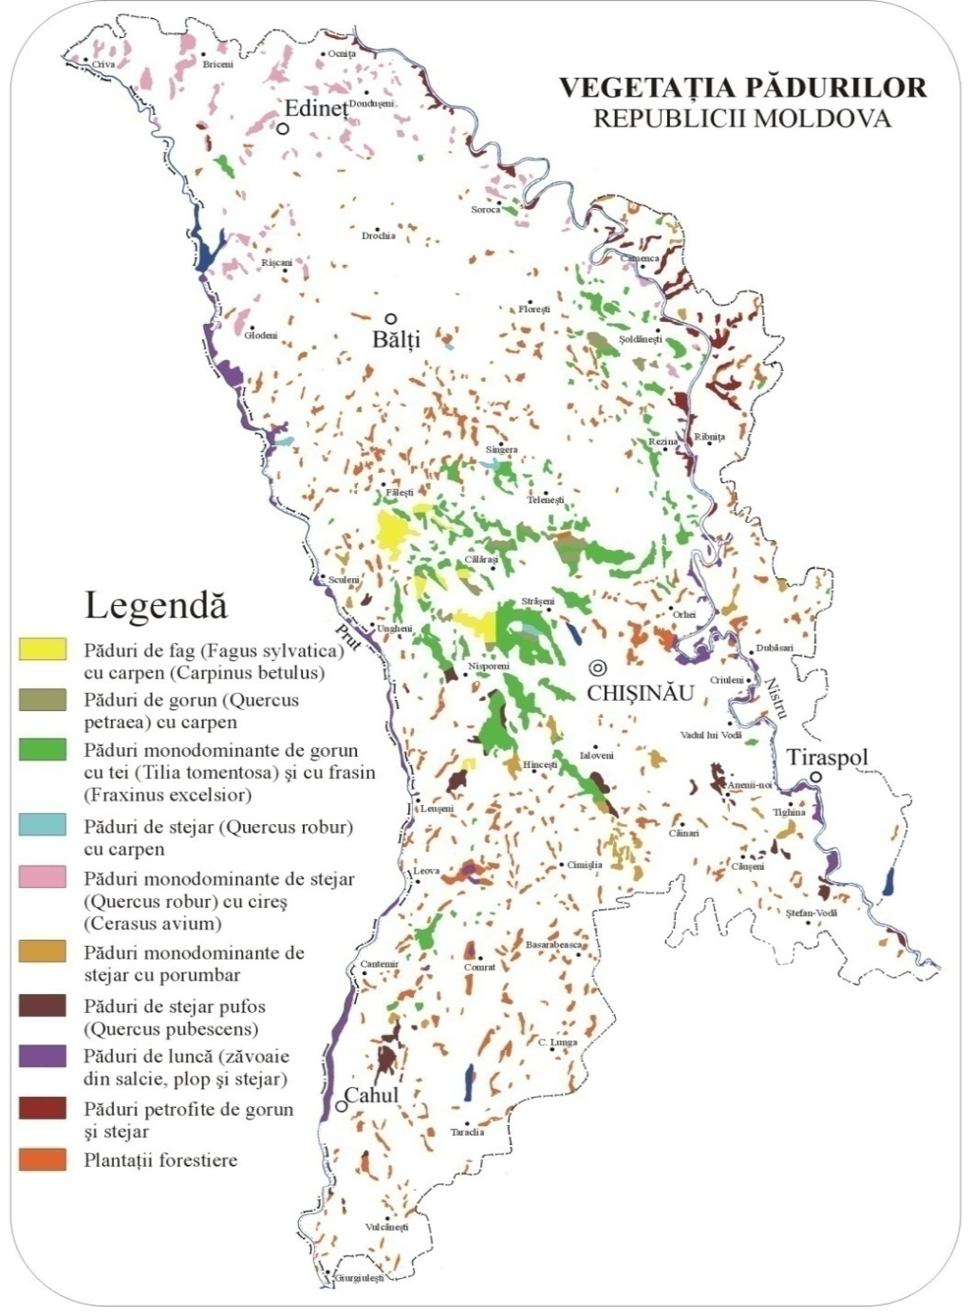
FOREST RESOURCES OF THE REPUBLIC OF MOLDOVA
1. Forest land:
Total area - 422.8 thousand ha, including the area covered with forests - 379.5 thousand ha (degree of afforestation - 10.2%), including state property 363.2 thousand ha (85.9%), public property of administrative-territorial units 57 thousand ha (13.5%) and 2.6 thousand ha in private property (0.6%).
2. Forest vegetation outside the forest land:
Total area - 50.8 thousand ha (30.7 thousand ha of forest protection curtains and 20.1 thousand ha of shrub vegetation).

Slide 3
THE EVOLUTION OF THE FOREST SURFACE IN THE PERIOD 1848-2020

Slide 4
EVOLUTION OF LAND INDICATORS IN THE PERIOD 1990-2020
Categories | Unit of measurement | Indicators reached
 |  | 1990 | 2020 | The difference
 |  |  |  | physical units | percent, %
I. Forest vegetation, total | thousand ha | 372,4 | 428,7 | +56,3 | +15,12
1.1. Forestry | thousand ha | 325,4 | 379,5 | +54,1 | +16,63
1.2. Other types of forest vegetation | thousand ha | 47,0 | 49,2 | +2,2 | +4,68
II. Arable land / Plowing land | thousand ha | 1589,1 | 1817,4 | +228,3 | +14,37
III. Multiannual plantations, total | thousand ha | 474,1 | 291,7 | -182,4 | -38,47
3.1. Vine plantations | thousand ha | 211,5 | 137,5 | -74,0 | -35,00
3.2. Orchards | thousand ha | 262,6 | 154,2 | -108,4 | -41,28
IV. Meadows | thousand ha | 354,6 | 348,6 | -6,0 | -1,69
V. Roads, streets, buildings | thousand ha | 209,8 | 235,0 | +25,2 | +12,01
VI. Land under water | thousand ha | 89,4 | 96,8 | +7,4 | +8,28
VII. Other categories of land | thousand ha | 295,2 | 166,4 | -128,8 | -43,63
VIII. Total land fund | thousand ha | 3384,6 | 3384,6 | - | -

Slide 5
DISTRIBUTION OF FORESTS BY MAIN FOREST FORMATIONS, %

Slide 6
GOVERNMENT STRUCTURE NATIONAL FOREST SECTOR
Parliament
Government
Ministry of the Environment
AM and IPM
”Moldsilva” Agency
Local Public Administration
Landowners, including Local Administration

Slide 7
ORGANIZATIONAL CHART OF THE STATE FOREST SECTOR
Government
Ministry of the Environment
”Moldsilva” Agency
Forestry enterprises 15
Forestry -wildlife enterprises 4
Nature reserves 4
Institute of research and forest arrangements
Orhei National Park
Forestry detour 74
Forestry Sectors 187
Forest cantons 1068

Slide 8
THE CORRELATION BETWEEN THE VOLUME OF AVERAGE ANNUAL GROWTH AND THE HARVESTING OF WOODEN MASS IN THE CUTTING PROCESS

Slide 9
Sales Revenue Dynamics 2016-2021 (plan)

Slide 10
Share of financial commitments to BPN, year 2020

Slide 11
The share of the main economic - financial indicators in the structure of total incomes (thousand lei), year 2021

Slide 12
Revenue dynamics of auxiliary - industrial production 2016-2021 (plan)

Slide 13
Quantity of processed wood (raw wood) 2015-2021 (plan)

Slide 14
Revenue dynamics wood processing and cutting 2016-2021 (plan)

Slide 15
Harvesting / collecting non-timber forest products

Slide 16
Harvesting / collecting non-timber forest products

Slide 18
FOREST REGENERATION AND EXTENSION
Serial | Years | Regeneration of the forest in the forest land managed by the “Moldsilva” Agency, ha |  |  | Extension of areas covered with forest vegetation, ha | Total regeneration and afforestation, ha
 |  | Total | including:
Number |  |  | Planting forest crops | Helping natural regeneration
1 | 2000 | 3309 | 816 | 2493 | 0 | 3309
2 | 2001 | 2809 | 953 | 1856 | 10 | 2819
3 | 2002 | 3643 | 1219 | 2424 | 7500 | 11143
4 | 2003 | 3050 | 998 | 2052 | 7587 | 10637
5 | 2004 | 3171 | 977 | 2194 | 7500 | 10671
6 | 2005 | 2944 | 981 | 1963 | 7532 | 10476
7 | 2006 | 3255 | 913 | 2342 | 7510 | 10765
8 | 2007 | 3896 | 1026 | 2870 | 7550 | 11446
9 | 2008 | 3659 | 976 | 2683 | 7932 | 11591
10 | 2009 | 3602 | 759 | 2843 | 4670 | 8272
11 | 2010 | 2743 | 685 | 2058 | 529 | 3272
12 | 2011 | 3745 | 980 | 2765 | 221 | 3966
13 | 2012 | 4851 | 1175 | 3676 | 73 | 4924
14 | 2013 | 4620 | 1244 | 3376 | 57 | 4677
15 | 2014 | 4767 | 1149 | 3618 | 37 | 4804
16 | 2015 | 4256 | 1582 | 2674 | 425 | 4681
17 | 2016 | 3804 | 1208 | 2596 | 1464 | 5268
18 | 2017 | 3933 | 978 | 2955 | 0 | 3933
19 | 2018 | 4436 | 1026 | 3410 | 0 | 4853
20 | 2019 | 4238 | 1228 | 3010 | 0 | 4602
21 | 2020 | 3975 | 1076 | 2899 | 0 | 4371

Slide 19
GROWTH OF FOREST REPRODUCTIVE MATERIAL IN FOREST NURSERIES

Slide 20
HARVEST VOLUMES OF NON-WOOD FOREST PRODUCTS

Slide 21
EVOLUTION OF THE SURFACE AREAS PROTECTED IN RM
FOREST STRUCTURE BY FUNCTIONAL SUBGROUP
Years |  | 1998 |  |  | 2007 |  | 2020
Surface (ha) |  | 66467,3 |  |  | 156776,09 |  | 189385,9
Rate (%) |  | 1,96 |  |  | 4,64 |  | 5,61

Slide 22
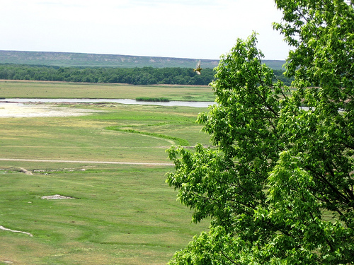
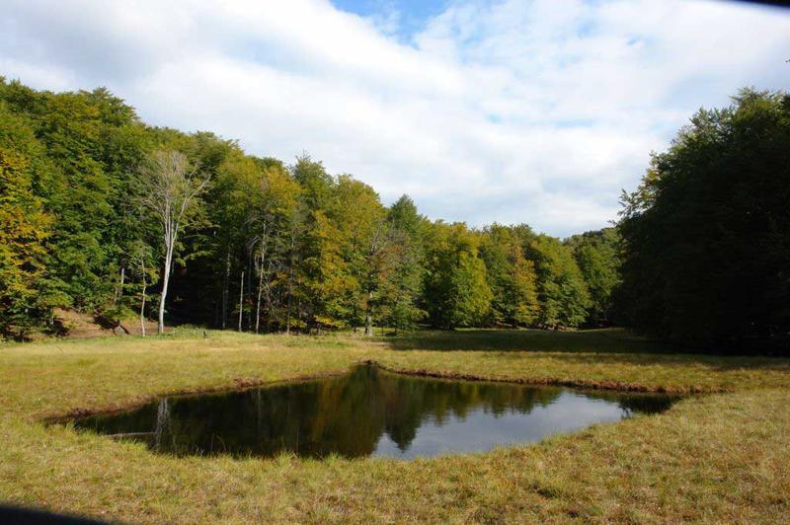
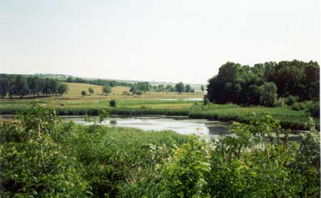
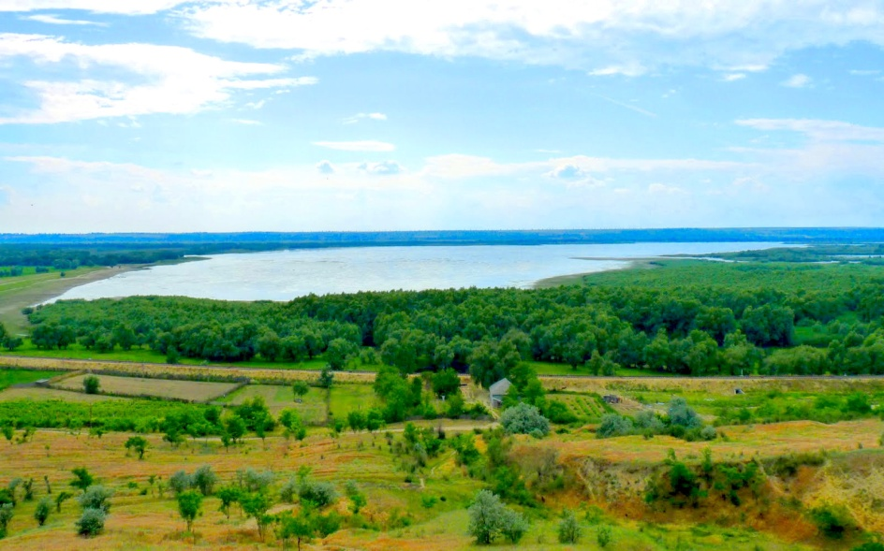

Slide 23
ENSURING FOREST GUARDS
 | Indicators | U.M | 2010 | 2011 | 2012 | 2013 | 2014 | 2015 | 2016 | 2017 | 2018 | 2019 | 2020
I. Illegal deforestation
 | Total volume of illegal deforestation | thousand m3 | 3,9 | 4,8 | 4,2 | 3,6 | 2,5 | 8,2 | 3,00 | 2,2 | 1,6 | 2,6 | 1,3
 | The volume of illegal deforestation per 1000 ha, the area covered with forests | m3/ 1000 ha | 12,7 | 14,3 | 12,4 | 10,1 | 7,6 | 25,2 | 9,00 | 6,7 | 4,8 | 6,3 | 3,6
 | Percentage of illegal deforestation detected | % | 57,0 | 73,0 | 80,0 | 90,0 | 63,1 | 31,6 | 77,7 | 74,6 | 76,2 | 68,5 | 48,3
 | Number of taken reports | cases | 520 | 860 | 757 | 570 | 427 | 581 | 612 | 442 | 306 | 179 | 250
 | The amount of damage caused | thousand lei | 675,0 | 826,4 | 674,1 | 497,3 | 557,1 | 833,6 | 1090,4 | 1141,6 | 711,3 | 519,9 | 752,7
 | II. Unauthorized grazing of animals
 | Number of taken reports | cases | 69 | 80 | 165 | 156 | 67 | 118 | 142 | 101 | 46 | 16 | 45
 | The amount of damage caused | thousand lei | 147,0 | 118,7 | 271,5 | 139,2 | 96,8 | 245,6 | 157,0 | 136,1 | 59,3 | 17,2 | 44,5
III. Other forestry contraventions
 | Number of taken reports | cases | 84 | 145 | 133 | 122 | 92 | 91 | 109 | 91 | 55 | 36 | 25
 | The amount of damage caused | thousand lei | 289,0 | 1264,6 | 229,7 | 252,6 | 1075,1 | 716,8 | 384,2 | 201,2 | 232,2 | 192,1 | 166,3

Slide 24
MAIN ISSUES FACING THE FOREST SECTOR IN THE REPUBLIC OF MOLDOVA
Continuous degradation of forest ecosystems, fragmentation of forest habitats.
Decreased occupied areas and aggravation of the situation of rare and endangered ecosystems (beeches, fluffy oaks, petrophytic formations, etc.).
Degradation and diminution of forest resorts..
Applying insufficient volumes of ecological regeneration and reconstruction works to improve the composition by promoting more resistant biotypes to climate change, replacing compromised introducers in forest culture, restoring fundamental phytocenoses, etc.
Lack of interconnection corridors between scattered forest bodies.
Continuous erosion of forest biodiversity.
Reduced effectiveness of methods and techniques currently used in the care and management of stands, regeneration, conservation and reconstruction of forests.
Inefficient integration of achievements in the field of forest biodiversity conservation in the theory and practice of forest management.
The continuous degradation, fragmentation, destruction, spontaneous management, without the planning imposed by the forest regime, of the forests owned by the town halls.

Slide 25
LIST OF SUBJECTS OF INTEREST FOR ENSURING THE SUSTAINABLE DEVELOPMENT OF THE FOREST SECTOR IN THE RM
Ensuring sustainable management of the forest sector in the face of climate change, forest regeneration and nursery, successful techniques and practices in afforestation of degraded land, production of forest reproductive material, including protected roots, use of high energy potential hybrid species in cultivation (creation of energy crops);
Realization of the National Forest Inventory, mechanisms of operation of the national system of inventory and landscaping of the forest, other areas covered with forest vegetation, forest certification;
Peculiarities of financial management within the forest management, the mechanism of redistribution of financial sources and the performance of compulsory forest-technical works in the sectors with a low degree of afforestation of the country; financing of state programs; transfers to / from the state budget;
Functioning of the mechanism for financing natural biodiversity conservation activities, including by providing payments / compensations for ecological forest protection services, the mechanism for identifying the beneficiaries of these services and the legal imposition for the collection of payment;

Slide 26
LIST OF SUBJECTS OF INTEREST FOR ENSURING THE SUSTAINABLE DEVELOPMENT OF THE FOREST SECTOR IN THE RM
Functionality of the Integrated Reporting System, including: the unique system based on specialized software for calculating the volume of wood exposed to exploitation (enhancement); wood source tracking and timber traceability control system; records of timber circulation, etc .;
The interaction of the state-owned forest sector with the private/communal one, the development of the public-private partnership in the foreset fund, the forest rent;
Management of state protected natural areas (nature reserves, nature parks), management plans, etc.;
Development of the auxiliary-industrial household and capitalization of the non-timber production of the forest, including: recreational services, tourism, hunting, hunting tourism, medicinal plants, forest leasing, etc.;
Signing of a bilateral cooperation agreement for the transfer of knowledge and advanced technologies in the field of forestry and biodiversity conservation, having as priority objective the southern area of the Republic of Moldova.

Slide 27
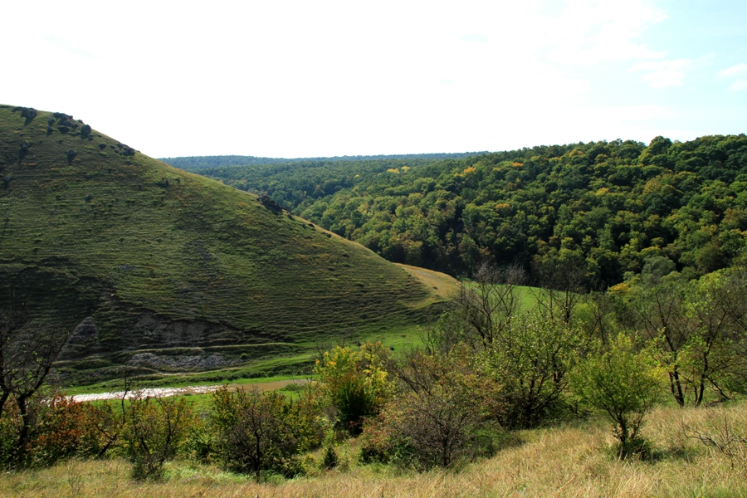

Slide 28
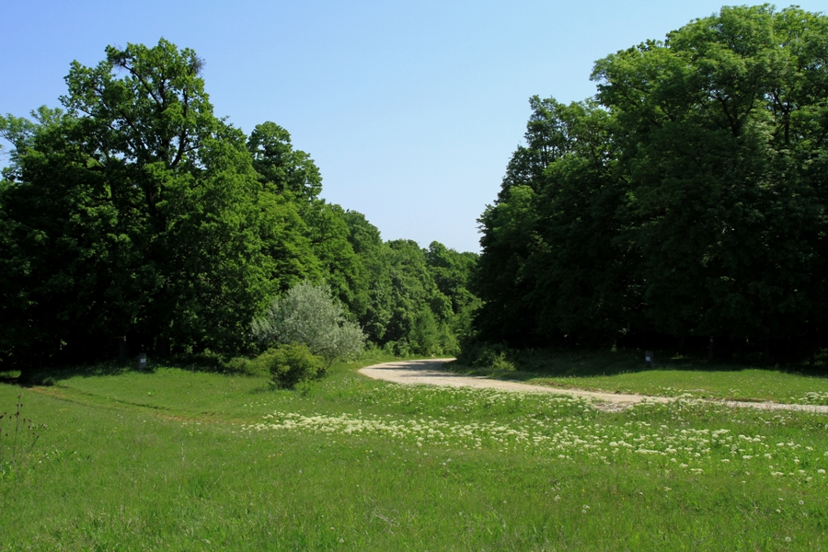
Thank you for your attention!

