Slide 1
Towards an FAO Framework for Nature-based Solutions for Food and Agriculture
Cuma UYKUN
Junior Technical Officer, FAOSEC
Notes:
Title should be same with the doc we used as ref.

Slide 2

FAO definition for NbS
 | NBS in the food and agriculture sector is proposed as “working with nature to improve sustainability of agroecosystems and their interactions with other socio-ecological systems, to enhance livelihoods, other economic, social and cultural functions, over various temporal and spatial scales.”
Notes:
First used by World Bank and IUCN in 2008/2009
: as actions to protect, sustainably manage, and restore natural or modified ecosystems, that address societal challenges effectively and adaptively, simultaneously providing human well-being and biodiversity benefits (IUCN, 2016)

Slide 3
FAO`s Work on NBSs:
1 | NbS in FAO strategic documents and regional initiatives
2 | Policy engagement on NbS
3 | Production of knowledge on NbS
4 | Development of NbS tools
5 | Application of NbS in the field
6 | Alignment of FAO Regional Initiatives with NbS
Notes:
FAO works on NBSs by categorizing the following topics listed below. These are general titles of what FAO covers in terms of NBSs. There area detailed works for each of the work listed here I will give some examples , you may find detail works by reading them all.

Slide 4
FAO Publications on NbS The FAO, engaged NBSs since 2018
FAO`s Work on NBSs: Examples
1 | NbS in FAO strategic documents and regional initiatives
• Nature-based solutions in agriculture: The case and pathway for adoption (2021)
• Nature-based solutions in agriculture: Project design for securing investment (2021)
• Nature-based solutions in agriculture: Sustainable management and conservation of land, water and biodiversity (2021)
• Hand in hand with nature – Nature-based Solutions for transformative agriculture (2021)
• Proceedings of the nature-based solutions webinar (2021)
• Ecosystem-based adaptation in the agriculture sector - A nature-based solution (NbS) for building the resilience of the food and agriculture sector to climate change (2020)
• Forests: nature-based solutions for water (2019)
• Nature-Based Solutions for Agricultural Water Management and Food Security (2018)
• Observations and key messages on Nature-Based Solutions for agricultural water management and food security (2018)
• EAF Toolbox – The ecosystem approach to fisheries (2012)
Notes:
I just wanted to highlight here what and how FAO is focusing on NBSs after 2018s you may find several doc and initiatives in last 5 years. The FAO, engaged NBSs since 2018, created the Nature-based Food and Agriculture Systems’ Solutions (NBFASS) framework. NbS implementation tackles with diverse challenges in different sectors. Aligned with FAO's plans, it guides work in sectors like crop, forestry, and fisheries.

Slide 5

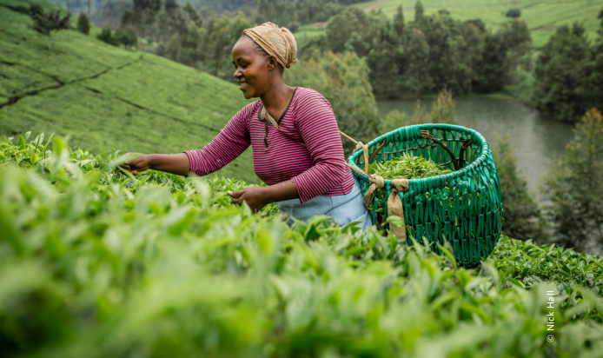
Notes:
Nature-based solutions in agriculture: The case and pathway for adoption (fao.org)

Slide 6
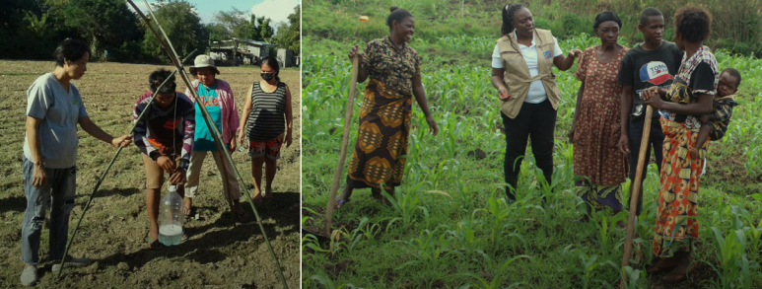
FAO`s Work on NBSs: Examples
 | Application of NbS in the field
FAO has also applied NbS practices throughout its field activities.
For example, in 2020 1.4 million farmers in Africa were trained on nature-based solutions for Fall Army Worm management.
https://www.fao.org/3/cb8910en/cb8910en.pdf
Notes:
The Conexus project is bringing together Latin American and European partners to strengthen international cooperation on nature-based solutions and ecosystem restoration.

Slide 7


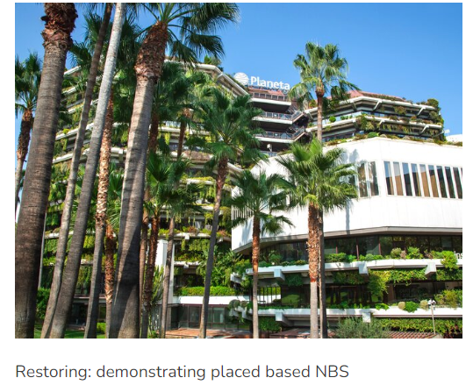


FAO`s Work on NBSs: Examples
Activities
Activities — Conexus (conexusnbs.com)
Notes:
FAO is partner in the CONEXUS project, which provides context-relevant evidence of the effects and long-term viability of nature-based solutions and ecosystem restoration in European and Latin American citieS. The Conexus Project Between Latin America And Europe. Strengthening international cooperation on nature-based solutions and ecosystem restoration

Slide 8
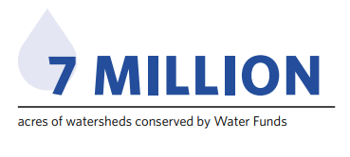

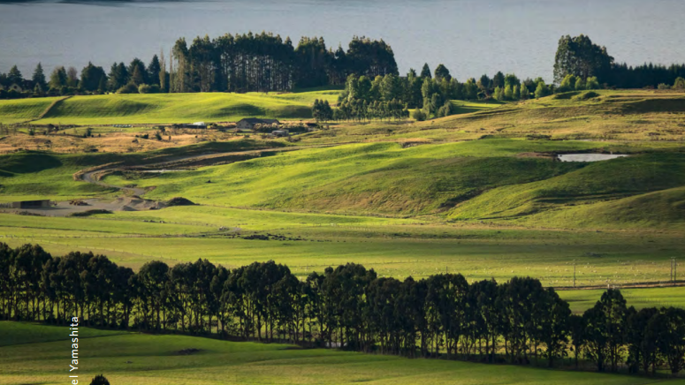
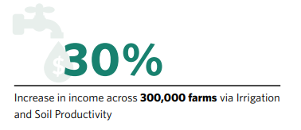
Notes:
The Upper Tana River Basin is of critical importance to the Kenyan economy. Covering an area of about 1.7 million hectares, the Upper Tana supplies 95 percent of Nairobi’s drinking water, sustains important aquatic biodiversity, drives agricultural activities that feed millions of Kenyans, and provides half of the country’s hydropower. The unchecked expansion of farming, quarrying and dirt road construction across the Upper Tana over the last 40 years has led to land degradation. Consequently, elevated sediment loads are entering the river system, impacting the delivery of water to Nairobi water users and reducing the efficiency and lifespan of reservoirs. Reservoir function has been further compromised by reduced dry season flows resulting from increased demand for irrigation water and encroachment on natural wetlands that once stored runoff water and recharged aquifers output. The largely rain-fed agricultural sector (including permanent crops such as coffee and tea, annual vegetable cash crops and subsistence crops and livestock) forms the dominant source of livelihood and labor employment in the Upper Tana River Basin, with smallholder farms collectively being the largest group of landowners. Unfortunately, the sustainability of small- and large-scale agricultural practices is under growing pressure due to over-cultivation, poor nutrient management, soil erosion on sloped land, low productivity of livestock in the lower reaches of the basin and persistent encroachment of cropland into forested riparian and high slope areas

Slide 9

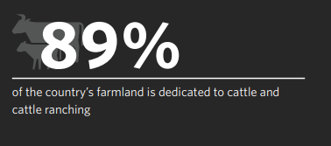
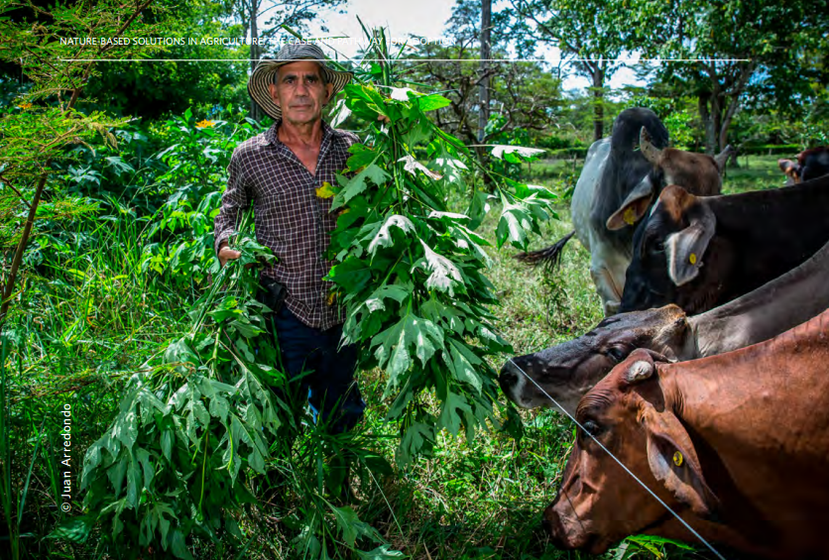
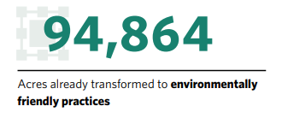
Notes:
Traditional cattle ranching consumes more than a third of Colombia’s territory and is the leading cause of deforestation. The cattle raising system in Colombia is extensive and inefficient, with very few cows occupying a large amount of land. Approximately 89% of the country’s farmland is dedicated to cattle and cattle ranching, often associated with speculative landholding. Often, cattle ranchers cut down trees because they are thought to compete with pasture for sun and water, or because tree and limb fall are perceived as a threat to cattle (World Bank, 2019).

Slide 10
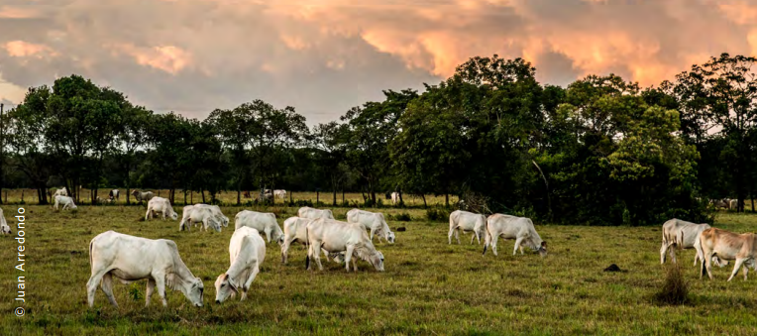
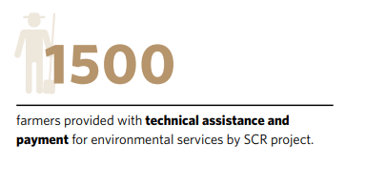
Notes:
Several factors have enabled the successful promotion and adoption of silvopastoral practices. - Longevity: The Mainstreaming Sustainable Cattle Ranching project has been in place for 10 years, allowing it to build relations and trust with family farmers across the different geographies. - Livelihood Benefits: While these projects enhance ecosystems and store carbon, they also provide a financial return to the farmers, in terms of cattle productivity, the quantity and quality of milk, reproduction rates, pasture condition and recovery, and resources that can be cut and saved for the dry season. - Key Partners: The project has been supported by the World Bank and implemented by Colombia’s National Cattle Ranchers Association (FEDEGAN), in partnership with TNC, the Center for Research on Sustainable Agriculture (CIPAV), and Fondo Accion (Lerner et al., 2017). - Direct Support to Farmers: The Sustainable Cattle Ranching – SCR project provided technical assistance to 4,100 farms, payment for environmental services to 1,500 farmers (over 2 million dollars paid to farmers) and training to 24,000 additional farmers in 12 departments.

Slide 11

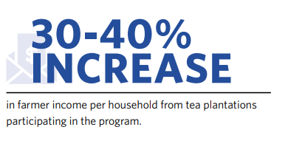

Notes:
Qiandao Lake (aka “Thousand Island Lake”) serves as the most important drinking water source in the Yangtze River Delta region in China and is integral in securing domestic water use and drinking water quality for residents in the Hangzhou metropolitan area. The watershed of Qiandao Lake is located within one of thirty-two priority biodiversity conservation areas in the country, acting as a key ecological buffer in the Yangtze River Delta region. Non-point source (NPS) pollution from conventional agricultural practices is increasing, threatening the ecosystem integrity of the Qiandao Lake watershed. Over the last decade, water quality in Qiandao Lake has declined due to nutrient enrichment in particular. In 2017, the World Bank and The Nature Conservation (TNC) jointly conducted a study which identified NPS pollution ‘hot spots’ within Qiandao Lake watershed – an estimated 30% of total NPS pollution originated from sub-watersheds representing just 10% of total watershed area. Moreover, 17% of agricultural fields and orchards are responsible for 64% of total excess nitrogen loading, 68% of total excess phosphorus loading, and 60% of sediment loading. One of the challenges in managing agricultural NPS pollution in China’s watersheds is that the landscape is dominated by smallholder farmers. In Qiandao Lake watershed, smallholder farms—many on steeply sloped land—comprise 70% of the total land area and account for about half of the total nitrogen and phosphorus pollution in the watershed. Tea plantations—a typical land use type contributing to NPS pollution within the area—have been identified as an entry point for promoting sustainable practices and testing a new performance-based compensation mechanism.

Slide 12
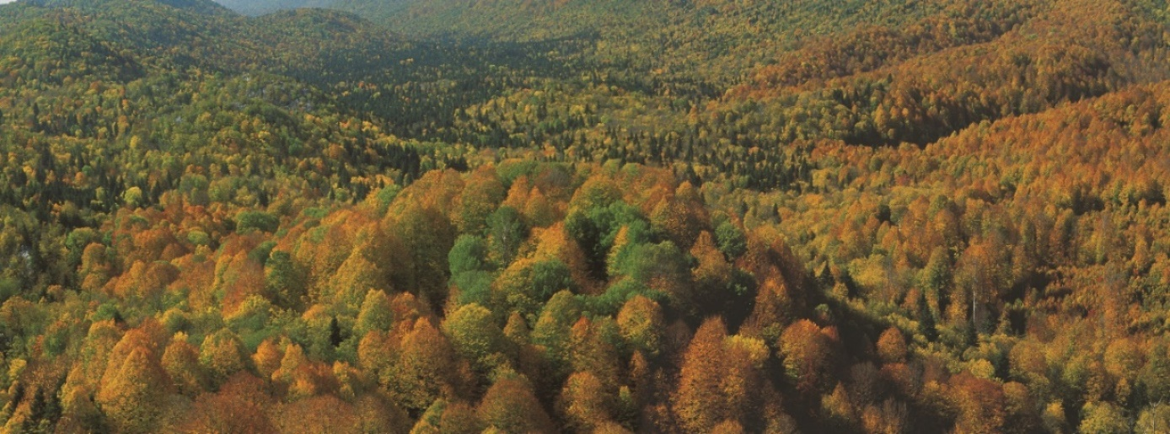
Thank You Cuma.uykun@fao.org

