Slide 1

Understanding the Efficiency of NBSs in Watershed Context
Prof.Dr. Yusuf Serengil
Istanbul University Cerrahpasa

Slide 2


Agenda
Watershed Pespective
Nature Based Solutions from Watershed Perspective
Case Studies
Conclusions

Slide 3

Introduction
Following the declaration of the UN Decade on Ecosystem Restoration, nature-based solutions (NbS) are at the forefront of the sustainability discourse.
However, this solution needs operational clarity to avoid the commonly mentioned vagueness of the concept.
Understanding the Efficiency of NBSs in Watershed Context

Slide 4
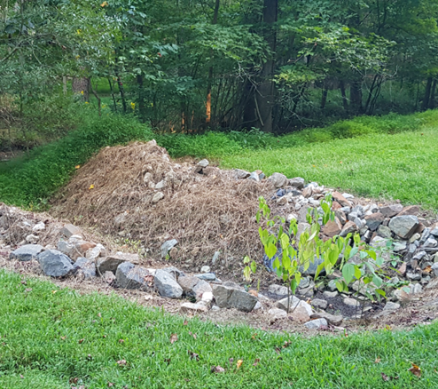


What is a watershed and why we need to understand it before we understand NBS?
Understanding the Efficiency of NBSs in Watershed Context

Slide 5
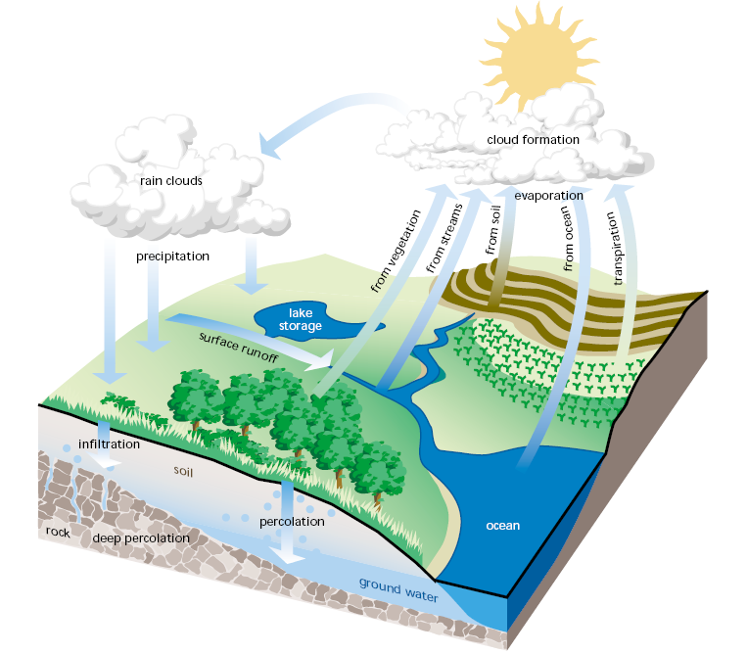






1. Identify your problem
. water pollution?
. noise pollution?
. landslides?
. torrents? floods?
…….
croplands
forests
wetlands
grasslands
Understanding the Efficiency of NBSs
in Watershed Context

Slide 6
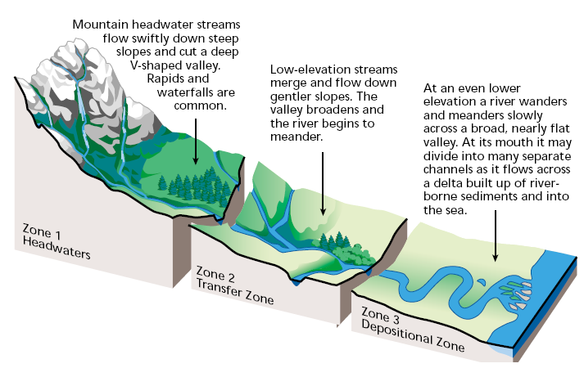
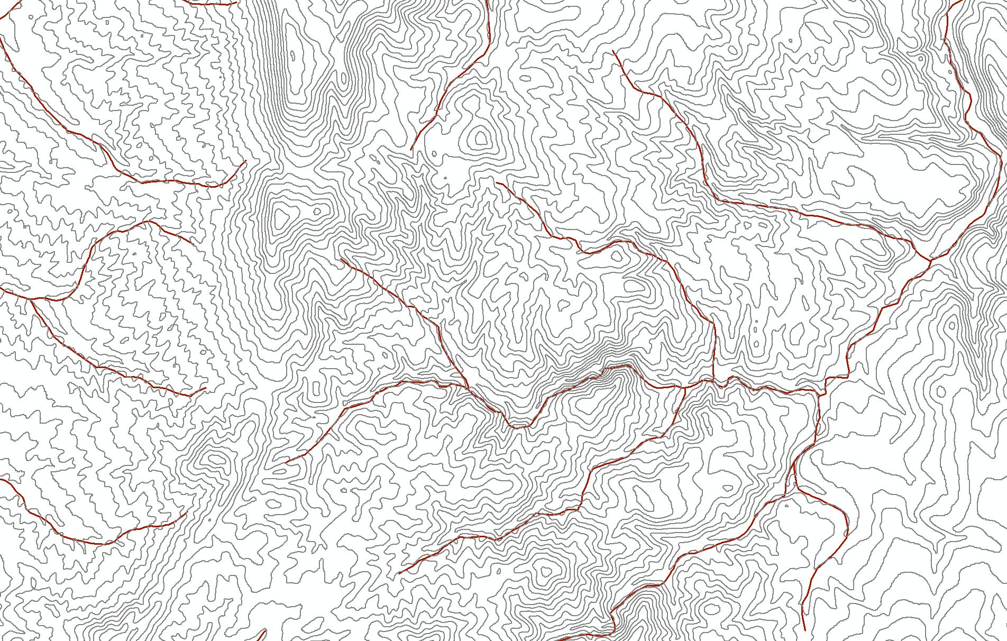
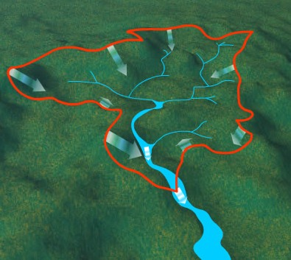
2. Delineate and Identify your watershed
Torrents
Debris flow
Avalanches
Rockfalls
Erosion
Erosion
Landslides
Torrents
Floods
Sedimentation
Euthrophication
Understanding the Efficiency of NBSs
in Watershed Context

Slide 7
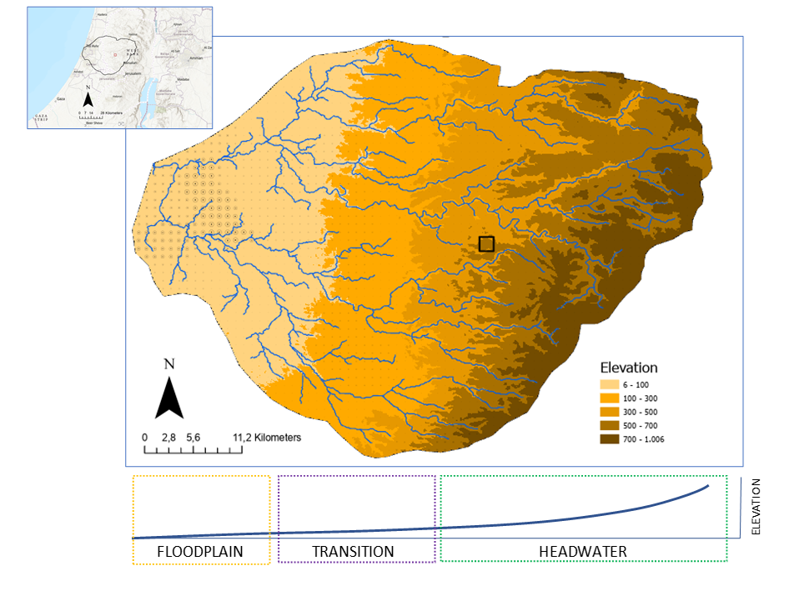
2. Delineate and Identify your watershed
The river network of the Yarkon River basin.
Understanding the Efficiency of NBSs
in Watershed Context

Slide 8
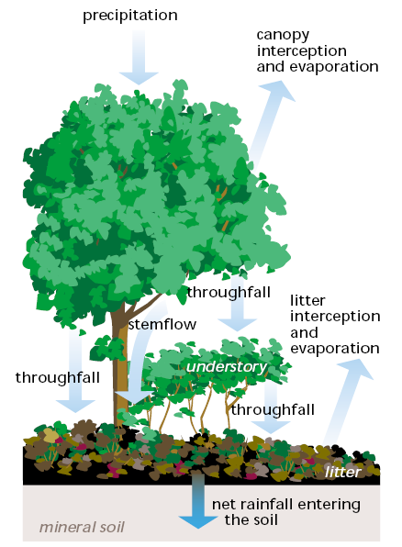
3. Understand the microscale
What are your vegetation types?
Closed canopy, sparse vegetation, perennial crops, grasses etc…
How do these vegetation affect water quality, quantity and regime?
Slope, litter, soil etc…
Understanding the Efficiency of NBSs
in Watershed Context

Slide 9
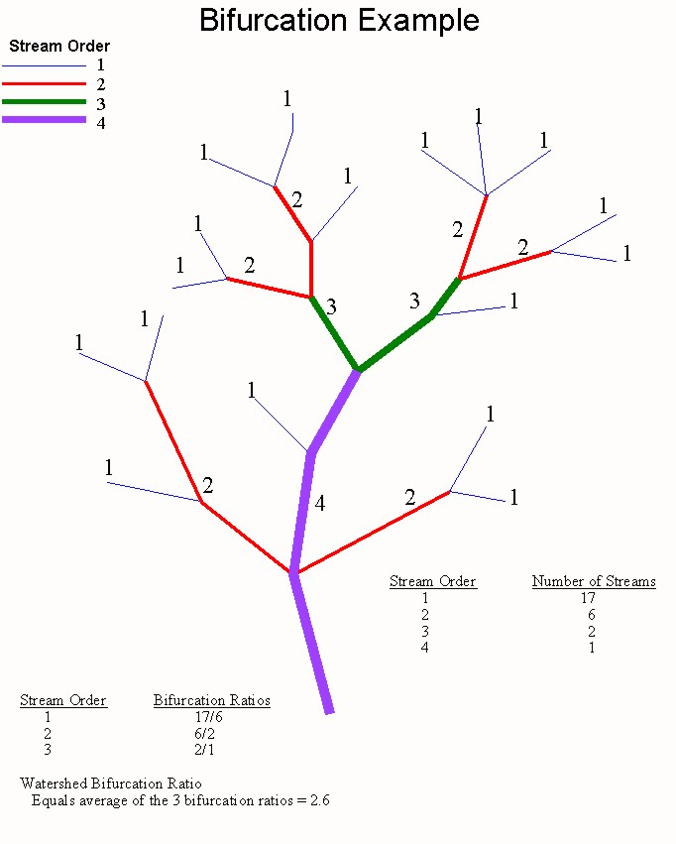






4. Preliminary analyses the watershed
Watershed area: 50 km2 (=50 000 000 m2)
Mean annual precipitation: 600 mm
Project precipitation (max 1 day)
This watershed can produce up to:
50 km2 = 50 Mm2
100 mm = 0.6 m
= 50 x 0.1 = 5 Mm3 flash flood
Understanding the Efficiency of NBSs
in Watershed Context

Slide 10
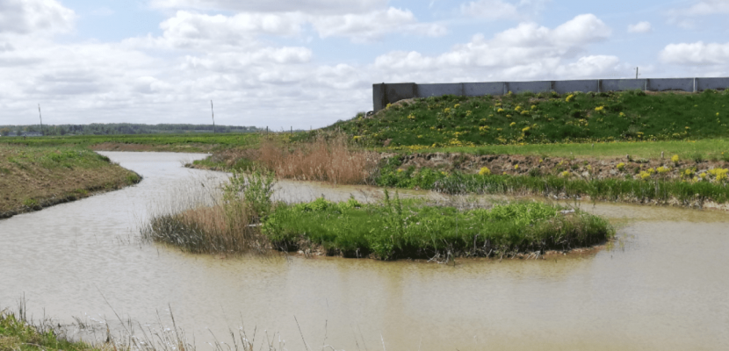










4. Preliminary analyses the catchment
Constructed wetland
Watershed area: 50 km2 (=50 000 000 m2)
Mean annual precipitation: 600 mm
Project precipitation (max 1 day)
This watershed can produce up to:
50 km2 = 50 Mm2
100 mm = 0.6 m
= 50 x 0.1 = 5 Mm3 flash flood
Catchment area: 200 ha (= 2 km2 = 2 Mm2)
This catchment can produce around:
Area 200 ha = 2 Mm2
Precipitation 600 mm = 0.6 m
Runoff coefficient = 0.2 – 0.6
= 2 x 0.6 x 0.2 – 0.6 = 0.24 – 0.72 Mm3 inflow per year
Understanding the Efficiency of NBSs
in Watershed Context

Slide 11



4. Preliminary analyses the catchment
What are the benefits?
Purification of 0.24 to 0.72 Mm3 of water to reduce euthrophication
Reservoir for irrigation
Reduction of surface runoff and recharge goundwater instead
Reduce erosion and sedimentation
Reduce torrent and flood risk
Produce biomass for grazing
Boost biodiversity and C accumulation
Landscape value
Constructed wetland
Catchment area: 200 ha (= 2 km2 = 2 Mm2)
This catchment can produce around:
Area 200 ha = 2 Mm2
Precipitation 600 mm = 0.6 m
Runoff coefficient = 0.2 – 0.6
= 2 x 0.6 x 0.2 – 0.6 = 0.24 – 0.72 Mm3 inflow per year
Understanding the Efficiency of NBSs
in Watershed Context

Slide 12
4. Preliminary analyses the catchment
What are the harms?
Conversion of a grassland/forestland/cropland etc into flooded land (emission)
Conversion of a lotic ecosystem into lentic (loss of native species such and new incoming species)
Constructed wetland
Catchment area: 200 ha (= 2 km2 = 2 Mm2)
This catchment can produce around:
Area 200 ha = 2 Mm2
Precipitation 600 mm = 0.6 m
Runoff coefficient = 0.2 – 0.6
= 2 x 0.6 x 0.2 – 0.6 = 0.24 – 0.72 Mm3 inflow per year
Understanding the Efficiency of NBSs
in Watershed Context

Slide 13
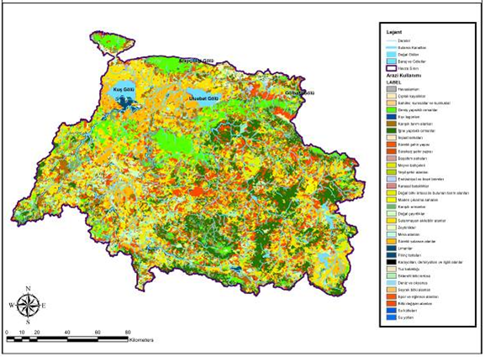
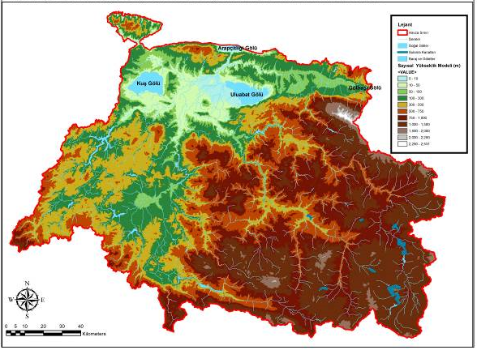
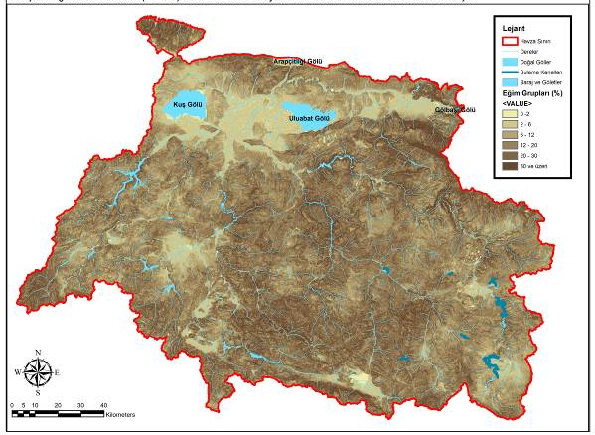
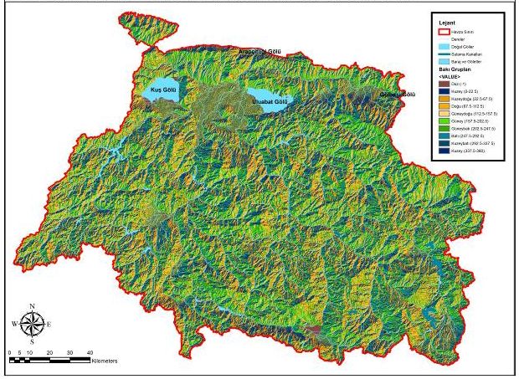
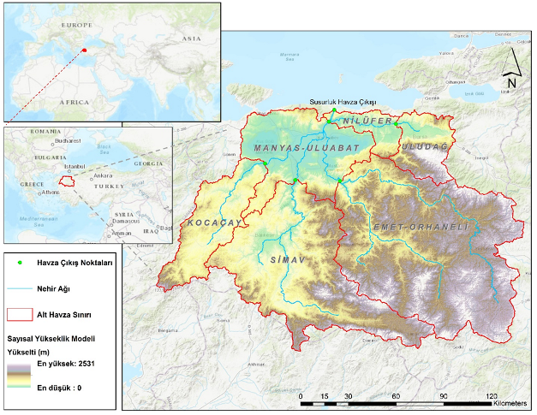
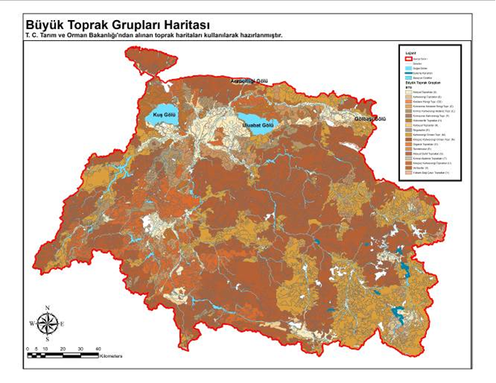
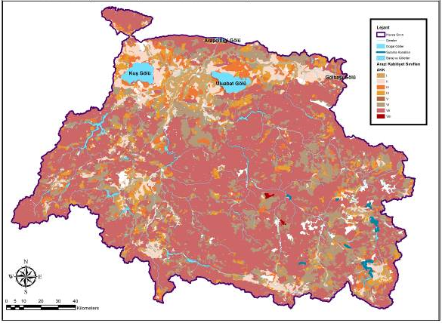
4. Analyses
Modelling
Susurluk Basin
Northwest Türkiye
Elevation model
Land use
Land capability
Soils
Slope
Aspect - facing
Understanding the Efficiency of NBSs
in Watershed Context

Slide 14
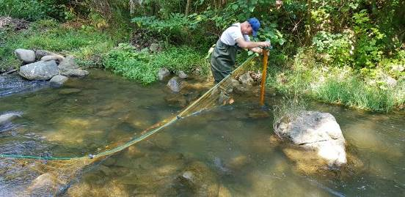


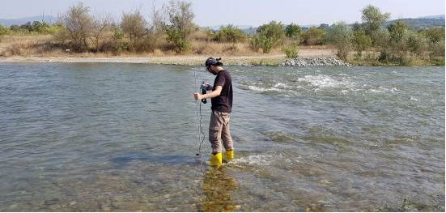

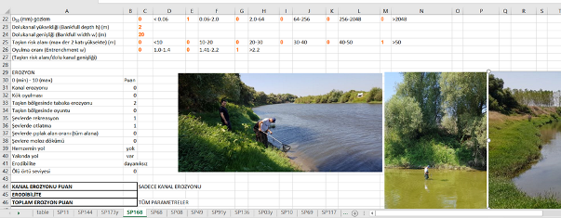

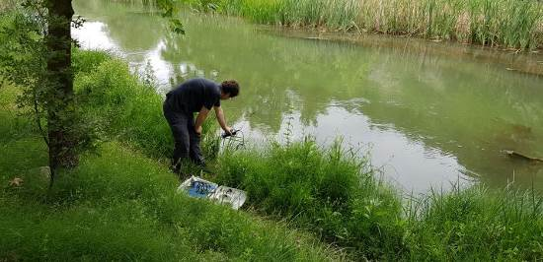
4. Analyses
Modelling
Susurluk Basin
Northwest Türkiye
Field mesurements and surveys to verify the modelling
NbS assessments and applications are all ecohydrologic
Understanding the Efficiency of NBSs
in Watershed Context

Slide 15
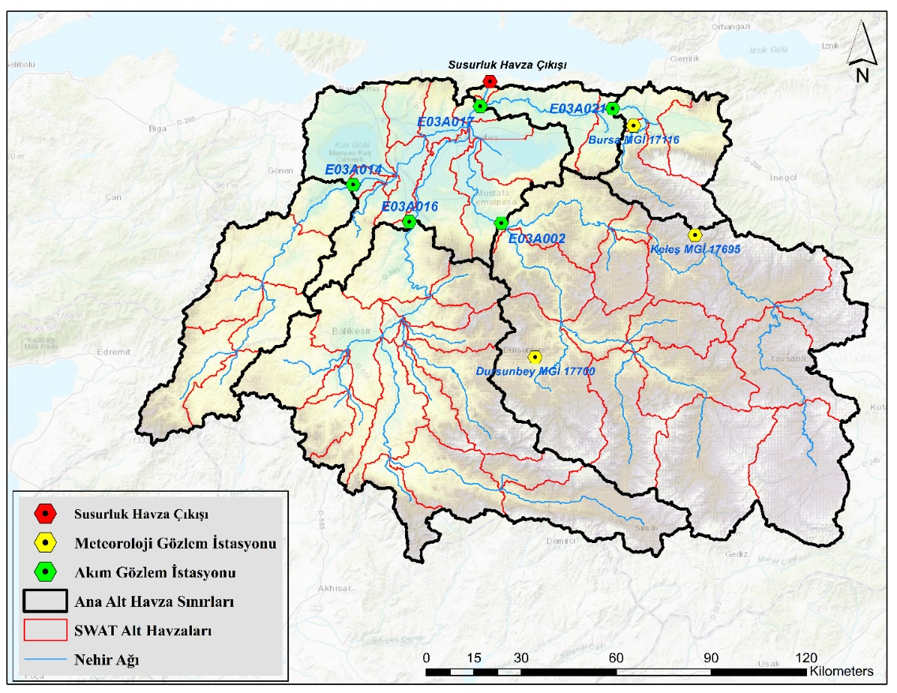
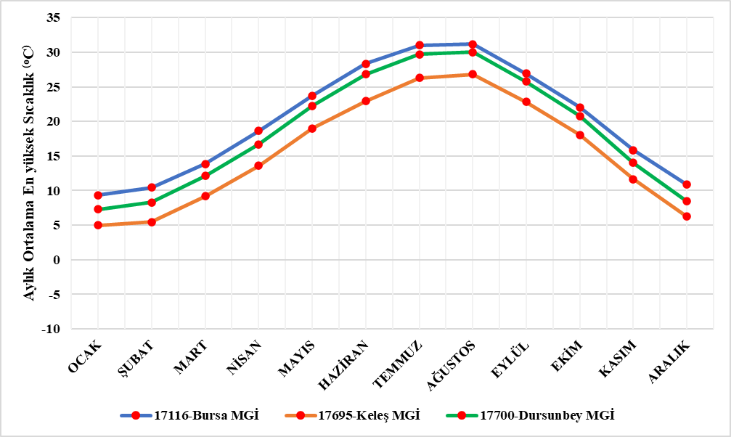
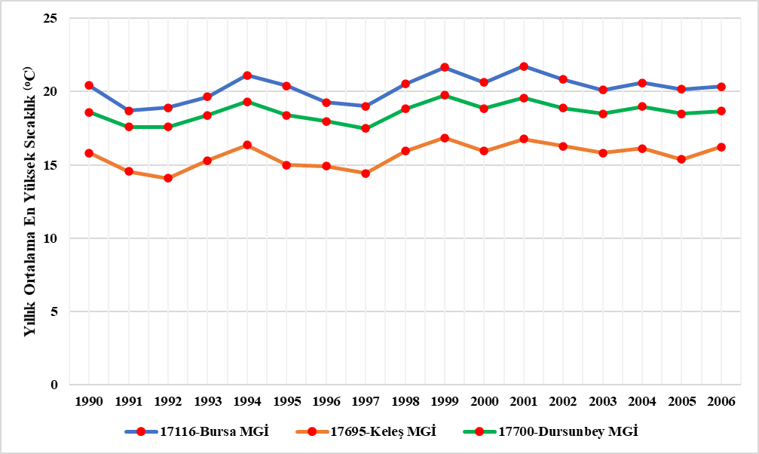
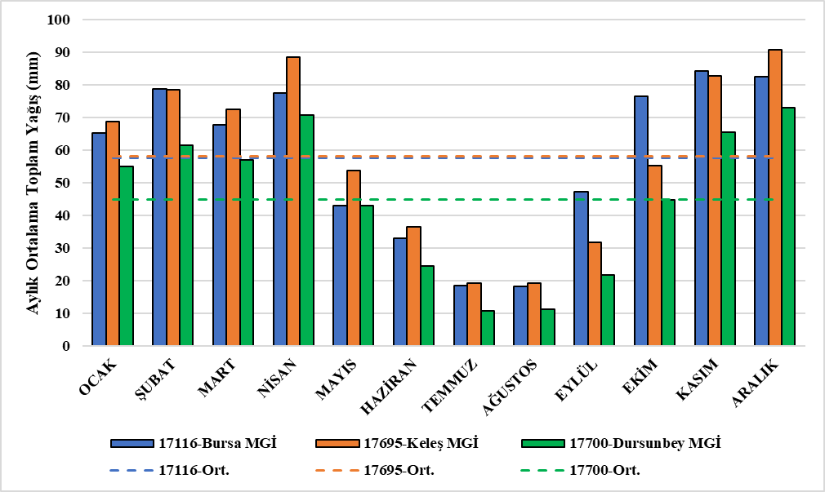
4. Analyses
Modelling
Susurluk Basin
Northwest Türkiye
Streamflow gauges
Precipitation
Streamflow
Temperature
Understanding the Efficiency of NBSs
in Watershed Context

Slide 16
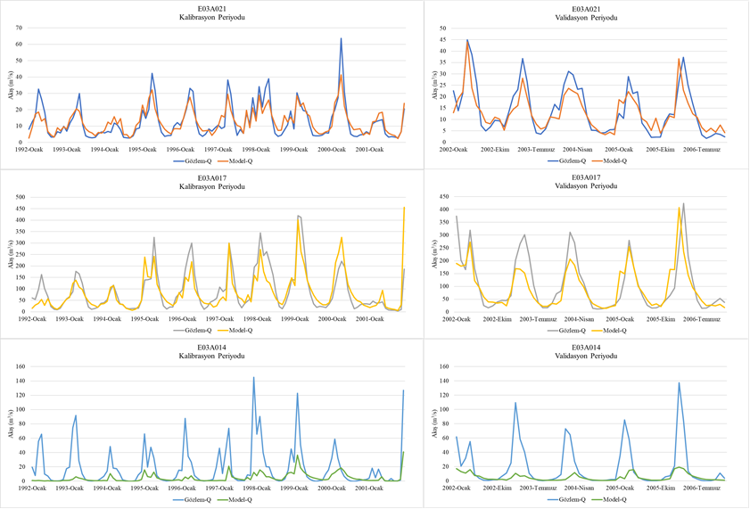
4. Analyses
Modelling
Susurluk Basin
Northwest Türkiye
Model calibration
Understanding the Efficiency of NBSs
in Watershed Context

Slide 17
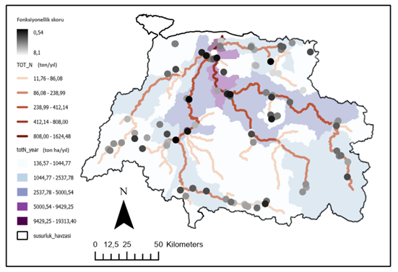
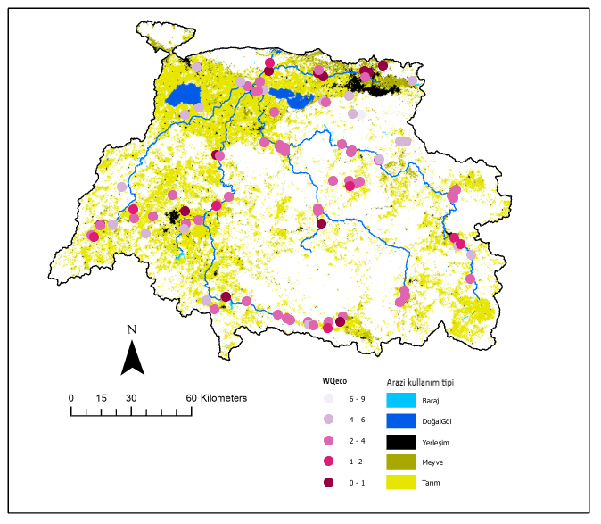
4. Analyses
Modelling
Susurluk Basin
Northwest Türkiye
Combine modelling
And field measurements
Riparian functionality vs Total nitrogen
WQ vs Land use
Understanding the Efficiency of NBSs
in Watershed Context

Slide 18
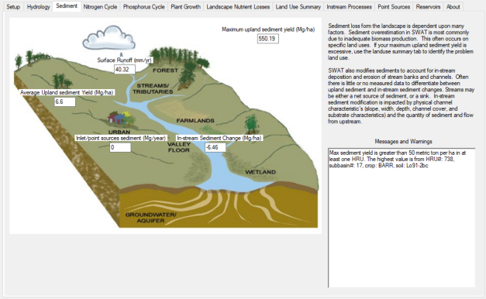
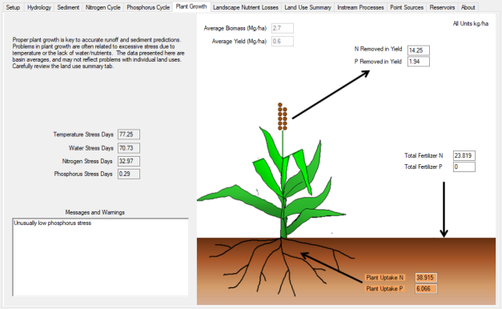
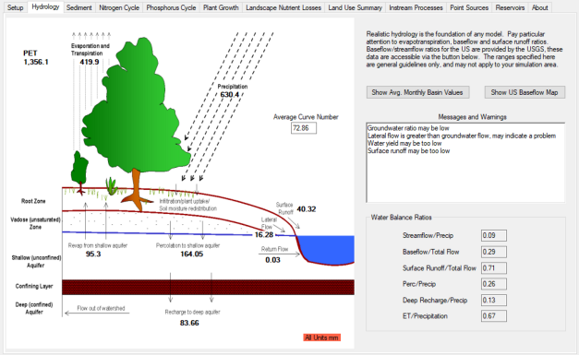
4. Analyses
Modelling
Susurluk Basin
Northwest Türkiye
Combine modelling
And field measurements
Understanding the Efficiency of NBSs
in Watershed Context

Slide 19

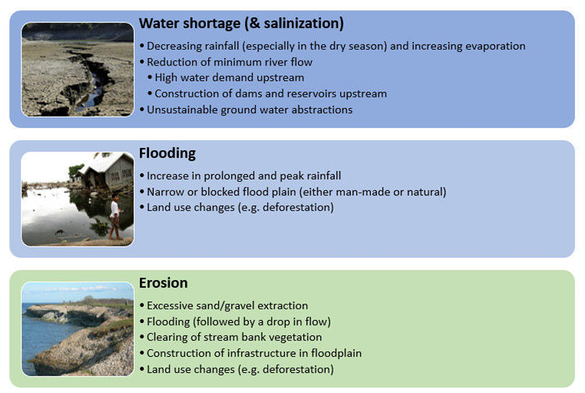
5. Flooding example
Applying Nature-Based Solutions in River Systems
Goals and objectives derived from present strategies and plans set the stage for future projects. In many plans, objectives are focused or prioritize a function, e.g. enhancing flood protection, increasing water supply or provision of energy.
Adequate river management requires a thorough understanding of river dynamics, socio-economic context and the institutional system in the whole river system, including upstream and downstream areas. Better natural system understanding can be acquired by a combination of general system knowledge, field visits, monitoring data and (rapid) modelling exercises.
Understanding the Efficiency of NBSs
in Watershed Context

Slide 20
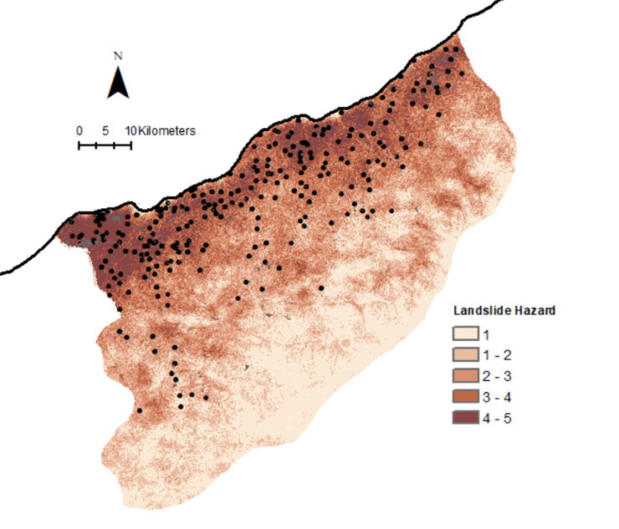
5. Flooding example
Applying Nature-Based Solutions in River Systems
Hotspot areas are identified based on a risk assessment. Risk is typically a combination of hazard (intensity and probability), exposure (people and assets) and vulnerability (susceptibility of assets and people to the hazard).
Landslide risk map for Rize
Understanding the Efficiency of NBSs
in Watershed Context

Slide 21
5. Flooding example
Applying Nature-Based Solutions in River Systems
Hotspot areas are identified based on a risk assessment. Risk is typically a combination of hazard (intensity and probability), exposure (people and assets) and vulnerability (susceptibility of assets and people to the hazard).
Risk matrix for Water Scarcity
Understanding the Efficiency of NBSs
in Watershed Context

Slide 22
5. Flooding example
Applying Nature-Based Solutions in River Systems
Hotspot areas are identified based on a risk assessment. Risk is typically a combination of hazard (intensity and probability), exposure (people and assets) and vulnerability (susceptibility of assets and people to the hazard).
Hazards and data sources to evaluate identified by the EBRD (2020).
Understanding the Efficiency of NBSs
in Watershed Context

Slide 23
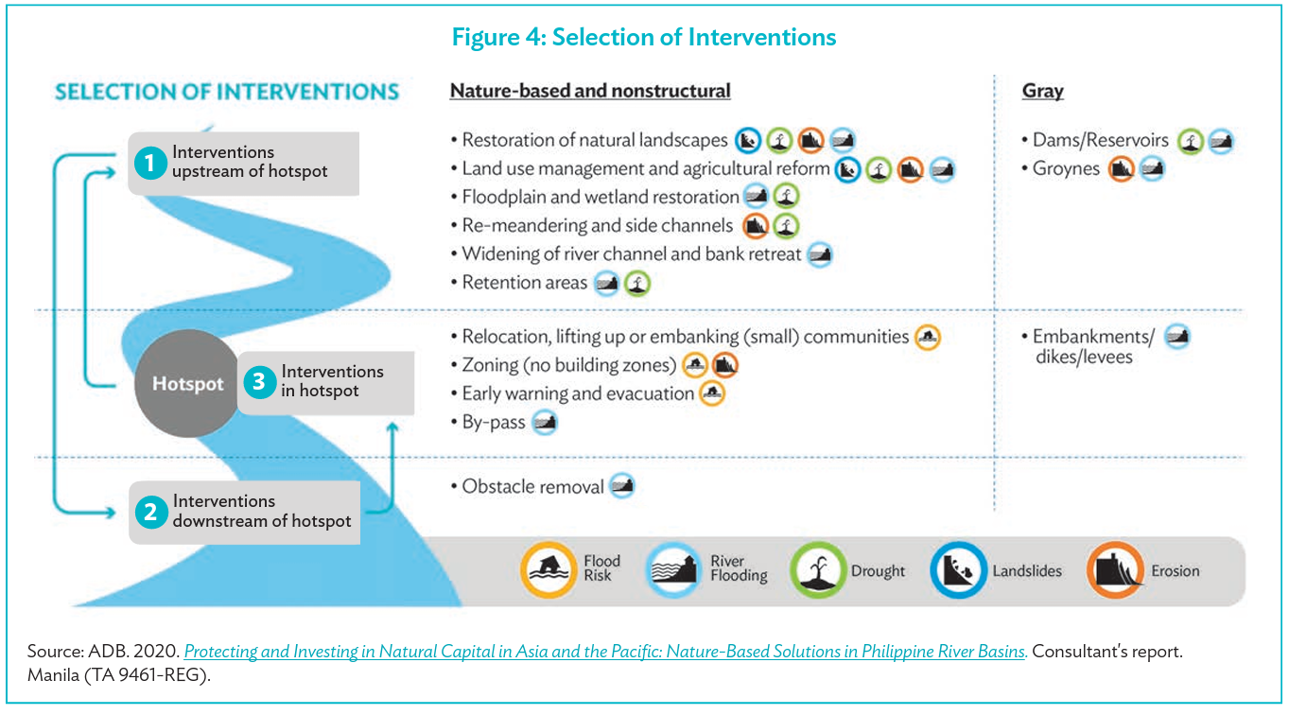
5. Flooding example
Applying Nature-Based Solutions in River Systems
Understanding the Efficiency of NBSs
in Watershed Context

Slide 24
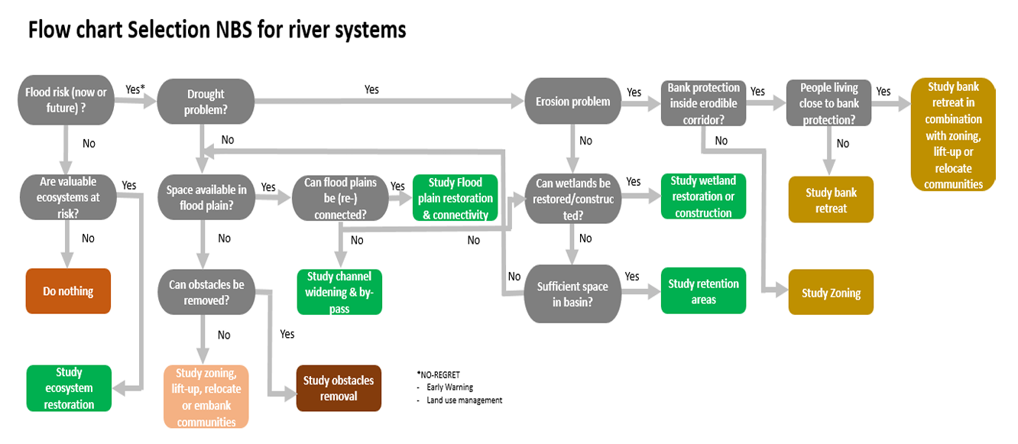
5. Flooding example
Applying Nature-Based Solutions in River Systems
Developing a flow chart may help
Understanding the Efficiency of NBSs
in Watershed Context

Slide 25
5. Efficiency
Lets work on a degraded hilslope
Issues
Erosion - sedimentation
Surface runoff
Soil compaction
Loss of biological diversity
…….
Reasons
Can be overgrazed
Abandoned croplands
Lost soil fertility
Lost organic soil
…….
Understanding the Efficiency of NBSs
in Watershed Context

Slide 26
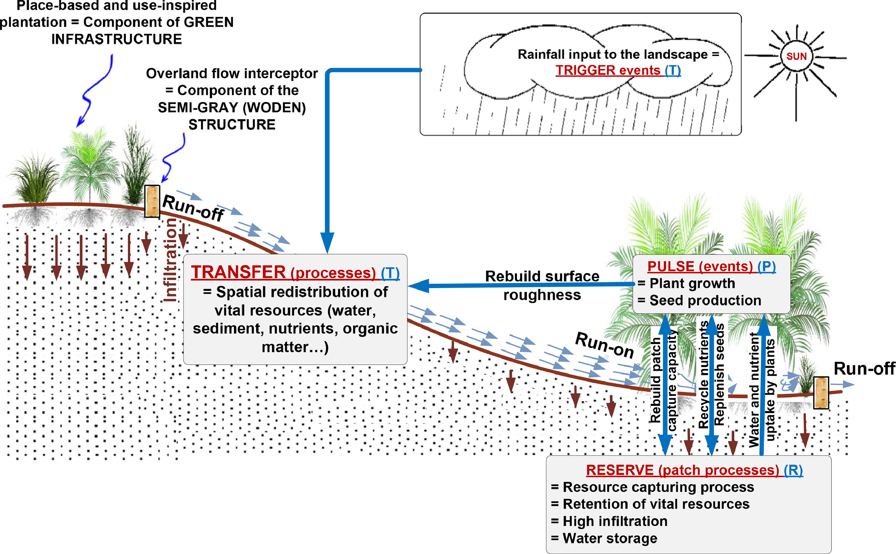
5. Efficiency
The efficiency of the application
Stability
Infiltration
Nutrient cycling
Soil moisture
Biodiversity
Mulugeta Dadi Belete, 2023. Ecohydrological nature-based solution for climate resilience and biodiversity enhancement in water-limited ecosystem: Perspectives and proof of concepts. Ecohydrology & Hydrobiology.
Understanding the Efficiency of NBSs
in Watershed Context

Slide 27
6. Selection
 | Forest Management | Stream Corridor Restoration & Management | Detention Ponds or Pools
Water production (quality, quantity, regime) | √ | √
Flood mitigation | √ | √ | √
Biodiversity conservation | √ | √
Eutrophication and sediment control | √ | √ | √
Carbon sequestration | √ | √
Habitat conservation | √ | √
Surface and channel erosion control | √ | √
Wood and non-wood products | √ | √
Nutrient management | √ | √
Landscape value |  | √
Microclimate regulation | √ | √ | -
Understanding the Efficiency of NBSs
in Watershed Context

Slide 28


Conclusions
NbS are very useful tools. They should be streamlined. Their benefitsand co-benefits should be explained well.
Their efficiency is based on the proper application and a proper application depends on very detailed assessment of the problems and the watershed system.
The solutions vary based on the location in the watershed. Headwater, transition, floodplain etc.
There may be more than 1 solution and a combination of various NbS may be needed.
In most cases, NbSs should be combined with grey solutions.
Be aware that in some cases even the combination of NbSs and the grey solutions will not be enough.

Slide 29



Thank you
Many thanks
for connecting and networking
Yusuf Serengil – Istanbul University Cerrahpaşa

