Slide 1

Restoration and adaptation of the mountain forests of Central and North-East Asia"
Bishkek, Kyrgyzstan, 19 to 22 October 2015
SOME EXAMPLES OF RECENT INTERNATIONAL DEVELOPMENTS ON FORESTRY AND MOUNTAINS
İsmail Belen
President of the Committee of Mediterranean Forestry Questions
(Silva Mediterranea, FAO),
ismailbelen52@gmail.com, Turkey
Notes:
For the last three decades there has been several important developments related to forestry and mountains. The year of 2015 is a kind of milestone. In this paper some examples and regulations have been examined.

Slide 2
1992-2012
1992
Forest Principles, Agenda 21-Combating Deforestation)
2000
Establishment of the United Nations Forum on Forests
2006
Global Objectives on Forests
Agenda 21-Managing Fragile Ecosystems: Sustainable Mountain Development
2007
UN Forest Instrument
2011
the International Year of Forests- International Day of Forest
2012
The Future We Want
2002
International Year of Mountains

Slide 3
2015- A Milestone Year
May-2015
UNFF- "The forests we want: beyond 2015"
Sept-2015
WFC-2050 vision for forests and forestry
Sept-2015
UNGA- Adoption of Post-2015 Sustainable Development Goals
Oct-2015
UNCCD COP12-Turkey
Oct-2015
The 7th FOREST EUROPE-Spain
Now-2015
UNFCCC COP21-France

Slide 4
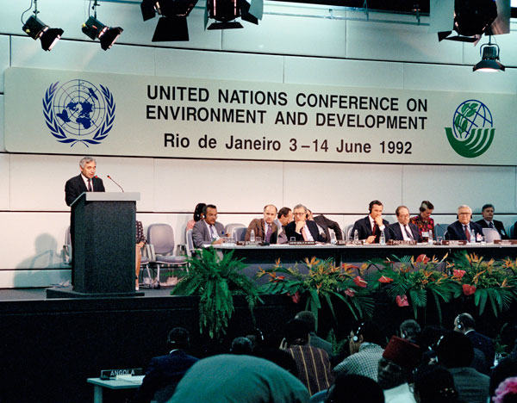
1992
In 1992, the United Nations Conference on Environment and Development, adopted Forest Principles together with Agenda 21, which included a chapter (Chapter 11) on “Combating Deforestation” and Chapter 13 “Managing Fragile Ecosystems: Sustainable Mountain Development”

Slide 5

2000
In 2000, the United Nations Economic and Social Council (ECOSOC) established the United Nations Forum on Forests (UNFF) with the main objective to promote “… the management, conservation and sustainable development of all types of forests and to strengthen long-term political commitment to this end…”

Slide 6

2002
The General Assembly Proclaims the year 2002 as the International Year of Mountains;
Invites the FAOto serve as the lead agency for the International Year of Mountains, in collaboration with Governments, the UNEP, the UNDP, the UNESCO and other relevant organizations.

Slide 7
2006
In 2006, UNFF agreed on four shared Global Objectives on Forests as follows:
Reverse the loss of forest
Enhance forest-based economic, social and environmental benefits;
Increase significantly the area of sustainably managed forests; and
Reverse the decline in official development assistance for SFM and mobilize increased financial resources for implementation of SFM.

Slide 8
2007
In 2007, the Forum adopted the landmark UN Non-Legally Binding Instrument on All Types of Forests (Forest Instrument). The instrument will have a major impact on international cooperation and national action to reduce deforestation, prevent forest degradation, promote sustainable livelihoods and reduce poverty for all forest-dependent peoples.
To strengthen political commitment and action at all levels to implement effectively sustainable management of all types of forests and to achieve the shared global objectives on forests;
To enhance the contribution of forests to the achievement of the internationally agreed development goals, including the Millennium Development Goals, in particular with respect to poverty eradication and environmental sustainability;
To provide a framework for national action and international cooperation

Slide 9


2011
The United Nations General Assembly has proclaimed 2011 as the International Year of Forests and adopted 21 March as International Day of Forest.

Slide 10

2012
In 2012, the Heads of State and Government renewed the commitment to sustainable development and adopted “ the Future we Want”
In this very important political text, “forest and forestry as well as mountains” have been referred many times. It has 283 Paragraphs. Paragraphs 52,111, 114,115, 193,194,195, 210,211,212 are related to forestry and mountains.

Slide 11
2012- The Future we Want
52. We recognize that farmers, including small-scale farmers and fishers, pastoralists and foresters, can make important contributions to sustainable development through production activities that are environmentally sound, enhance food security and the livelihood of the poor, and invigorate production and sustained economic growth.
111. We reaffirm the necessity to promote, enhance and support more sustainable agriculture, including crops, livestock, forestry, fisheries and aquaculture, that improves food security, eradicates hunger, and is economically viable, while conserving land, water, plant and animal genetic resources, biodiversity and ecosystems, and enhancing resilience to climate change and natural disasters. We also recognize the need to maintain natural ecological processes that support food production systems.
114. We resolve to take action to enhance agricultural research, extension services, training and education to improve agricultural productivity and sustainability through the voluntary sharing of knowledge and good practices. We further resolve to improve access to information, technical knowledge and know-how, including through new information and communication technologies that empower farmers, fishers and foresters to choose among diverse methods of achieving sustainable agricultural production. We call for the strengthening of international cooperation on agricultural research for development.
115. We reaffirm the important work and inclusive nature of the Committee on World Food Security (CFS), including through its role in facilitating country-initiated assessments on sustainable food production and food security, and we encourage countries to give due consideration to implementing the CFS Voluntary Guidelines on the Responsible Governance of Tenure of Land, Fisheries and Forests in the Context of National Food Security. We take note of the on-going discussions on responsible agricultural investment in the framework of the CFS, as well as the Principles for Responsible Agricultural Investment (PRAI).

Slide 12
2012- The Future we Want- Forests
193. We highlight the social, economic and environmental benefits of forests to people and the contributions of sustainable forest management to the themes and objective of the Conference. We support cross-sectoral and cross-institutional policies promoting sustainable forest management. We reaffirm that the wide range of products and services that forests provide creates opportunities to address many of the most pressing sustainable development challenges. We call for enhanced efforts to achieve the sustainable management of forests, reforestation, restoration and afforestation, and we support all efforts that effectively slow, halt and reverse deforestation and forest degradation, including inter alia promoting trade in legally-harvested forest products. We note the importance of ongoing initiatives such as reducing emissions from deforestation and forest degradation in developing countries; and the role of conservation, sustainable management of forests and enhancement of forest carbon stocks in developing countries. We call for increased efforts to strengthen forest governance frameworks and means of implementation, in accordance with Non-Legally Binding Instrument on All Types of Forests (NLBI) to achieve sustainable forest management. To this end, we commit to improving the livelihoods of people and communities by creating the conditions needed for them to sustainably manage forests including through strengthening cooperation arrangements in the areas of finance, trade, transfer of environmentally sound technologies, capacity-building and governance, as well as by promoting secure land tenure, particularly decision-making and benefit sharing, in accordance with national legislation and priorities.
194. We call for urgent implementation of the Non-legally Binding Instrument on all Types of Forests and the Ministerial Declaration of the high-level segment of the ninth session of the United Nations Forum on Forests on the occasion of the launch of the International Year of Forests.
195. We recognize that the United Nations Forum on Forests, with its universal membership and comprehensive mandate, plays a vital role in addressing forest-related issues in a holistic and integrated manner, and promoting international policy coordination and cooperation to achieve sustainable forest management. We invite the Collaborative Partnership on Forests to continue its support to the Forum and encourage stakeholders to remain actively engaged in the work of the Forum. 196. We stress the importance of integrating sustainable forest management objectives and practices into the mainstream of economic policy and decision-making, and to that end we commit to working through the governing bodies of member organizations of the Collaborative Partnership on Forests to integrate, as appropriate, the sustainable management of all types of forests into their strategies and programmes.

Slide 13
2012- The Future we Want-Mountains
210. We recognize that the benefits derived from mountain regions are essential for sustainable development. Mountain ecosystems play a crucial role in providing water resources to a large portion of the world’s population; fragile mountain ecosystems are particularly vulnerable to the adverse impacts of climate change, deforestation and forest degradation, land use change, land degradation, and natural disasters; and mountain glaciers around the world are retreating and getting thinner with increasing impacts on the environment and human well-being.
211. We further recognize that mountains are often home to communities, including indigenous peoples and local communities, who have developed sustainable uses of mountain resources. They are, however, often marginalized, and we therefore stress that continued effort will be required to address poverty, food security and nutrition, social exclusion and environmental degradation in these areas. We invite States to strengthen cooperative action with effective involvement and sharing of experience of all relevant stakeholders, by strengthening existing arrangements, agreements, and centers of excellence for sustainable mountain development, as well as exploring new arrangements and agreements, as appropriate.
212. We call for greater efforts toward the conservation of mountain ecosystems, including their biodiversity. We encourage States to adopt a long-term vision and holistic approaches, including through incorporating mountain-specific policies into national sustainable development strategies which could include, inter alia, poverty reduction plans and programmes in mountain areas, particularly in developing countries. In this regard, we call for international support for sustainable mountain development in developing countries

Slide 14
May-2015-The Forest we Want
The latest session of UNFF held in New York (2015) and adopted Resolution on the International Arrangement on Forests and Ministerial Declaration "The forests we want: beyond 2015"
Some items of this Ministerial Declaration as follows:
Over 1.6 billion people depend on forests for subsistence, livelihoods, employment and income generation.
Forests and sustainable forest management provide multiple benefits for the lives and well-being of people across the planet, recognizing the importance of living well in harmony with nature;
The sustainable management of all types of forests is vital to facilitate transformative change and address major challenges, such as poverty eradication, economic growth and sustainable livelihoods, food security and nutrition, gender equality, cultural and spiritual values, health, water, energy production, climate change mitigation and adaptation, combating desertification, reduction of dust and sand storms, biodiversity conservation, sustainable soil and land management, watershed protection and disaster risk reduction;

Slide 15

Sept-2015 (2050 vision for forests and forestry)
The first World Forestry Congress was held in Rome in 1926 and has generally taken place every six years since then. The Eleventh World Forestry Congress was held in Antalya, Turkey from 13 to 22 October, 1997.
This year, nearly 4000 participants from 138 countries came together.
Three important political documents adopted during this conference as follows:
The Durban Declaration-2050 vision for forests and forestry
Message on Climate Change
Message to the UNGA Summit for the adoption of the 2030 Agenda for Sustainable Development

Slide 16
2015-Durban Declaration
Forests are more than trees and are fundamental for food security and improved livelihoods. The forests of the future will increase the resilience of communities by: providing food, wood energy, shelter, fodder and fibre; generating income and employment to allow communities and societies to prosper; and harbouring biodiversity. They will support sustainable agriculture and human wellbeing by stabilizing soils and climate and regulating water flows.
Integrated approaches to land use provide a way forward for improving policies and practices to: address the drivers of deforestation; address conflicts over land use; capitalize on the full range of economic, social and environmental benefits of integrating forests with agriculture; and maintain multiple forest services in the landscape context.
Forests are an essential solution to climate change adaptation and mitigation. Sustainably managed forests will increase the resilience of ecosystems and societies and optimize the role of forests and trees in absorbing and storing carbon while also providing other environmental services.

Slide 17
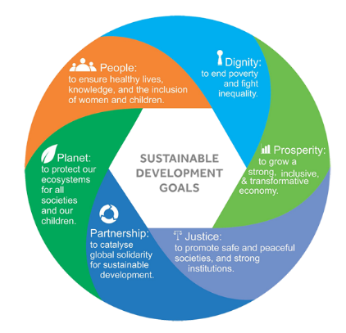
Sept-2015- Sustainable Development Goals
United Nations General Assembly adopted the “Sustainable Developments Goals”. There are 17 Sustainable Developments Goals and 169 targets under this titles.
Number 15 is truly related to forestry, land degradation, mountains, biodiversity. Number 6 has targets on water-related ecosystems, including mountains, forests, wetlands, rivers, aquifers and lakes

Slide 18


Slide 19
2015- Sustainable Development Goals
Goal 1. End poverty in all its forms everywhere
Goal 2. End hunger, achieve food security and improved nutrition and promote sustainable agriculture
Goal 3. Ensure healthy lives and promote well-being for all at all ages
Goal 4. Ensure inclusive and equitable quality education and promote lifelong learning opportunities for all
Goal 5. Achieve gender equality and empower all women and girls
Goal 6. Ensure availability and sustainable management of water and sanitation for all
Goal 7. Ensure access to affordable, reliable, sustainable and modern energy for all
Goal 8. Promote sustained, inclusive and sustainable economic growth, full and productive employment and decent work for all
Goal 9. Build resilient infrastructure, promote inclusive and sustainable industrialization and foster innovation
Goal 10. Reduce inequality within and among countries
Goal 11. Make cities and human settlements inclusive, safe, resilient and sustainable
Goal 12. Ensure sustainable consumption and production patterns
Goal 13. Take urgent action to combat climate change and its impacts*
Goal 14. Conserve and sustainably use the oceans, seas and marine resources for sustainable development
Goal 15. Protect, restore and promote sustainable use of terrestrial ecosystems, sustainably manage forests, combat desertification, and halt and reverse land degradation and halt biodiversity loss
Goal 16. Promote peaceful and inclusive societies for sustainable development, provide access to justice for all and build effective, accountable and inclusive institutions at all levels
Goal 17. Strengthen the means of implementation and revitalize the Global Partnership for Sustainable Development

Slide 20
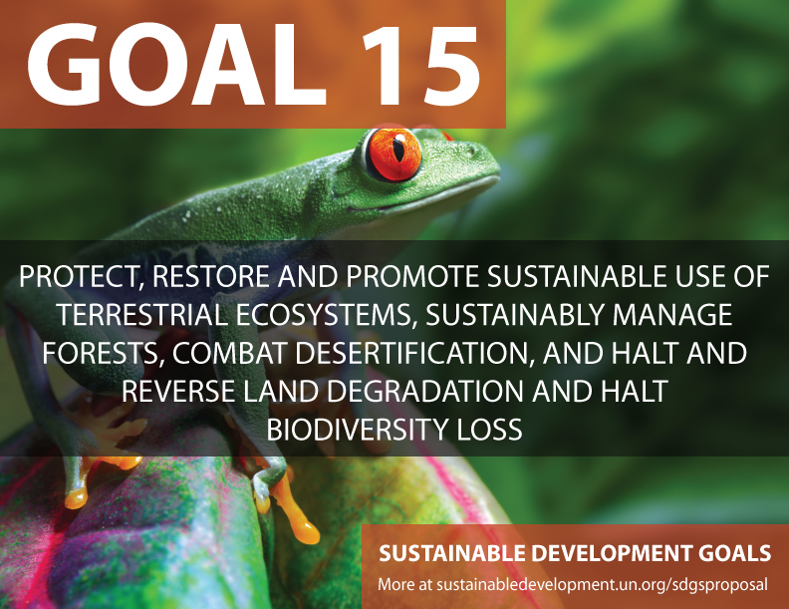

Slide 21
Goal 15
15.1 By 2020, ensure the conservation, restoration and sustainable use of terrestrial and inland freshwater ecosystems and their services, in particular forests, wetlands, mountains and drylands, in line with obligations under international agreements
15.2 By 2020, promote the implementation of sustainable management of all types of forests, halt deforestation, restore degraded forests and substantially increase afforestation and reforestation globally
15.3 By 2030, combat desertification, restore degraded land and soil, including land affected by desertification, drought and floods, and strive to achieve a land degradation-neutral world
15.4 By 2030, ensure the conservation of mountain ecosystems, including their biodiversity, in order to enhance their capacity to provide benefits that are essential for sustainable development
15.5 Take urgent and significant action to reduce the degradation of natural habitats, halt the loss of biodiversity and, by 2020, protect and prevent the extinction of threatened species
15.6 Promote fair and equitable sharing of the benefits arising from the utilization of genetic resources and promote appropriate access to such resources, as internationally agreed

Slide 22
Goal 15
15.7 Take urgent action to end poaching and trafficking of protected species of flora and fauna and address both demand and supply of illegal wildlife products
15.8 By 2020, introduce measures to prevent the introduction and significantly reduce the impact of invasive alien species on land and water ecosystems and control or eradicate the priority species
15.9 By 2020, integrate ecosystem and biodiversity values into national and local planning, development processes, poverty reduction strategies and accounts
15.A Mobilize and significantly increase financial resources from all sources to conserve and sustainably use biodiversity and ecosystems
15.B Mobilize significant resources from all sources and at all levels to finance sustainable forest management and provide adequate incentives to developing countries to advance such management, including for conservation and reforestation
15.C Enhance global support for efforts to combat poaching and trafficking of protected species, including by increasing the capacity of local communities to pursue sustainable livelihood opportunities

Slide 23
Goal 6. Ensure availability and sustainable management of water and sanitation for all
6.1 By 2030, achieve universal and equitable access to safe and affordable drinking water for all
6.2 By 2030, achieve access to adequate and equitable sanitation and hygiene for all and end open defecation, paying special attention to the needs of women and girls and those in vulnerable situations
6.3 By 2030, improve water quality by reducing pollution, eliminating dumping and minimizing release of hazardous chemicals and materials, halving the proportion of untreated wastewater and substantially increasing recycling and safe reuse globally
6.4 By 2030, substantially increase water-use efficiency across all sectors and ensure sustainable withdrawals and supply of freshwater to address water scarcity and substantially reduce the number of people suffering from water scarcity
6.5 By 2030, implement integrated water resources management at all levels, including through transboundary cooperation as appropriate
6.6 By 2020, protect and restore water-related ecosystems, including mountains, forests, wetlands, rivers, aquifers and lakes

Slide 24

Oct-2015-
UNCCD COP12-
Turkey, 12-23 October 2015
The Conference of the Parties seems to adopt this following Decision on Land Degradation Neutrality. It says;
Welcoming the United Nations General Assembly adoption of the outcome document Transforming our world: the 2030 Agenda for Sustainable Development, which includes Sustainable Development Goal (SDG) 15: “Protect, restore and promote sustainable use of terrestrial ecosystems, sustainably manage forests, combat desertification, and halt and reverse land degradation and halt biodiversity loss”; and target 15.3: “By 2030, combat desertification, restore degraded land and soil, including land affected by desertification, drought and floods, and strive to achieve a land-degradation-neutral world”,
Endorses the following definition of land degradation neutrality (LDN): “Land degradation neutrality [in affected areas] [in arid, semi-arid and dry sub-humid areas] is a state whereby the amount and quality of land resources necessary to support ecosystem functions and services and enhance food security remain stable or increase within specified temporal and spatial scales and ecosystems”

Slide 25

Oct-2015 Forest Europe
The 7th FOREST EUROPE Ministerial Conference will be held on 20-21 October 2015.
It is expected to adopt these following declarations, resolutions and decisions.
Madrid Ministerial Declaration: 25 years together promoting Sustainable Forest Management in Europe
Madrid Ministerial Resolution 1: Forest sector in the center of Green Economy
  WELCOMING the global and regional on-going work on green economy and social issues, such as the Rio+20 and post-2015 development agenda including the development of the Sustainable Development Goals, the Decent Work Agenda of the International Labor Organization and the Rovaniemi Action Plan for the Forest Sector in a Green Economy and TAKING NOTE of the outcomes of the World Forestry Congress "Forests and People: Investing in a Sustainable Future
Madrid Ministerial Resolution 2: Protection of forests in a changing environment
Madrid Ministerial Decision: The future direction of FOREST EUROPE

Slide 26

Dec-2015
The twenty-first session of the Conference of the Parties (COP) and the eleventh session of the Conference of the Parties serving as the meeting of the Parties to the Kyoto Protocol (CMP) will take place from 30 November to 11 December 2015, in Paris, France.

Slide 27
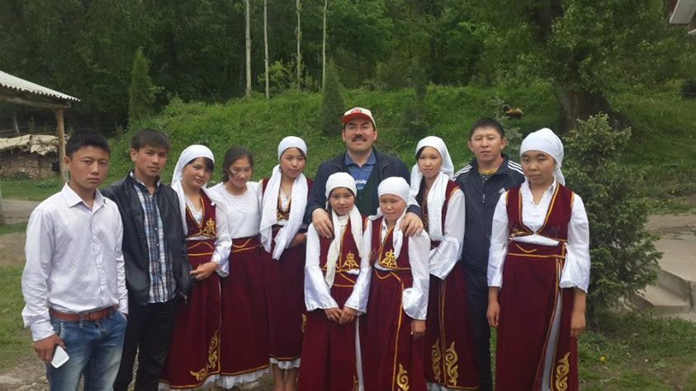
Telman Village May 2014
рахмат

