Slide 1


Chamber of Forest Engineers of Turkey
April 2019

Slide 2
The Chamber of Forest Engineer of Turkey (OMO)
Chamber of Forest Engineers is one of the non-governmental organization recognized by the Constitution of the Republic of Turkey.
According to the Turkish Constitution it has “public corporate entity” and “public institute nature”. Currently it has approximately 17 thousand (17 000) active members.
OMO is an organization with a legal personality affiliated to the UNION OF CHAMBERS OF TURKISH ENGINEERS AND ARCHITECTS. It has its own code approved by the Grand National Assembly of Turkey
the Chamber has ordinary functions on forestry and foresters’ matters over the country such as:
  contribution to preparation/improvement of forestry related policy, strategy, laws, regulations, norms and standards,
  Protect and improvement of the rights, authorities and responsibilities of forest engineers,
  Preparation and dissemination of forestry related documents, reports, books, visual promotion materials (e.g. quarterly journal of Forest Engineering)

Slide 3
Date of Estab. | 4 February 1954
Date of Register | 4 February 1954
Place of Register | The Official Gazette of Turkey
Institution Nature | OMO, a non-profit NGO, was established within the framework of ” 6235 Numbered Turkish Engineer and Architect Chambers Union Law” published at Turkey’s Official Gazette dated 4 February 1954. According to Turkish Legislation this date is the establishment and registry date of OMO. OMO has also “Main Regulation” beside the Law which was also published at Turkey’s Official Gazette. The Main Regulation establishes the structure, working principles and procedures of OMO. Since the OMO was established by law, there is no separate declaration of establishment or charter. This “Main Regulation” replaces “Charter of OMO”
Post Address | Beştepeler Mah. 31.Sk. No:3 Beştepe Yenimahalle –Postal Code: 06560 Ankara TURKEY
Web Page | https://ormuh.org.tr/
Email | ormuh@ormuh.org.tr
Phone | +90 312 215 00 33
For contact | İsmail BELEN- Foreign Relations Adviser Mail: ismailbelen52@gmail.com

Slide 4
Members of OMO
Beside the Foundation Law, there is another Law No. 5531 entitled “The Law on Forest Engineers, Forest Industrial Engineers and Woodworking Industrial Engineers.” dated July 8, 2006 has been published in Turkish Official Gazette.
According to this Law Numbered 5531, OMO is the legal representative of three different professional groups as follows:
  Forest Engineers,
  Forest Industrial Engineers,
  and Woodworking Industrial Engineers.
Currently OMO has about 17 thousand active members. A large number of its members work in forestry related departments of the Ministry of Agriculture and Forestry.
These Institutes are as follows;
  a) General Directorate of Forests,
  b) General Directorate of Nature Conservation and National Parks,
  c) General Directorate of Combating Desertification and Erosion.
In addition, there are members working in public institutions such as General Directorate of State Hydraulic Works and General Directorate of Highways.
On the other hand, there are members working in their own workplace and working in private sector companies. There are 800 offices and companies registered to OMO and continuing their business life.

Slide 5
Management of OMO
The main management mechanism of the Chamber of Forest Engineers is "General Assembly" held every two years.
The executive body is the "Board of Directors". The last General Assembly was held in April 2018 and the Board of Directors Chaired by Hasan Türkyılmaz was elected.
The Headquarter of OMO is in Ankara, which is the capital city of Turkey as well. In addition to headquarters (Center) of OMO, there are several "branches" located in different places of Turkey.
These branches are established or removed by the OMO General Assembly according to regional situations and the number of members. The management of each branch is determined by its members in a completely democratic election. As of 2019, OMO has branches as follows: https://www.ormuh.org.tr/subeler Ankara,Istanbul, East Black Sea- Trabzon, Izmir, West Mediterranean-Antalya, East Mediterranean, Elaziğ, West Black Sea, Bursa, Denizli, Amasya, Erzurum, Sakarya
In addition to the branches, there are OMO representatives in the relevant Faculties, regions and provinces. These representatives are assigned by the OMO Board of Directors.

Slide 6
Budget and National Cooperation
OMO meets all expenses with its own means. The main source of income is the membership fees. All members must pay the membership fee.
OMO has its own web page https://www.ormuh.org.tr/ and periodicals. https://www.ormuh.org.tr/post/yeni-dergimiz-cikti
OMO has close cooperation with the State Institutions including the General Directorate of Forests. The Director General of Forest, himself is a member of OMO as well as all deputies, heads of departments, all regional workers.
In Turkey OMO organise several meetings, conferences and training programmes. It has its own building in Ankara with branches offices in overall of Turkey.

Slide 7
International Cooperation
In addition to the activities in Turkey, OMO, is working actively in the international arena. According to its legislation, OMO is authorized to cooperate internationally, to carry out projects and to establish partnerships.
It has close cooperation with United Nations agencies including FAO.
In 2018, OMO was the chair of the Council of European Foresters. OMO Participates in "Forest Europe" meetings. It’s is an active member of the Union of European Foresters (http://european-foresters.eu/meetings/gcm/74,6)
It is also an accredited Non-Governmental Organisation to the United Nations Convention to Combat Desertification. (UNCCD) https://knowledge.unccd.int/cso/turkish-chamber-forest-engineers
It is also a member of International Union for Conservation of Nature-IUCN

Slide 8







OMO's international memberships and collaborations

Slide 9
The Last International Symposium- 2/5 December 2019
The Chamber of Forest Engineers has been organizing the “Nature and Forestry Symposium Towards 2023”’for many years. The fourth of which was organized on 3-6 December 2017 in Antalya.
As the continuation of this tradition, the fifth edition was held on 2-5 December 2018 in Antalya/Turkey.
The theme of the symposium was decided to be-“ The Role of “Public-Civil Society-Private Sector Cooperation and International Partnerships” in Achieving Sustainable Development Goals and Global Forest Goals”

Slide 10
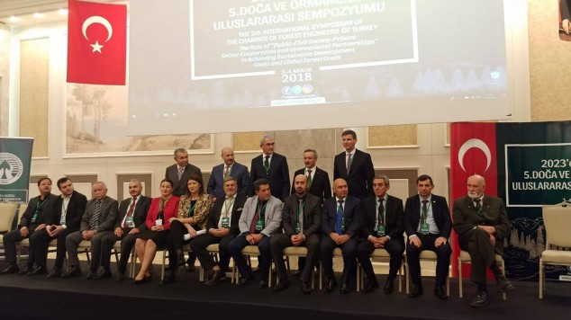
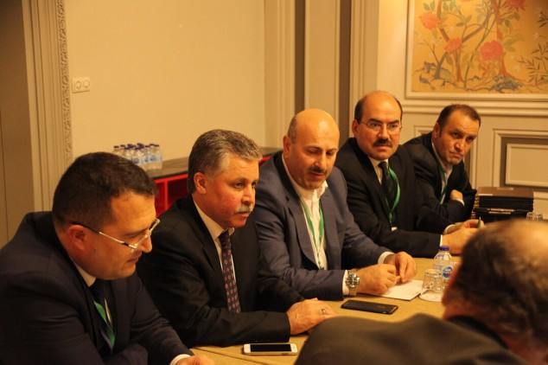
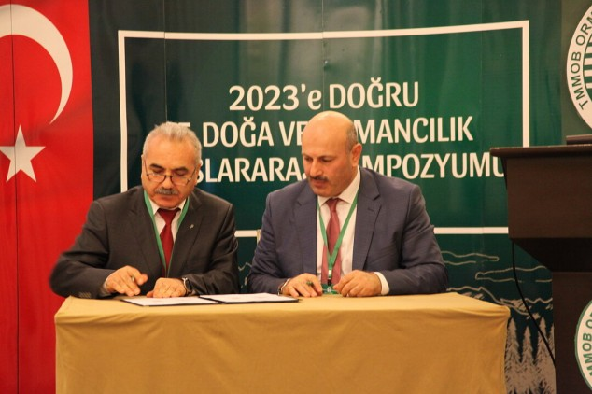
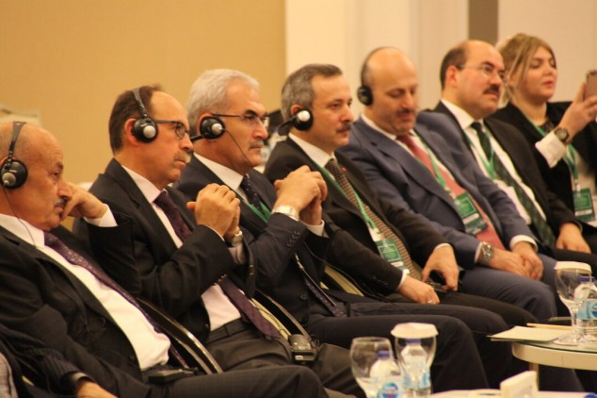

Slide 11
Signing Ceremony of «Declaration of Intention» with NGOs
After the opening speeches, cooperation protocols were signed between NGOs. These protocols are generally signed in the following content.

Slide 12
Preamble, Purpose and Scope
Preamble:
  Forests, which are the common assets of the whole world, are vital for many issues such as the well-being and happiness of humanity, conservation of biodiversity, adaptation to climate change, energy, and water and food security.
  Forests are one of the key sectors in achieving the “2030 Sustainable Development Goals” adopted by the United Nations General Assembly in 2015.
  “The United Nations Strategic Plan for Forests 2017-2030 (UNSPF)” and “The Six Global Forest Goals and 26 Associated Targets ” adopted in 2017 have set a global road map for forests and forestry in achieving sustainable development goals.
  Achieving these goals requires a common understanding and cooperation at national and international level between all sectors, including the public, private sector, academic circles and non-governmental organizations.
  In this context, Chamber of Forest Engineers of Turkey and the ……. (hereinafter referred to as Parties) have signed this Declaration of Intention to cooperate with the principles and procedures set out below.
Purpose: The purpose of this Declaration of Intention is to determine the principles and procedures of co-operation.
Scope:This “Declaration of Intention” encompasses the matters contained in this text. Additional agreements may be made if the Parties agreed upon them.

Slide 13
Issues to be cooperated
Article 3: Issues to be cooperated
The Parties have agreed to cooperate on the following issues.
Transforming our world: the 2030 Agenda for Sustainable Development
“The United Nations Strategic Plan for Forests 2017-2030 (UNSPF)” and “The Six Global Forest Goals”
EU Forest Strategy, Ministerial Commitments of Forest Europe
Sustainable land management
Sustainable forest management
Coordinating activities to increase cooperation between members of the Parties such as student exchange, internship support and job search support,
Other issues agreed by the Parties

Slide 14
Ways of Cooperation
Article 4: The Parties may cooperate with one or more of the forms listed below.
To organize events such as joint meetings, workshops, conferences, symposia etc.
To participate in activities organized by one of the Parties and to represent each other upon request,
To prepare projects jointly or separately, to be a partner in projects prepared by one of the Parties,
To submit project proposal jointly to international and regional institutions and organisations such European Commission, the World Bank, the Global Environment Agency (GEF), the European Environment Agency etc..
To submit project proposal to national agencies of any countries.
To prepare publication , report and working document in digital media and other platforms together,
To establish international platforms, to join the existing ones.
To cooperate with any method not to be written here, to be agreed by the Parties.

Slide 15
Responsibilities of the Parties
Article 5:
This Declaration of Intention was prepared and signed within the framework of mutual goodwill. It does not bring any legal or economic responsibility to any of the Parties. Each party is liable to comply with its national legislation and responsibilities.
The Parties undertake the necessary efforts in the framework of the principles of mutual goodwill in order to announce this cooperation and to ensure its continuity.

Slide 16
No | Country | Name of the NGO | Web Page
1 | Albania | ALBAFOREST CENTER Arnavutluk-Alba Forest | www.albaforest.com
2 | Azerbaijan | Natural Wealth and Ecology Workers Trade Union Republic Committee Azerbaycan-English Azerbaycan-Türkçe Azerbaycan-копия | http://ahik.org
3 | Federation of Bosnia and Herzegovina | The Association of Hunting Organizations in Bosnia and Herzegovina Bosnia-Avcılar | http://www.slobih.ba/
4 | Federation of Bosnia and Herzegovina | The Independent Trade Union of Forestry, Wood Processing and Paper of Bosnia and Herzegovina- | http://ssspdp.ba/

Slide 17
5 | Federation of Bosnia and Herzegovina | Forestry Association of Federation of Bosnia and Herzegovina | http://usitfbih.ba/
6 | Federation of Bosnia and Herzegovina | Beekeepers Union of Sarajevo Bosnia-Beekepers
7 | France | The International Association for Mediterranean Forests (AIFM) | http://aifm.org/en
8 | Kyrgyzstan | KYRGYZ ASSOCIATION OF FOREST AND LAND USERS Kırgızistan-Kyrgyz-Kaflu MoU | http://www.landuse-association.kg/
9 | Hungary | The Trade Union of Forestry and Wood Industry Workers | http://efdsz.hu/
10 | Romania | SILVA TRADE UNION FEDERATION Romanya-Federatia Silva | https://federatiasilva.ro/

Slide 18
11 | Romania | The “Forest Progress” Society Romania-Progresul Silvic | http://progresulsilvic.ro/
12 | Turkey | Association of Forestry Faculties ORFAMDER-3 Aralık 2018 | http://www.orfamder.org/
13 | Turkey | ÖZ ORMAN-İŞ TRADE UNION OF FOREST, AGRICULTURE, HUNTING AND FISHERY of the Republic of Turkey OMO-_z Orman __ 3 Aralık 2018 | http://www.ozorman-is.org.tr
14 | Turkey | TOÇ BİR-SEN | Trade Union of Agriculture and Forest Civil Servants Association | https://www.tocbirsen.org.tr/

Slide 19
Business plan for the future
With its strong technical and financial structure, the Chamber of Forest Engineers is ready for any national and international cooperation.
On March 11, 2019, it signed a cooperation agreement with FAO and started training with Kyrgyz foresters with the framework of FAO/GEF Founded Project.

Slide 20
THANK YOU
Teşekkür ederim
شكرا
Merci

