Slide 1

Chamber of Forest Engineers of Turkey
June 2019

Slide 2
The Chamber of Forest Engineer of Turkey (OMO)
Chamber of Forest Engineers (OMO) is one of the non-governmental organization established with Turkish Regulations.
Beside being an NGO, OMO has “public corporate entity” and “public institute nature” according to the Turkish Constitution . Currently it has approximately 17 thousand (17 000) active members.
OMO is an organization with a legal personality affiliated to the UNION OF CHAMBERS OF TURKISH ENGINEERS AND ARCHITECTS. It has its own code approved by the Grand National Assembly of Turkey
the Chamber has ordinary functions on forestry and foresters’ matters over the country such as:
  contribution to preparation/improvement of forestry related policy, strategy, laws, regulations, norms and standards,
  Protect and improvement of the rights, authorities and responsibilities of forest engineers,
  Preparation and dissemination of forestry related documents, reports, books, visual promotion materials (e.g. quarterly journal of Forest Engineering)

Slide 3
Date of Estab. | 4 February 1954
Date of Register | 4 February 1954
Place of Register | The Official Gazette of Turkey
Institution Nature | OMO, a non-profit NGO, was established within the framework of ” 6235 Numbered Turkish Engineer and Architect Chambers Union Law” published at Turkey’s Official Gazette dated 4 February 1954. According to Turkish Legislation this date is the establishment and registry date of OMO. OMO has also “Main Regulation” beside the Law which was also published at Turkey’s Official Gazette. The Main Regulation establishes the structure, working principles and procedures of OMO. Since the OMO was established by law, there is no separate declaration of establishment or charter. This “Main Regulation” replaces “Charter of OMO”
Post Address | Beştepeler Mah. 31.Sk. No:3 Beştepe Yenimahalle –Postal Code: 06560 Ankara TURKEY
Web Page | https://ormuh.org.tr/
Email | ormuh@ormuh.org.tr
Phone | +90 312 215 00 33
For contact | İsmail BELEN- Foreign Relations Adviser Mail: ismailbelen52@gmail.com

Slide 4
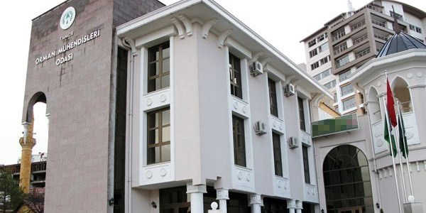
The Headquarter of the Chamber of Forest Engineer
Ankara/Turket

Slide 5
Members of OMO
Beside the Foundation Law, there is another Law No. 5531 entitled “The Law on Forest Engineers, Forest Industrial Engineers and Woodworking Industrial Engineers.” dated July 8, 2006 has been published in Turkish Official Gazette.
According to this Law Numbered 5531, OMO is the legal representative of three different professional groups as follows:
  Forest Engineers,
  Forest Industrial Engineers,
  and Woodworking Industrial Engineers.
A large number of its members work in forestry related departments of the Ministry of Agriculture and Forestry.
These Institutes are as follows;
  a) General Directorate of Forests,
  b) General Directorate of Nature Conservation and National Parks,
  c) General Directorate of Combating Desertification and Erosion.
In addition, there are members working in public institutions such as General Directorate of State Hydraulic Works and General Directorate of Highways.
On the other hand, there are members working in their own workplace and working in private sector companies. There are 800 offices and companies registered to OMO and continuing their business life.

Slide 6
Management of OMO
The main management mechanism of the Chamber of Forest Engineers is "General Assembly" held every two years.
The executive body is the "Board of Directors". The last General Assembly was held in April 2018 and the Board of Directors Chaired by Hasan Türkyılmaz was elected.
The Headquarter of OMO is in Ankara, which is the capital city of Turkey as well. In addition to headquarters (Center) of OMO, there are 13 "branches" located in different places of Turkey. https://www.ormuh.org.tr/subeler
These branches are established or removed by the OMO General Assembly according to regional situations and the number of members.
The management of each branch is determined by its members in a completely democratic election.
In addition to the branches, there are OMO representatives in the relevant Faculties, regions and provinces. These representatives are assigned by the OMO Board of Directors.

Slide 7
Budget and National Cooperation
OMO meets all expenses with its own means. The main source of income is the membership fees. All members must pay the membership fee.
OMO has its own web page https://www.ormuh.org.tr/ and periodicals. https://www.ormuh.org.tr/post/yeni-dergimiz-cikti
OMO has close cooperation with the State Institutions including the Ministry of Agriculture and Forest.
The Director General of Forest, the Director General of Nature Protection and National Parks as well as the Director General of Combating Desertification are member of OMO.
In Turkey OMO organize several meetings, conferences and training programmes.

Slide 8
International Cooperation
In addition to the activities in Turkey, OMO, is working actively in the international arena. According to its legislation, OMO is authorized to cooperate internationally, to carry out projects and to establish partnerships.
It has close cooperation with United Nations agencies including FAO.
In 2018, OMO was the chair of the Council of European Foresters. OMO Participates in "Forest Europe" meetings. It’s is an active member of the Union of European Foresters (http://european-foresters.eu/meetings/gcm/74,6)
It is also an accredited Non-Governmental Organisation to the United Nations Convention to Combat Desertification. (UNCCD) https://knowledge.unccd.int/cso/turkish-chamber-forest-engineers
It has applied to be a member of International Union for Conservation of Nature-IUCN

Slide 9







OMO's international memberships and collaborations

Slide 10
Cooperation with FAO
OMO signed a Letter of Agreement with FAO at 11 March 2019.
Under this Agreement, as Service Provider, OMO undertook two training activities in March and April for Kyrgyz participants
  Nursery Plant and Management, Sapling Production with Closed Root System and Afforestation Techniques.
  Provision with Training of Forest Pests and Diseases.
The last training program on “Forest Fire preparation, early warning, fire fighting, post-fire rehabilitation, computer-based fire management system” is going to be undertake 17-26 June 2019 at Antalya Forestry Training and Simulation Center

Slide 11
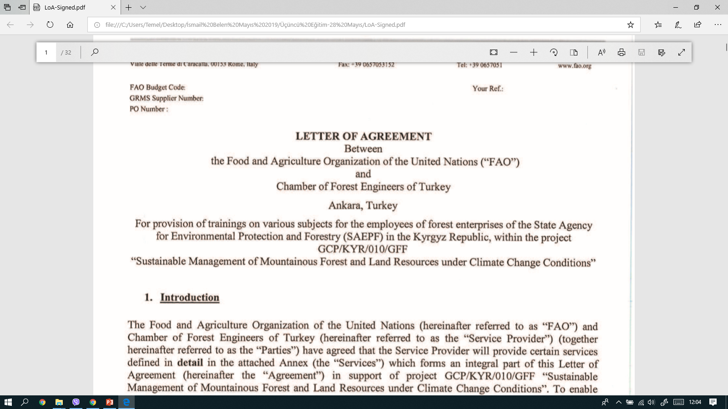

Slide 12
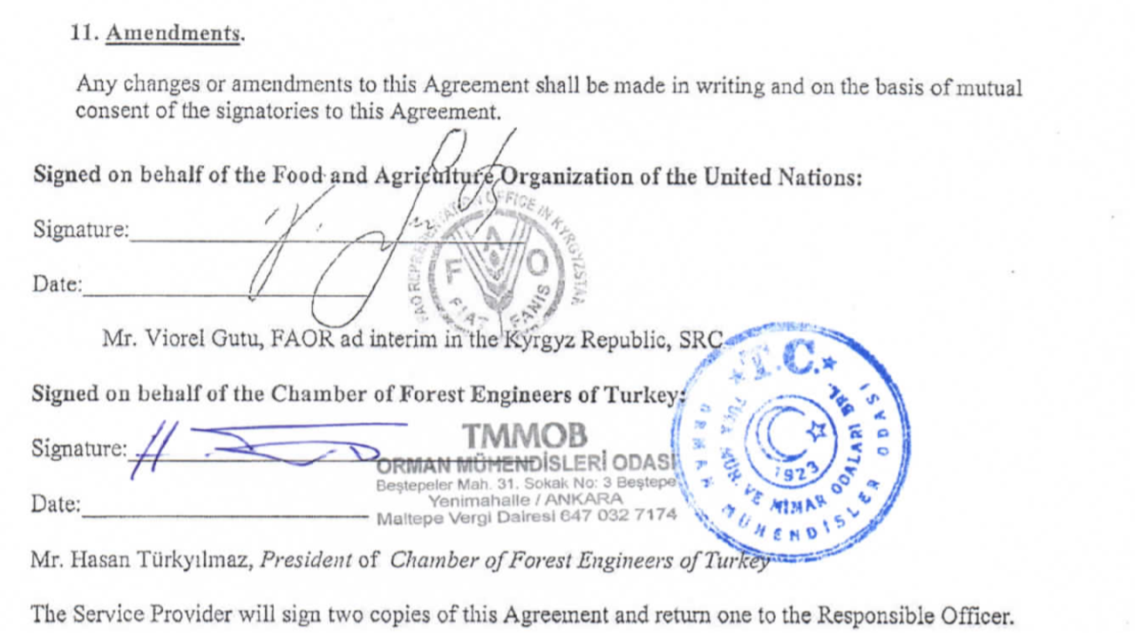

Slide 13
A new LoA with FAO is coming soon!
Under the FAO-Turkey Forestry Partnership Program, during the Second Steering Committee meeting was held 26th of November 2018, the Committee approved the concept note of the Project entitled «Restoration of Degraded Forests and other Lands inCentral Asian Countries».
Further, the Committee decided to make this concept note a full project text by the Chamber of Forest Engineers.
The projected budget for this project is $ 2 million. LoA is about to be signed between OMO and FAO for project writing.
The project writing work is planned to be completed by November 2019.

Slide 14
International Symposium- 2/5 December 2019
The Chamber of Forest Engineers has been organizing the “Nature and Forestry Symposium Towards 2023”’for many years.
As the continuation of this tradition, the fifth edition was held on 2-5 December 2018 in Antalya/Turkey.
The theme of the symposium was “ The Role of “Public-Civil Society-Private Sector Cooperation and International Partnerships” in Achieving Sustainable Development Goals and Global Forest Goals”

Slide 15
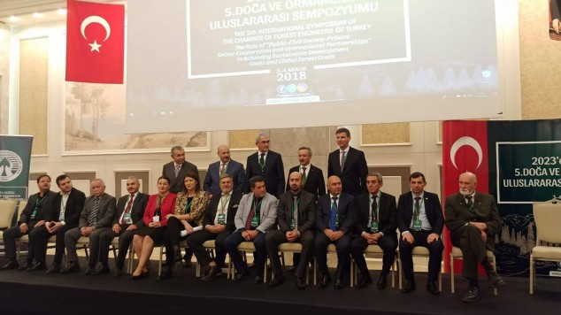
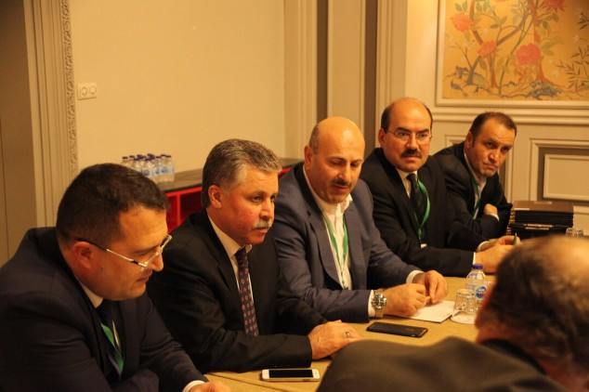
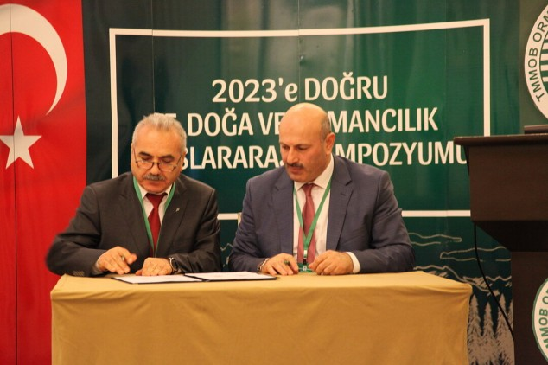
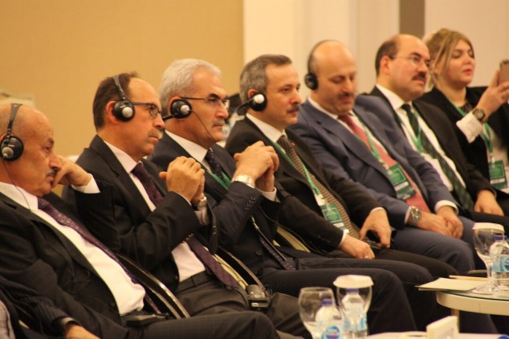

Slide 16
Signing Ceremony of «Declaration of Intention» with NGOs
During that international symposium several cooperation protocols were signed between NGOs from different countries

Slide 17
Preamble, Purpose and Scope
Preamble:
  Forests, which are the common assets of the whole world, are vital for many issues such as the well-being and happiness of humanity, conservation of biodiversity, adaptation to climate change, energy, and water and food security.
  Forests are one of the key sectors in achieving the “2030 Sustainable Development Goals” adopted by the United Nations General Assembly in 2015.
  “The United Nations Strategic Plan for Forests 2017-2030 (UNSPF)” and “The Six Global Forest Goals and 26 Associated Targets ” adopted in 2017 have set a global road map for forests and forestry in achieving sustainable development goals.
  Achieving these goals requires a common understanding and cooperation at national and international level between all sectors, including the public, private sector, academic circles and non-governmental organizations.
  In this context, Chamber of Forest Engineers of Turkey and the ……. (hereinafter referred to as Parties) have signed this Declaration of Intention to cooperate with the principles and procedures set out below.
Purpose: The purpose of this Declaration of Intention is to determine the principles and procedures of co-operation.
Scope:This “Declaration of Intention” encompasses the matters contained in this text. Additional agreements may be made if the Parties agreed upon them.

Slide 18
No | Country | Name of the NGO | Web Page
1 | Albania | ALBAFOREST CENTER Arnavutluk-Alba Forest | www.albaforest.com
2 | Azerbaijan | Natural Wealth and Ecology Workers Trade Union Republic Committee Azerbaycan-English Azerbaycan-Türkçe Azerbaycan-копия | http://ahik.org
3 | Federation of Bosnia and Herzegovina | The Association of Hunting Organizations in Bosnia and Herzegovina Bosnia-Avcılar | http://www.slobih.ba/
4 | Federation of Bosnia and Herzegovina | The Independent Trade Union of Forestry, Wood Processing and Paper of Bosnia and Herzegovina- | http://ssspdp.ba/

Slide 19
5 | Federation of Bosnia and Herzegovina | Forestry Association of Federation of Bosnia and Herzegovina | http://usitfbih.ba/
6 | Federation of Bosnia and Herzegovina | Beekeepers Union of Sarajevo Bosnia-Beekepers
7 | France | The International Association for Mediterranean Forests (AIFM) | http://aifm.org/en
8 | Kyrgyzstan | KYRGYZ ASSOCIATION OF FOREST AND LAND USERS Kırgızistan-Kyrgyz-Kaflu MoU | http://www.landuse-association.kg/
9 | Hungary | The Trade Union of Forestry and Wood Industry Workers | http://efdsz.hu/
10 | Romania | SILVA TRADE UNION FEDERATION Romanya-Federatia Silva | https://federatiasilva.ro/

Slide 20
11 | Romania | The “Forest Progress” Society Romania-Progresul Silvic | http://progresulsilvic.ro/
12 | Turkey | Association of Forestry Faculties ORFAMDER-3 Aralık 2018 | http://www.orfamder.org/
13 | Turkey | ÖZ ORMAN-İŞ TRADE UNION OF FOREST, AGRICULTURE, HUNTING AND FISHERY of the Republic of Turkey OMO-_z Orman __ 3 Aralık 2018 | http://www.ozorman-is.org.tr
14 | Turkey | TOÇ BİR-SEN | Trade Union of Agriculture and Forest Civil Servants Association | https://www.tocbirsen.org.tr/

