Slide 1
Meeting of the bureau of Silva Mediterranea
Monday 15 July 2019 - Room D-440, FAO HQ, Rome, Italy
Objectives and expected outcomes
Debrief on the 6th Mediterranean Forest Week
  Lessons learned from the 6th MFW
Outline the joint organization of the 7th Mediterranean Forest Week and 24th Session of Silva Mediterranea
  Tentative dates and place
  Topic of the 7th MFW
  Structure (blocks of sessions) of the 7th MFW
  Composition of the organizing committee
  Possible resource mobilization to support the 7th MFW
  Modalities for the organization of the Week
  Calendar with the main steps

Slide 2
Meeting of the bureau of Silva Mediterranea
Monday 15 July 2019 - Room D-440, FAO HQ, Rome, Italy
Objectives and expected outcomes (Cont’d)
Define a roadmap to implement the recommendations taken by the Committee Silva Mediterranea at its 23rd Session in April 2019
  Draft roadmap

Slide 3
Debriefing of the 6th MFW
Approximately 220 participants from 31 countries (5th MFW: 286 participants from 31 countries)
10 sessions, 93 oral presentations or speeches, 6 side events + several meetings of partenering institutions (MedForum 2019 of the IMFN, general assembly of AIFM…)
Total budget: a little more than EUR 300,000, with contributions from
Main outcome: Brummana Declaration
Ministry of Agriculture of Lebanon
Federal Ministry for the Environment , Nature Conservation and Nuclear Safety of Germany
Ministry of Agriculture, Fisheries and Food of Spain,
contributions from participants
FAO
Ministry of Agriculture and Food of France
Secretariat of the Union for the Mediterranean
EFIMED
And indirect or in-kind contributions (UNDP, IMFN, etc.)

Slide 4
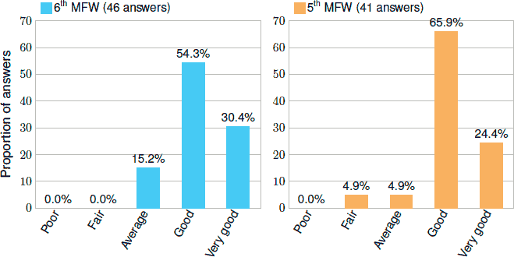
Satisfaction survey of the 6th MFW
46 answers to the survey
Overall evaluation of the 6th MFW: 85% ➔ (not statistically different from 5th MFW)

Slide 5
Satisfaction survey of the 6th MFW (Cont’d 1)
Questions related to the technical content of the Week: not statistically different from the 5th MFW
  Relevance of the theme: 91% satisfaction (good or very good) ➔
  Content of the plenary sessions: 76% satisfaction ➔
  Field trip: 75% statisfaction ➔
  Side events: 89% satisfaction ➔
Questions related to speakers: not statistically different from the 5th MFW
  Speaker’s diversity: 91% satisfaction ➔
  Speaker’s expertise: 96% satisfaction ➔
  Speakers’ interactions with the audience: 64% satisfaction ➔

Slide 6
Satisfaction survey of the 6th MFW (Cont’d 2)
Questions related to the settings and logistics the Week: statistically better than the 6th MFW
  Venue (hotel): 87% satisfaction ➔
  Coffee breaks: 96% satisfaction 
  Lunches: 96% statisfaction  
  Conference rooms: 100% satisfaction  
  Internet access: 46% satisfaction  
  French-English interpretation: 83% satisfaction ➔

Slide 7
Free comments in the satisfaction survey
Improve the environmental impact of the conference (plastic use, etc.)
Improve the website
Better consider the Arabic language
Too many presentations in a reduced time (recurring comment from 5th MFW)
Venue choice
… and many thanks for the organizers, in particular the MoA of Lebanon

Slide 8
Tentative date and place
International day of forests: Sunday 21 March 2021
Ramadan 2021: 12 or 13 April-11 to 13 May 2021
16th Session of the UNFF in 2021: often April or May
International day for biological diversity: Saturday 22 May 2019
World day to combat desertification and drought: Thursday 17 June 2021
15th World Forestry Congress, Seoul, Korea, 2021: no official dates (usually September or October)
COP 15 of the UNCCD: September or October 2021?
COP 27 of the UNFCCC: 8-20 November 2021
Second half of 2021 will be packed with international events:

Slide 9
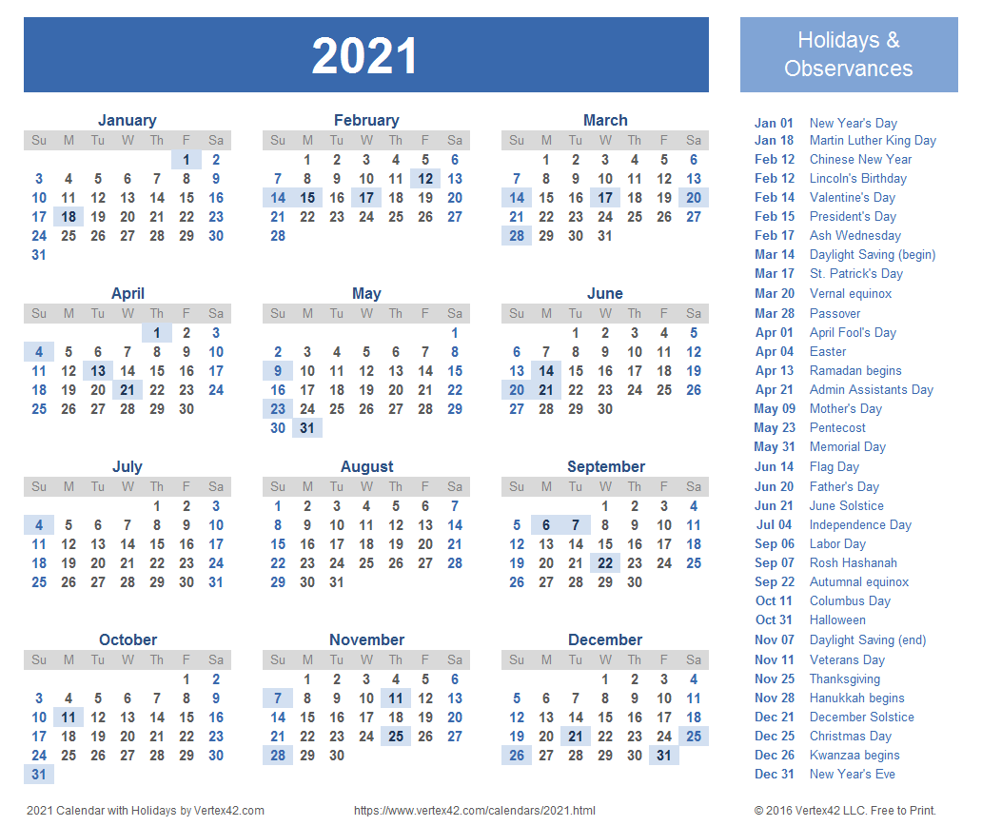

Slide 10
Topic of the 7th Mediterranean Forest Week
1st MFW (Antalya, 2010): Contribution of Mediterranean forests and other wooded lands to food security + Knowledge-based management of Mediterranean forests under climate risks
2nd MFW (Avignon, 2011): water & forests, management of biodiversity, societies & territories
3rd MFW (Tlemcen, 2013): The Mediterranean forests at the service of sustainable development of landscapes: mitigation and adaptation strategies to cope with global changes
4th MFW (Barcelona, 2015): Improving livelihoods: the role of Mediterranean forest value chains in a green economy
5th MFW (Agadir, 2017): Mediterranean landscape and forest restoration
6th MFW (Brummana, 2019): Role of Mediterranean forests in the Paris Agreement
Proposals from participants of the 6th MFW for the 7th MFW:
  The role of youth in Mediterranean forestry, job creation, innovation and green jobs
  Social dimension, participatory approaches, involving populations in forest challenges…

Slide 11
Structure of the 7th MFW
 | Day 1 | Day 2 | Day 3 | Day 4 | Day 5
09:00-10:30 | Registration | Silva Med session (close meeting) | Field trip or celebration of international event | Silva Med session (open) | Silva Med session (close meeting)
10:30-11:00 | Coffee break | Coffee break |  | Coffee break | Coffee break
11:00-13:00 | Opening session | MFW session |  | MFW session
13:00-14:30 | Lunch break | Lunch break |  | Lunch break
14:30-16:30 | MFW session | MFW session |  | MFW session
16:30-17:00 | Coffee break | Coffee break |  | Coffee break
17:00-18:30 | Side events | Side events |  | Conclusions / high level segment
Evening |  |  |  | Gala diner / closing of the MFW

Slide 12
Expected outcome of the 7th MFW
Should a high-level segment be organized?
Should a Tunisia Declaration be the main expected outcome?

Slide 13
Modalities for the organization of the 7th MFW
Host country agreement between Tunisia and FAO
Languages of the 7th MFW
How to organize the plenary sessions and side events: open call or close decision of the Organizing Committee?
Relevance of the participant fee to cover coffee breaks and lunch breaks
Benefit of participant fees (6th MFW) | Cost of participant fees (6th MFW)
Contributions collected in cash: 8,674 EUR | LoA with service provider to organize registration and fee collection: 23,430 EUR
Contributions collected by bank transfer: 15,150 EUR | Bank and Weezevent fees: 406 EUR
Total benefits: 23,824 EUR | Total costs: 23,836 EUR

Slide 14

Composition of the Organizing Committe
Members of the Organizing Committee of the 5th MFW:
Rule to be respected: a beneciary of a Letter of Agreement with FAO for activities related to the 7th MFW cannot be member of the Organizing Committee
Secretariat of the 7th MFW: FAO (Silva Mediterranea) + host country

Slide 15
Possible resource mobilization
Item | Cost USD (250 participants)
Coffee and lunch breaks (including lunch boxes) | 60,000
Gala diner | 20,000
Interpretation | 10,000
Secretariat | 25,000
Carbon compensation measures | 15,000
Other logistical items (venue rent, materials, airport shuttle, welcome, participant folder…) | 45,000
Sub-total logistics | 175,000
Web site | 10,000
Video of the Week | 5,000
Proceedings | 15,000
Other communication activities (leaflet and booklet, banners, social media, bootcamp, contests, press releases, interviews…) | 35,000
Sub-total communication and documents | 65,000
Travel support to keynote speakers | 35,000
Travel support to key participants | 35,000
Sub-total travels | 70,000
Total | 310,000
Unexpected costs (10%) | 30,000
Grand total | 340,000

Slide 16
Calendar of follow-up actions
OC1 meeting in Tunisia: week of 16 December 2019
Milestones:
Objectives and title of the 7th MFW
Venue
Draft agenda of the 7th MFW: sessions and their coordinators
First version of the budget
Main tasks distributed among the members of the OC (web site, visual identity…)
OC2 meeting in Rome back-to-back to COFO 25 (22-26 June 2020)
Milestones:
Preparation of the sessions: draft ToRs of the sessions
Second version of the budget
Validation of the visual identity of the 7th MFW, preparation of the leaflet, web site
Organizational arrangements for registration, carbon compensation measures, poster contest, proceedings

Slide 17
Calendar of follow-up actions (Cont’d 1)
OC3 meeting in Rome: end of September 2020
Milestones:
Review of the sessions: validation of ToRs, identification of speakers
Update of the budget
Consolidation of the communication plan
Organizational arrangements: side events, decision on proceedings, invitation letters, review of leaflet, review of web site, registration arrangements, poster sesion, background documents
OC4 meeting by Skype: end of November 2020
Milestones:
Sessions finalized
Consolidated budget
Communication plan finalized
Organizational arrangements: invitation letters, booklet, travel of speakers

Slide 18
Calendar of follow-up actions (Cont’d 2)
OC5 meeting in Tunisia: first week of February 2021
Milestones:
Final on-site checking of all organizational arrangements

Slide 19
Short-term follow-up actions (until OC1 meeting)
Date | Action | Responsibility
Sept. 2019 | List of material and human resources (number and capacity of rooms, interpretation needs, etc.) that are needed for the 7th MFW | Secretariat of the MFW
Sept.-Nov. 2019 | Collect quotations locally to address these needs, so that a precise budget can be elaborated and discussed during OC1 meeting | Tunisia
Oct. 2019 | Clearance by the cabinet of the DG of FAO of the 7th MFW (clearance process to be initiated asap) | Silva Med secretariat
Nov. 2019 | Identify possible member organizations that could be interested in the topics of the 7th MFW | Secretariat of the MFW
Nov. 2019 | Hosting agreement sent to Tunisia | FAO
Dec. 2019 | Draft budget of the 7th MFW | Secretariat of the MFW
Week of 16 Dec. 2019 | OC1 meeting in Tunisia | OC members

Slide 20
Recommendations to address
Amend the Rules of Procedure of Silva Mediterranea
Continue clarifying the role of observers and coordinators within its subsidiary bodies
Continue reactivating the network of national focal points for Silva Mediterranea
Encourage member countries to work with the Near East Forest Health and Invasive Species Network and Forest Invasive Species Network for Europe and Central Asia
Urged FAO to explore ways and means to develop and implement the project “Blue Forest-Empowering Young Entrepreneurs around the Mediterranean”

Slide 21
Amending the Rules of Procedure
A two-third majority of members is needed to adopt any amendment
Number of members: 27
Number of participants to sessions since at least 1997 (with the
exception of a session in Rome in 2002): between 10 and 13
Organizing a special session may raise problems rather than bring solutions
Three non-exclusive options to get more members at the sessions:
  Informal talk (by the end of 2019) to countries during next EFC session (target countries: Bulgaria, Serbia, Slovenia, Cyprus, Romania) and next NEFRC session (target country: Egypt)
  Official letter from the Chair Silva Mediterranea encouraging countries to attend the 24th Session (to be done 6 months before 24th Session)
  Letter from the DG of FAO asking countries to leave the Committee (if they are not interested in its activities) or attend its sessions

Slide 22
Clarify the role of observers and coordinators within subsidiary bodies
When no recent confirmation of the coordinator of the subsidiary bodies has been received, send a request to the respective Ministry in charge of forests to confirm designation
Request Members to propose candidates for the coordination of the working groups, and proceed with the election of the working group coordinators at each session
Ensure that a progress report on the activities of the subsidiary bodies is made at each session
Organize meeting specifically dedicated to official representatives of Silva Mediterranea member countries during the Committee’s meetings, not open to observers

Slide 23
Reactivate the network of national focal points
Attract Members’s attention with a view to have them take part in the activities of Silva Mediterranea by presenting current common problems and challenges of interest to them
Suggest the development of projects and funding sources with a view to contribute to ease, or even, solve the constraints that hinder the participation of some Members

Slide 24
Explore ways and means to develop and implement Blue Forest
Change of name: Blue Forest → MedForYouth
A draft concept note has been developed
Tentative development as a FAO project within the Forest & Farm Facility with co-financing of the Islamic Development Bank and the French Global Environement Facility (FFEM)

