Slide 1

The national Turkish context: the National Turkish Program on Non-Wood Forest Products.
İsmail BELEN
BLOCK 1 – Setting the scene
21 March 2022-14:40-14:50
Non-wood forest products for people, nature and the green economy. Recommendations for policy priorities in the Mediterranean

Slide 2
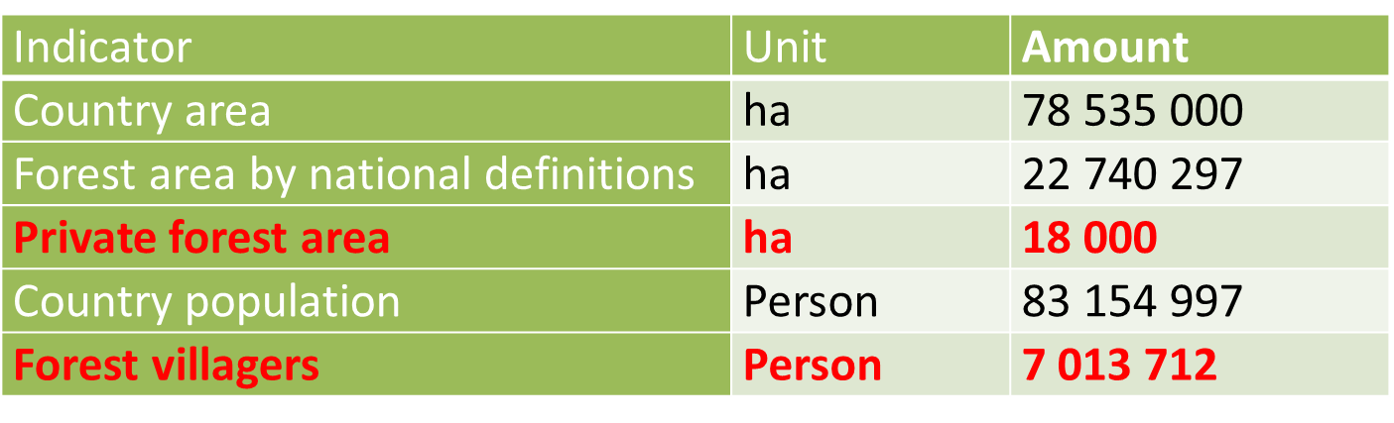
A few numbers about Turkey

Slide 3
Policy Tools
  The Constitution has 177 Articles.
    Article 45- Protection of farmers
    Article 169- Conservation and improvements of forests
    Article 170- Protection of forest villagers
    Article 171- Promotion of cooperatives
  Organic Agriculture Law:
    NWFPs fall under the scope of "harvesting products from natural areas and sources".
  Veterinary Services, Plant Health, Food and Feed Law
  Forest Law

Slide 4
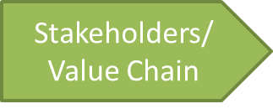
Presidency of the Republic of Turkey
Presidential Policy Councils
Ministry of Agriculture and Forestry
Ministry of Trade
Ministry of Treasury And Finance
Council of Health and Food Policies
Council of Local Administration Policies
Ministry of Industry and Technology
Presidency of Strategy and Budget
National Development Plans
GD of Sectors and Public Investments
GD of Forests
Depart. of Forest Ecosystem Services
GD of Plant Production
GD of Animal Husbandry
GD of Food and Control
GD of Exportation
GD of Customs
Turkish Statistical Institute
Turkish Standards Institution
Turkish Patent and Trademark Office
Small and Medium Enterprises Development Organization of Turkey

Slide 6
  Some Regulations and Communiqués
  Forest Management Regulation
  Communiqués
    Communiqué on Inventory, Planning, Production and Sales Principles of NWFPs-2016
    Honey Forests Communiqué
    Ecotourism Areas Communiqué
    Truffle Communiqué

Slide 7
Action Plans- National Scale
  Resine, bay leaf, blueberry, truffle, pine honey etc.
Utilization Plans- For the specific field and product
  Apr.. 2 000 utilization plans
Investor Guidelines- For Private Sector
  Truffle Orchard Investor Guidelines

Slide 8
Name: "Provision of Technical Guidelines on Sustainable Management of NWFPs and the Status Reports on Specific Selected Products”
Started: on 20 December 2019
Deliverables:
  NWFPs Assessment Report of Turkey
  NWFPs Policy Report of Turkey,
  Detailed reports for pine honey, bay leaf, chestnut, resin and truffle mushroom.
  Technical Guidelines of NWFPs,
  Status Update Reports Along with Recommendations in the Value Chain

Slide 9
In 2019, the contribution of NWFPs to economy 880 million USD,
Appr. 200 million USD export,
Contribution to forest villagers 123 million USD.
The number of forest villagers working in the collection of NWFPs is around 25 000 people. (wood production is around 150 000 people. )
The NWFPs sector makes an economic contribution directly or indirectly to approximately 500 000 people in Turkey.
This number includes the people;
  working in the field for collection,
  working in drying processes,
  working in the process of making the final product or semi-finished products,
  packer, end seller-retailer, exporter etc.

Slide 10
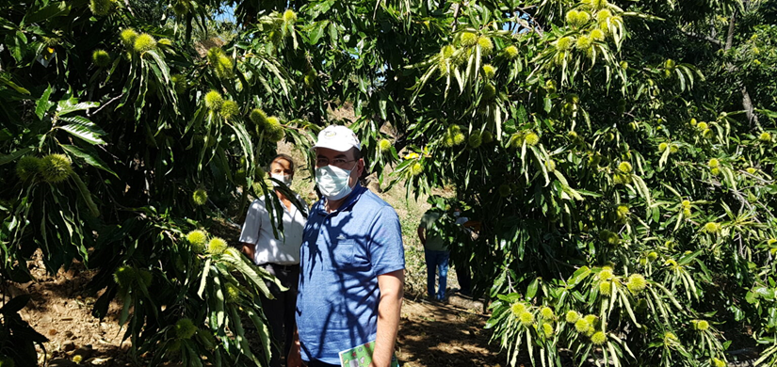
Around 70 thousand tons of chestnut harvested in 2019,
with around 120 million USD national contribution,
Exported mainly to Italy.
Prices of chestnut-based products (1 kg.)
Harvesting site 2 USD
Markets 5 USD
Candied Chestnut 15 USD
Chestnut honey 40 USD
For more information: İsmail Belen, 2001, Utilization of chestnut as non wood forest product in the World and Turkey.
http://www.fao.org/3/y3660e/y3660e05.htm#P1398_260616

Slide 11
Key Messages
1- Non-wood forest products are the face of forests that touch life, economy, animal and people.
2- Forests without water, flowers, fragrance, colors, animals, insects, birds, places to walk hand in hand with their beloved, and grass where the lambs can run happily would be a «mechanical tree desert".

Slide 12
Thank you!
İsmail BELEN ismailbelen52@gmail.com https://www.linkedin.com/in/ismailbelen/
+90 506 222 48 19

