Slide 1
Interdisciplinary planning approaches to environmental management-
Basin Planning in Turkey: Forest Area Management and surveys of forest areas (Examining database in specific to Bozkurt in terms of forest)
İsmail Belen- Forest Engineer (MSc.)
General Directorate of Forests of Turkey-Chief Inspector
Chamber of Forest Engineers of Turkey- Foreign Relations Adviser
The Foundation of the People Caring for Future- Chairman- www.gonder.org.tr
ismailbelen52@gmail.com
28 April 2022 Thursday
08:50-09:30 GMT+2
Virtual: https://uni-kassel.zoom.us/j/93148848298?pwd=TG82OHloUCtEWHpuVDVCMUZ1REMwQT09
Meeting ID: 931 4884 8298 Passcode: 698902

Slide 2
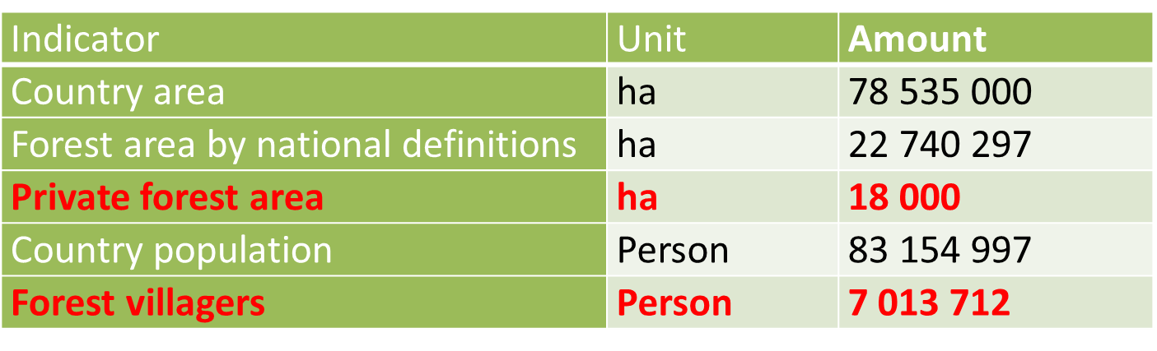
A few numbers about Turkey

Slide 3
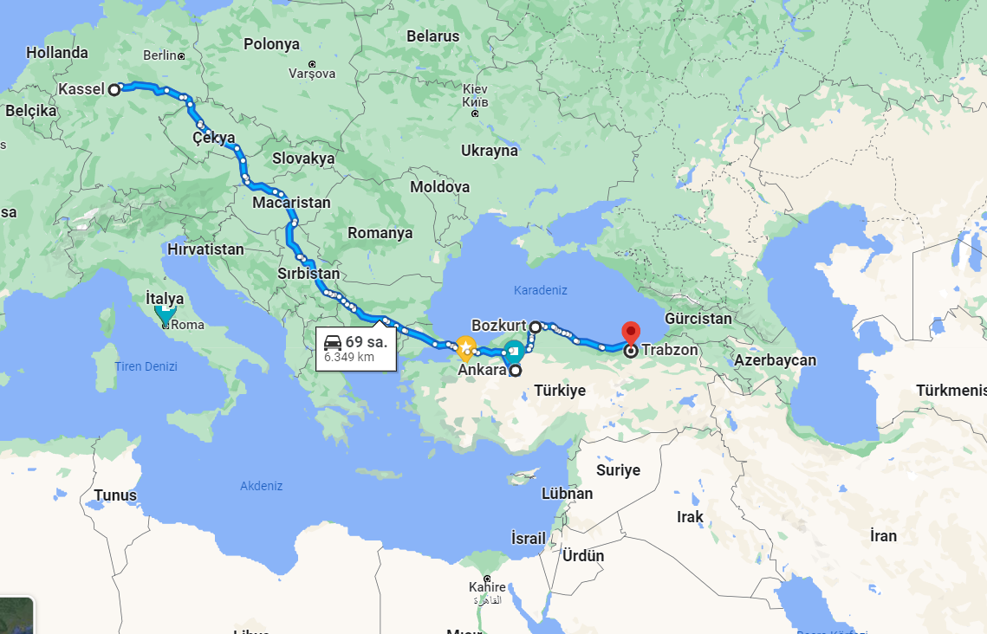
Kassel-Ankara-Bozkurt-Trabzon

Slide 4
An Overview of Land Planning in Turkey
Zoning Law No. 3194 dated 1985- İmar Kanunu https://www.mevzuat.gov.tr/MevzuatMetin/1.5.3194.pdf
The targets set forth in the development plan and, if any, regional plans, regional development strategies and other strategy documents.
Spatial Strategy Plans
Environmental Plans- Landscapes Plans
Zoning Plans
The zoning plans are prepared as a master zoning plan and an implementation zoning plan. Each plan is prepared in accordance with the plan at the next level.

Slide 5
Forests and Zoning Plans
All forests in Turkey are managed by the State.
No construction/settlement is allowed in state-owned forests.
Partial settlement/settlement is possible in privately owned forests (there are around 20 thousand hectares of private forests in total).
Forests are managed according to "Forest Management Plans" prepared in accordance with the Forest Law.
Various permits can be granted according to the Tourism Incentive Law and the Mining Law.

Slide 6
There are the following exceptions for the constructions to be made in forest areas.
Defense, transportation, energy, communication, water, waste water, oil, natural gas, infrastructure, solid waste disposal and landfill facilities.
Dams, ponds, animal shelters, cemeteries,
State-owned health, education, judicial services, panel institutions and sports facilities

Slide 7
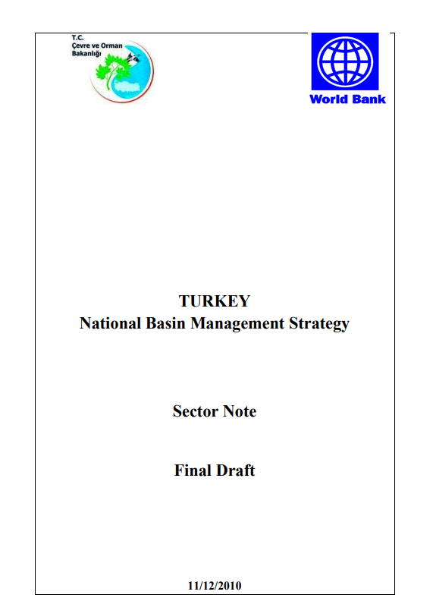
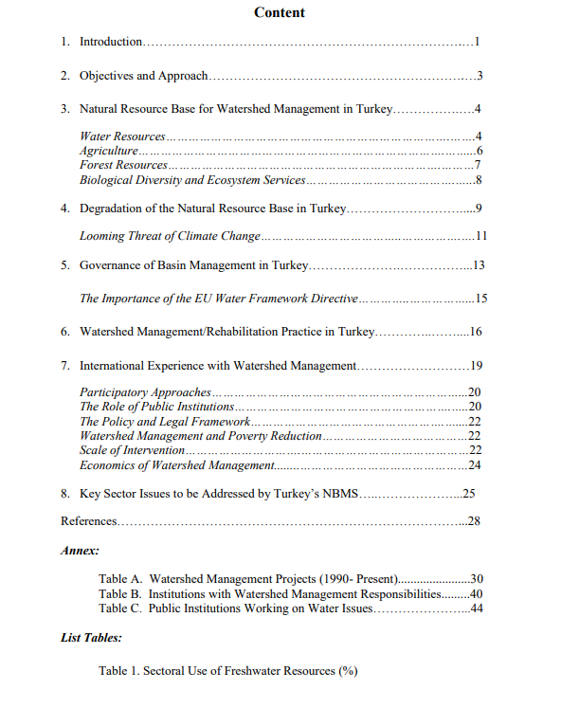
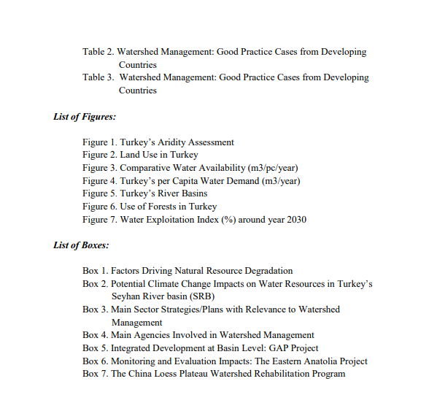
Basin Planning/ Management in Turkey
http://www.gonder.org.tr/wp-content/uploads/2015/01/The-World-Bank-Sector_Note-on-Watershed-Management.pdf

Slide 8
Through its State Planning Organization (SPO), the Government of Turkey has started to prepare a National Basin Management Strategy (NBMS) to inform its longer-term investment program in watershed rehabilitation and water management and ensure that such investments meet key objectives, including livelihood support and income generation, conservation and sustainability of natural resources, reduced vulnerability to climate change, and fiscal efficiency.
The preparation of the strategy builds on a few General Directorate of Afforestation and Erosion Control (AGM)-led rehabilitation projects as well as a pilot watershed management project (including the ongoing World Bank-financed Anatolia Watershed Rehabilitation Project, and the EU-financed Capacity Development Assistance for Water Sector in Turkey and the work by the General Directorate of Environmental Management (GDEM) on Watershed Protection Action Plans for Turkey’s 25 river basins
The NBMS will be a critical component of a strong integrated natural resource management policy framework and strategy that prioritizes the needs of the country, is consistent with EU environmental and water management standards, and strengthens Turkey’s sustainable development agenda.

Slide 9
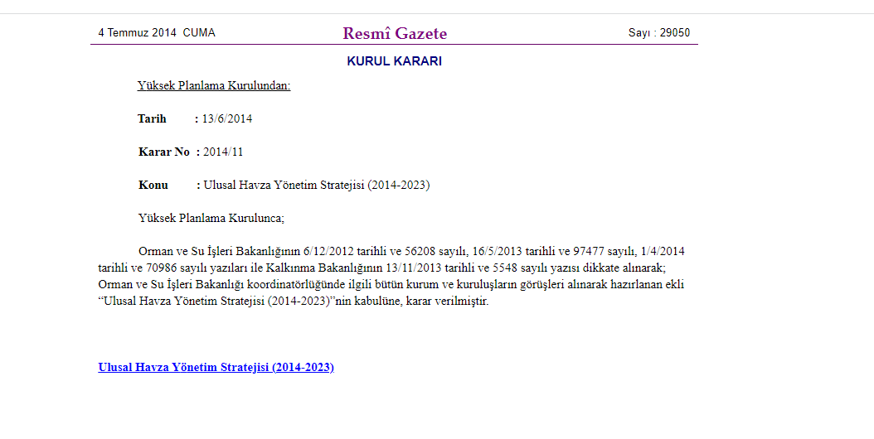
https://www.resmigazete.gov.tr/eskiler/2014/07/20140704-23.htm

Slide 10

http://www.gonder.org.tr/?p=11271
Turkey National Basin Rehabilitation Strategy 2023-2033

Slide 11
The vision of NBRS
Watersheds that are productive, integrated to local, regional, national and global conditions and resistant to threats, where the balance between people and nature is re-established, boundaries are known, landscape values are known, degradation is stopped and improved, ecosystem-based planned and managed with the participation of all human and physical stakeholders.

Slide 12
Examining database in specific to Bozkurt in terms of forest

Slide 13
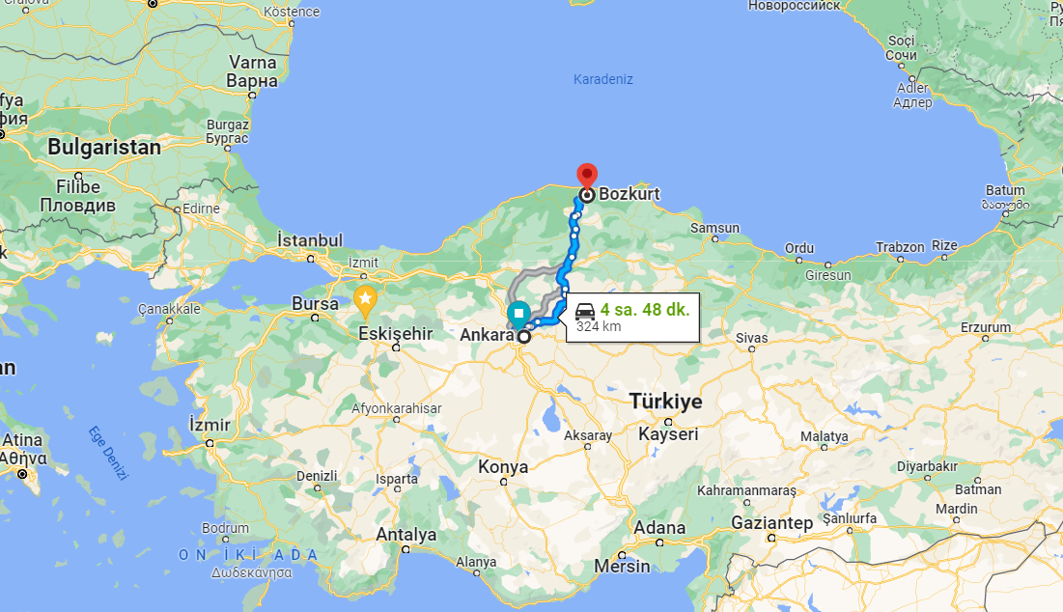

Slide 14
Bozkurt Flood Disaster Causes and Findings
11 August 2021
https://haberler.itu.edu.tr/en/newsdetail/2021/08/20/bozkurt-flood-disaster-causes-and-findings
https://www.youtube.com/watch?v=qkrnTiHxhWs
https://news.sky.com/video/turkey-flash-flood-sweeps-away-cars-in-bozkurt-near-the-black-sea-12380943

Slide 15
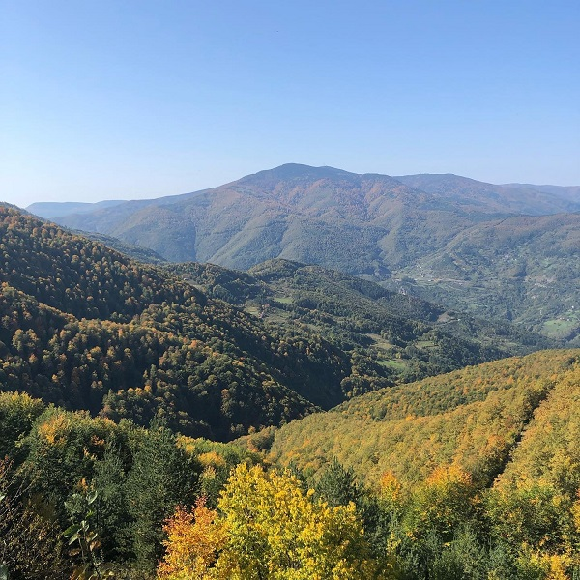
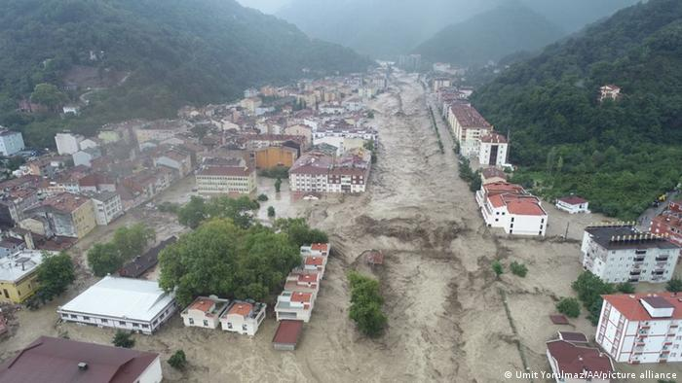
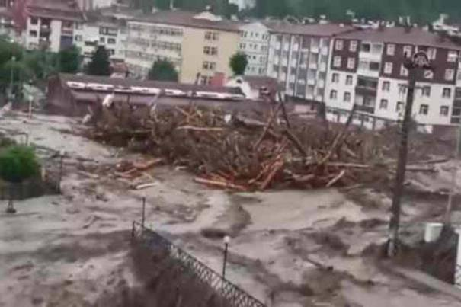
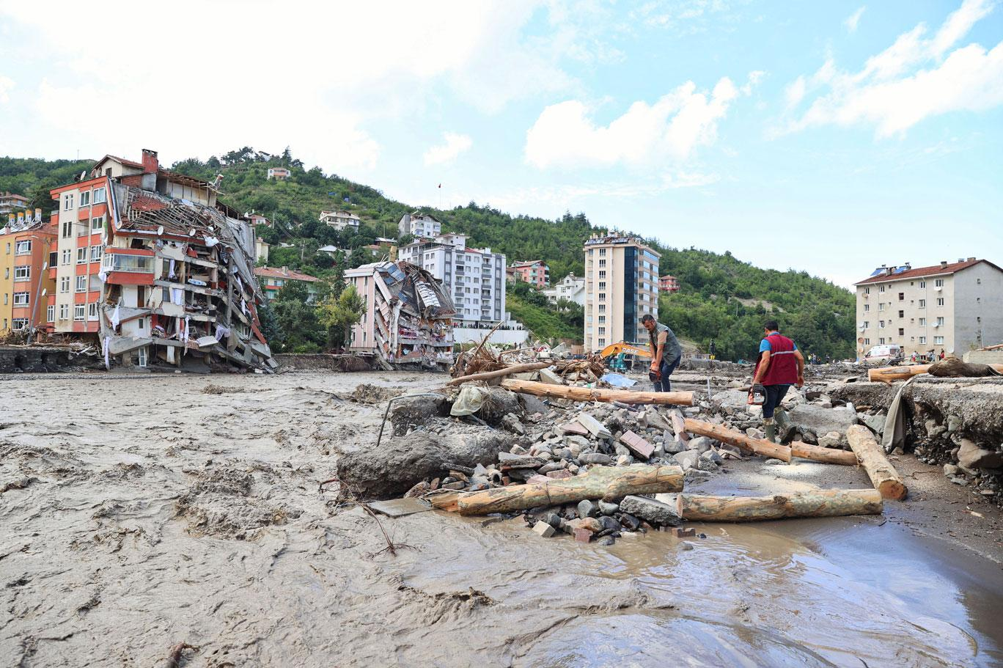

Slide 16
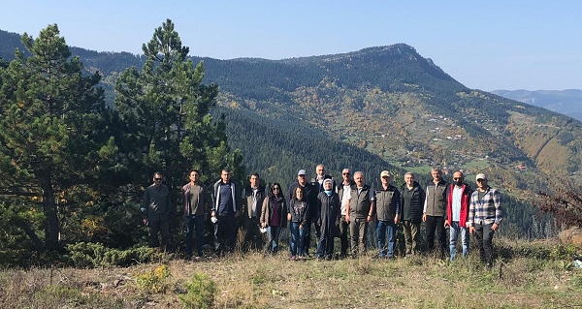
Kastamonu Regional Director of Forestry, Fahri Söylemezoğlu, stated that the Ezine stream basin has an area of approximately 376 square kilometers, has a very sloping land structure, and therefore causes more surface runoff, causing more sediment to be carried into the streams.
Fahri Sönmezoğlu continued, “The rains are not as regular as they used to be. We see that there is 4-5 times more precipitation than the average in flood disasters in the Black Sea region. When we look at the precipitations of the past 10-15 years, there was 40-50 kilograms of precipitation in August. On the day of the disaster, 139 kilograms of precipitation per square meter fell on Bozkurt. In the upper parts of the basin, there was a precipitation of 450 kilograms. Since it is a wide and rugged basin, heavy rain caused great damage by removing stone blocks, rock fragments, trees and bringing them to Bozkurt district with the flood.”

Slide 17
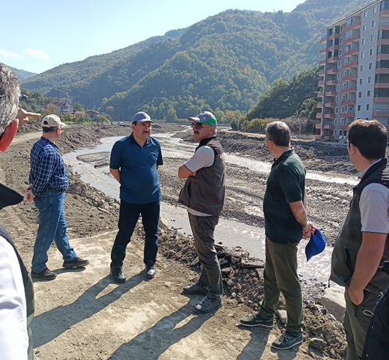
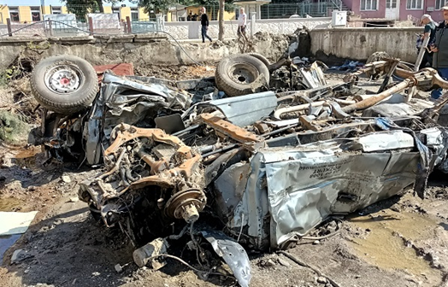
Forest Manager of Bozkurt District Mr. Mehmet Aktaş said, “Flood waters rose very quickly, taking away whatever came their way, in a very short time. With the second flood, the waters rose to a height of 5-6 meters and continued to flow for about 30 hours without any decrease.

Slide 18
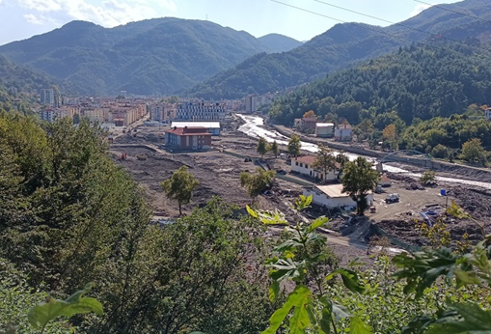
Deputy Director Ali Kabaoğlu stated that there was a large amount of precipitation the day before, and that it was said that there was a flood, and that some similar warnings had been made before, therefore they did not take it very seriously.
One of the most important issues for floods and overflows is the early warning system, that the Ezine Stream was 30-40 cm. He said that even though the municipality announced that it was flooding, the public did not care enough for the thought that it would be like the previous day.
Ali Kabaoğlu stated that contrary to the news in the press, the warehouse where the forest properties are kept is located at the exit of Bozkurt district, not at the entrance, and that it is one of the victims of floods and overflows, not the causes.

Slide 19
Conclusions
As it can be understood from the example of Bozkurt district, the presence of dense forests cannot prevent floods.
Stream beds should be kept absolutely clean, no buildings should be built, and riparian vegetation should be managed appropriately.
"Interdisciplinary Planning Approaches" is of vital importance in the prevention of disasters.
In the event of a disaster, however, "integrated disaster management, early warning, effective communication, and trust" come to the fore.

Slide 20
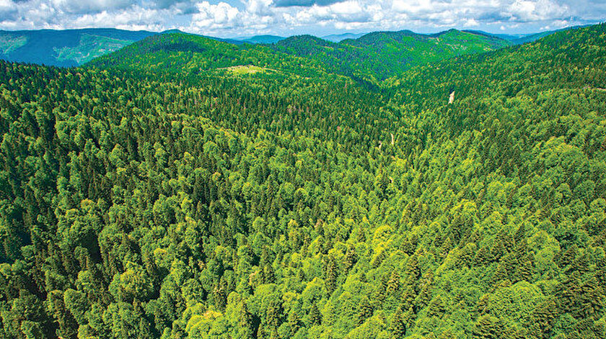
Teşekkür ederim

