Slide 1

An introduction to the Forest stewardship council
Monika Patel, Regional Director Europe (Interim)
Fernando Rodriguez, Network Development Manager
Aynur Mammadova, FSC consultant for Türkiye

Slide 2

WHAT IS THE FOREST STEWARDSHIP COUNCIL?

Slide 3
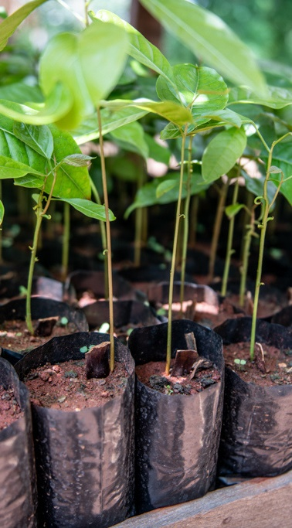


A sustainable forest management solution to help protect healthy and resilient forests, for all, forever
© FSC China / Feiyue Liu

Slide 4

FSC® standards protect forests.
As the most rigorous and trusted forest certification system, FSC helps forests remain:
Deforestation free
Biodiverse
Effective carbon storehouses
In harmony with Indigenous Peoples
Healthy and resilient

Slide 5





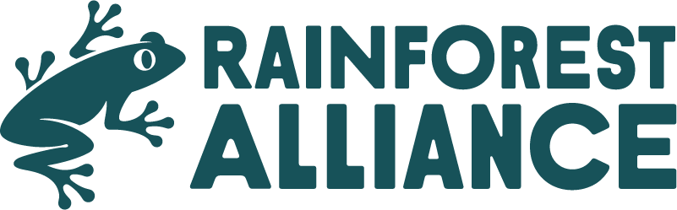






Trusted by NGOs, consumers and businesses
BY NGOs
BY CONSUMERS
BY BUSINESSES
Active FSC International Members:
54%
of global consumers trust FSC to protect the world’s forests, above all actors including governments, companies, and individuals.
Source: 2021 Global Consumer Research
FSC is uniquely supported by
the world’s most trusted environmental organizations.
…chosen by 1000s of global brands
FSC is the preferred certification scheme for companies and the most used by members of the Fortune 500.
Notes:
Trusted by NGOs. FSC is uniquely supported by the world’s most trusted environmental organizations, such as WWF, Rainforest Alliance, Sierra Club, National Wildlife Foundation and more
Trusted by consumers.
Trusted by the private sector. FSC is the preferred certification scheme for companies and the most used by members of the Fortune 500.

Slide 6

HOW FSC WORKS

Slide 7

The foundation of our forestry standard.
FSC’s Ten Principles
Developed to be relevant to different kinds of forest ecosystems and in diverse cultural, political, and legal settings, they require any managers of certified forests to:
Comply with all applicable laws;
Maintain or improve the social and economic well-being of workers;
Uphold the rights of Indigenous Peoples
Maintain or improve the social and economic well-being of local communities;
Manage their products and services in a way that maintains or improves their long-term economic viability, social benefits, and environmental benefits;
Maintain, conserve, and/or restore the ecosystem services and environmental values of managed forests; and also avoid, repair, or mitigate negative environmental impacts;
Establish a management plan that outlines their economic, environmental, and social policies and objectives;
Demonstrate progress toward meeting these objectives;
Maintain or improve high conservation values;
Ensure that all management activities comply with FSC principles and criteria.

Slide 8



Fundamentally balanced
33.3%
Social
33.3%
Environmental
33.3%
Economic
Local People &
Society at Large
Biodiversity
& Ecological Protection
Responsible &
Economically Viable
Notes:
In order to equally balance the interests of different stakeholders, FSC is governed by three chambers that balance the voting power between different interests. International members are divided into chambers (Environmental, Social, and Economic)
FSC is the pioneer of a multi-stakeholder governance system that gives equal weight to economic, environmental, and social chambers – an approach respected by many NGOs as the gold standard. For these reasons, FSC is widely regarded as the most credible and effective forest certification system.
FSC is a democratic member based and consensus-seeking organization with a balanced voting structure:
Our three-chamber approach means that we deliver a solution that secure better outcomes for businesses, communities and forests.

Slide 9






From forest to consumer
Forest Management (FM) certification
Chain of Custody (CcC) certification
Promotional
licence
Forest
Sawmill
Factory
Processor
Retailer
9

Slide 10

Our labels verify that products have been sourced sustainably

Slide 11


Slide 12
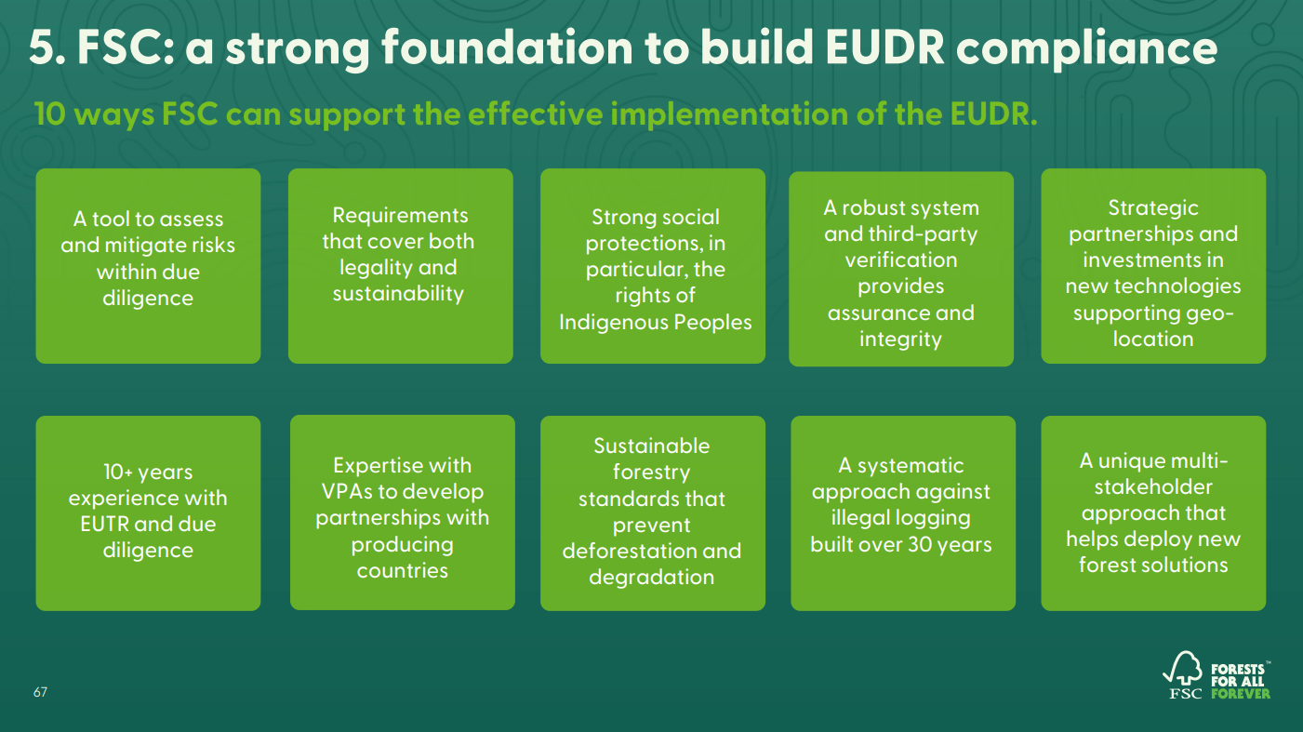

Slide 13
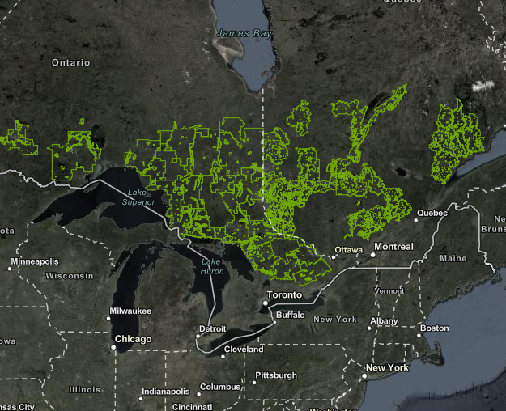


Advancing certification compliance
We’re bringing together people and organizations around the world to create new solutions for protecting the health and resilience of forests everywhere – at every step of the supply chain.
Geo-location
Blockchain
Isotope Testing
We’re collecting geo-location as coordinates representing certifiedd forest management units.
We’re leveraging the power of blockchain to revolutionize materials traceability and trade compliance in high-risk supply chains.
We're piloting the application of cutting-edge wood identification technology to root out false claims and trace the origins of timber.

Slide 14
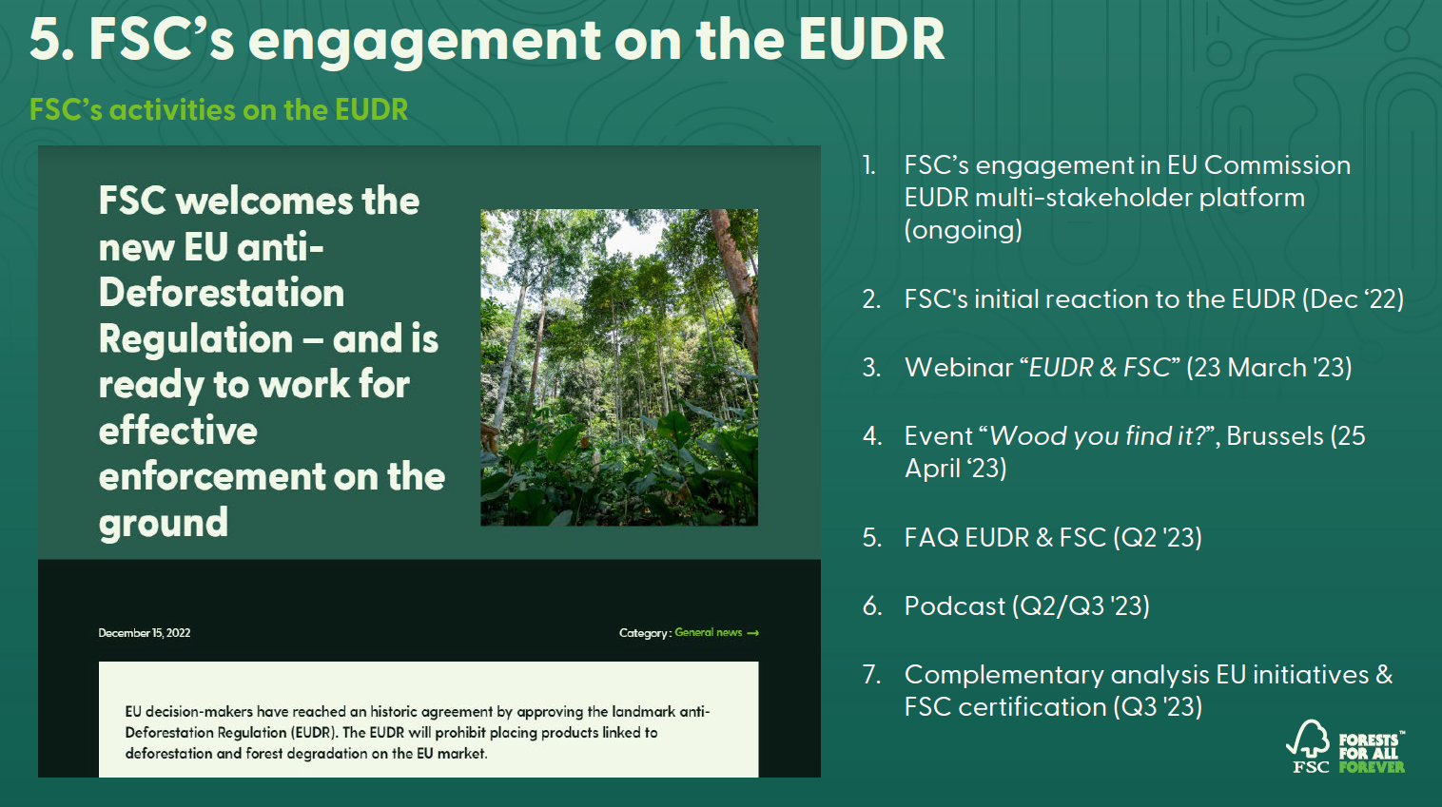

Slide 15


FSC in
Türkiye and in Europe

Slide 16


58.1 M ha
FM certified area in the Region
28%
Of Europe’s total 207M ha forest is certified
8.2 M ha
FM certified area in the Türkiye
37%
Of Türkiye’s total 22M ha are certified
Forest Management certification in Europe
Türkiye is the country with the biggest growth rates in Europe over the past 12 months and is now the 2ndcountry with the most certified area after Sweden.
60
56,4
56,7
58,1
8,2
44,6
48,0
40,5
40,9
42,0
40
37,7
26,2
29,5
20
13,5
0
2000
2005
2010
2015
2016
2017
2018
2019
2020
2021
2022
2023
= 19,7 M ha
5 – 10 M ha
1 – 5 M ha
0.5 – 1 M ha
0 – 0.5 M ha
No FM certification
Türkiye
Certified area Europe (in M ha)
Notes:
Turkey has surpassed Poland as no. 2 in region with approx. 6 mil Ha growth, currently there is no FM certification in the middle east aside from Turkey.
under development are: UK, Turkey, Estonia, North Macedonia, Montenegro, Switzerland and Czech Republic. All at different stages, I need to check with Michal on the latest updates. 22 factbooks are finalized.

Slide 17

22,227
Chain of Custody certificates in 49 countries in the region
41%
Of global CoC certificates
946
Chain of Custody certificates in Türkiye
Our Chain of Custody certification: Verification from forests to consumers
Europe is the leading CoC region but there is still potential to grow. Türkiye’s CoC has doubled in only 3 years and is now at close to 1,000 certificates
CoC (in thousand)
25
23
21
22
1
20
19
20
17
18
15
16
15
10
9
5
2
0
0
2000
2005
2010
2015
2016
2017
2018
2019
2020
2021
2022
2023
> 3.000 CoC
1000 – 2999 CoC
500 – 999 CoC
100 – 499 CoC
1 – 99 CoC
No FM certification
Türkiye
Europe
17
Notes:
In the past 10 years we gained 85.5 new certificates monthly, in the past 5 year-span we are growing at a rate of 88 certificates / month
VC: indication in the NP reports 2021. Most NP’s see themselves as relevant Demand and Supply countries
Global AAF – approx. 37.3 Mill.

Slide 18
INDUSTRY: OVERALL POSITIVE EVALUATION BY TURKISH CERTIFICATE HOLDERS
88%
Series 2
of Turkish Certificate Holders are satisfied with their certification
2%
1%
Very satisfied
Satisfied
Neither satisfied nor dissatisfied
83% of Certificate Holders consider their FSC certificate as important of very important
Dissatisfied
Very dissatisfied
59% Net Promoter Score in Türkiye
Series 1
Question: How satisfied are you with your FSC certification?
Number of responses: 195
Source: FSC Global Client Survey 2022

Slide 19



91 %
of the Turkish consumers who recognize FSC trust a brand carrying the FSC logo.
Q9. If you learned that a brand promotes FSC or offers FSC-certified products, what influence would it have on your trust in that brand? (5-point scale)
Base: Total sample in Türkiye (n=800: Recognizer of FSC (seen often & seen occasionally, according to Q3)

Slide 20

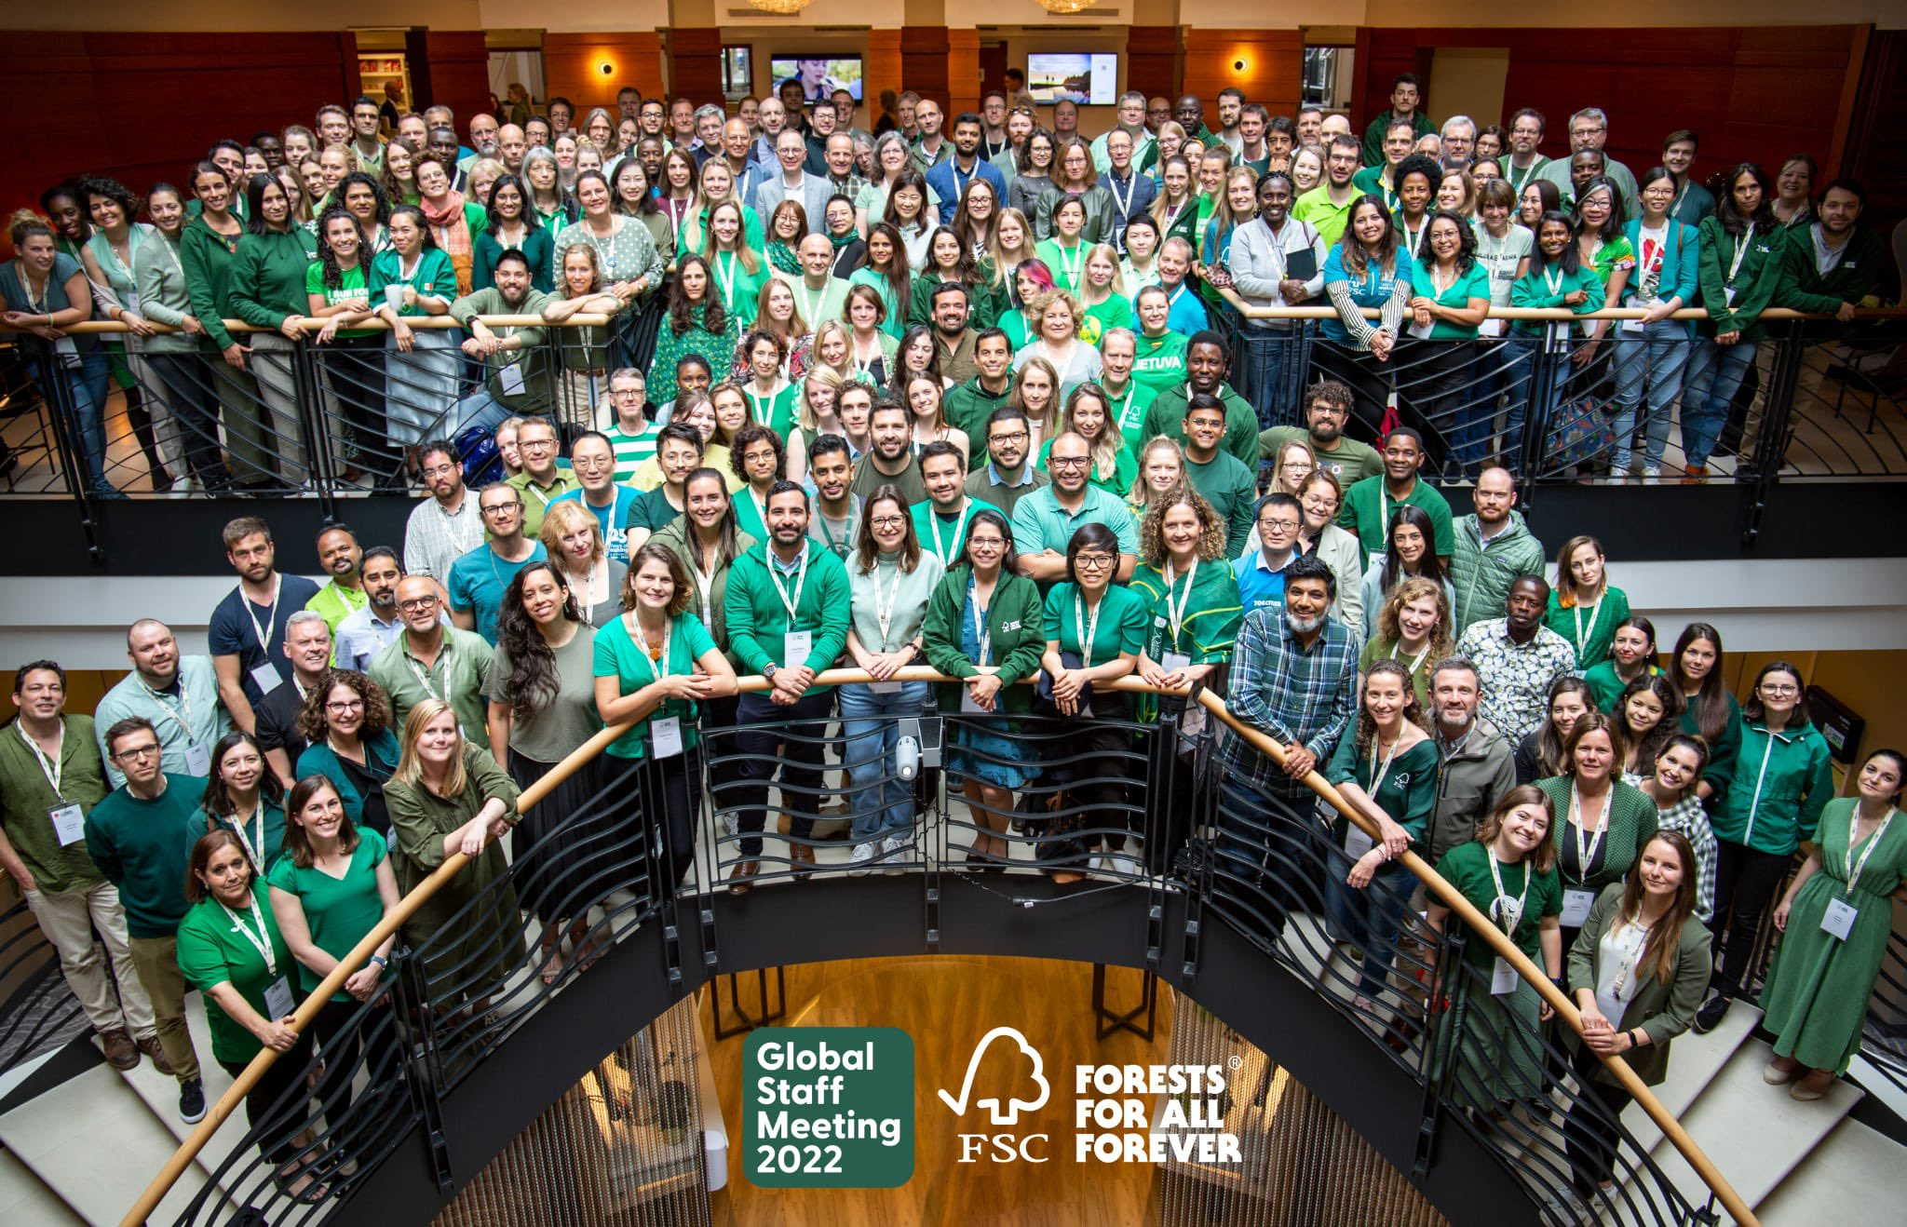

The FSC Network is present in over 56 countries
 | FSC Global Network
 | Regional teams (4 main locations)

Slide 21
The FSC Network is present in over 56 countries
 | FSC Global Network
 | Regional teams (4 main locations)

Slide 22

Next steps for Türkiye in 2023
25 April 2023
Meeting with Turkish Stakeholders
Q3 / Q4 2023
Stakeholder Event in Türkiye
Apr
May
…
Sep
Oct
Nov
Dec
February
Job Posting for FSC National Representative in Türkiye published
Q3 / Q4 2023
Start of FSC National Representation Türkiye
Selection period

Slide 23

Teşekkürler
Forest Stewardship Council®
FSC® Global Development
Adenauerallee 134, 53113 Bonn, Germany
T +49 (0) 228 367 66-0
F +49 (0) 228 367 66-65
FSC Global Development © All rights reserved
FSC® F000100
www.fsc.org

